Slide 11
Point & Draw Devices

Slide 12
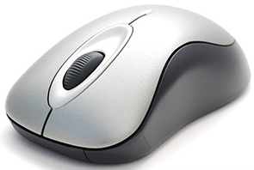
1) Mouse
A Computer Mouse is a handheld hardware input device that controls a cursor in a GUI (Graphical User Interface) and can move and select text, icons, files and folders on your computer.

Slide 13
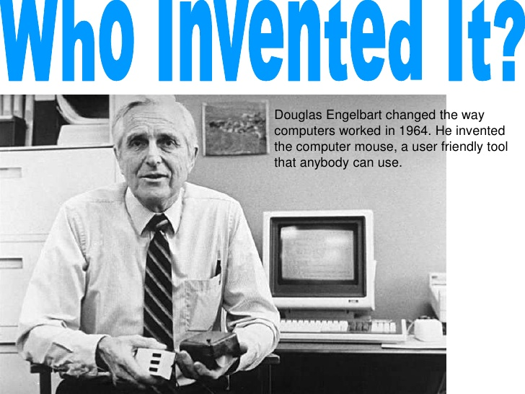
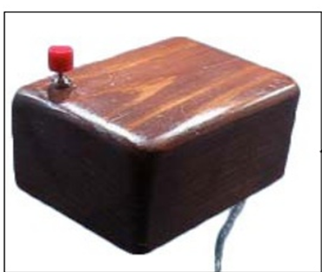

Slide 14
How has the Mouse Increased Computer Usability?
By using a computer mouse, you don't have to memorize commands, such as those utilized in a text-based command line environment like MS-DOS
MS-DOS you would need to know the cd command and dir command and type the commands on the keyboard to open a directory (folder) and view its files
Whereas a Windows user only has to double-click to open a folder and see its contents.

Slide 17
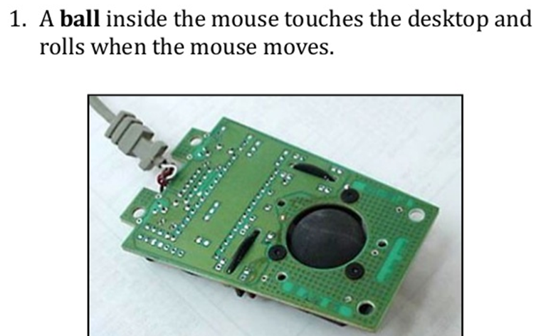
Working of Mechanical Mouse

Slide 21
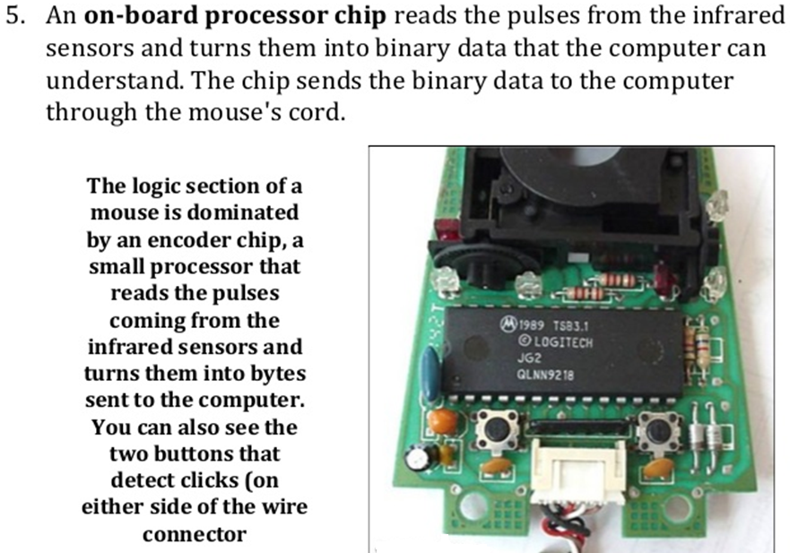

Slide 22
Optical Mechanical Mouse
The optical-mechanical or opt mechanical mouse consists of a ball that rolls one of two wheels inside the mouse
Each wheel contains a circle of holes , allowing an LED light to shine through and be detected by a sensor
As the wheel spins these lights represent an X or Y axis for the mouse pointer on your screen
This mouse is more accurate than a mechanical mouse that uses only wheels and rollers.

Slide 23
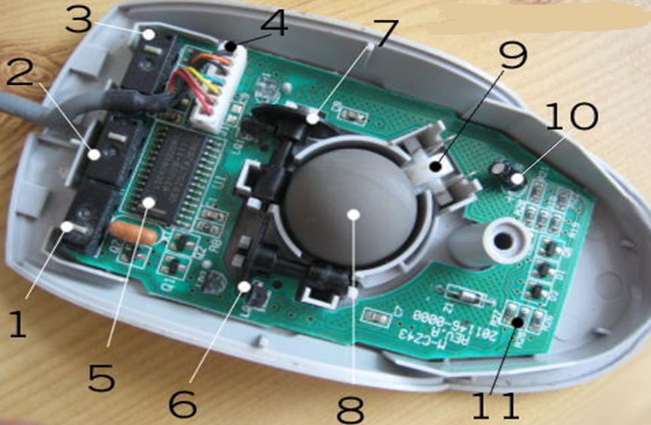
Inside a Ball Style Computer Mouse

Slide 24
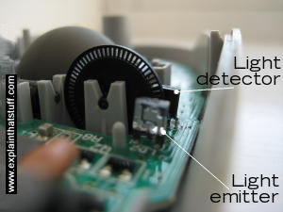
1 Switch detects clicks of left mouse button.
2 Switch for middle button.
3 Switch for right button.
4 Old-style connection to PS/2 socket on computer.
5 Chip turns back-and-forth (analog) mouse movements into numeric (digital) signals computer can understand.
6 X-axis wheel turns when you move mouse left and right.
7 Y-axis wheel turns when you move mouse up and down.
8 Heavy rubber wheel.
9 Spring presses rubber ball firmly against X- and Y-axis wheels so they register movements properly.
Electrolytic capacitor
Resistors

Slide 26
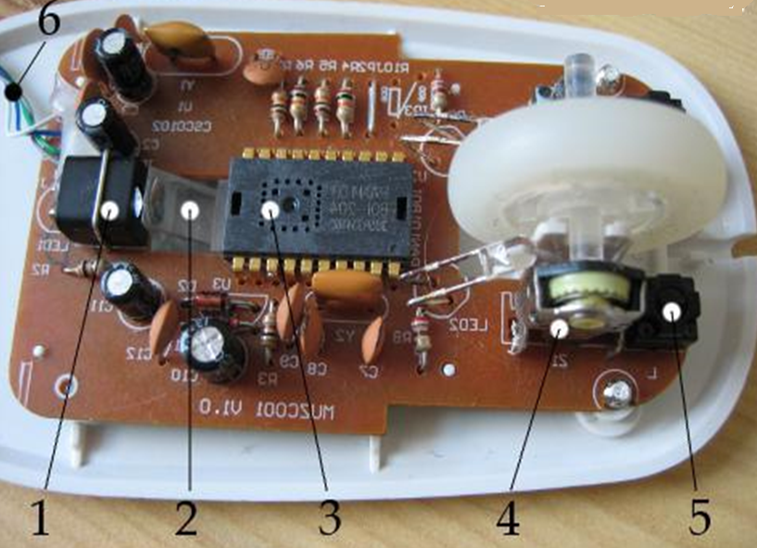

Slide 28
How optical mouse work
An optical mouse also has a tiny low-resolution camera that takes a thousand or more pictures every second. In the camera, the complementary metal-oxide semiconductor (CMOS) sensor sends a signal to a Digital Signal Processor (DSP). The DSP can analyze each picture for pattern and light changes and then based off those changes moves the mouse cursor on your screen.

Slide 34
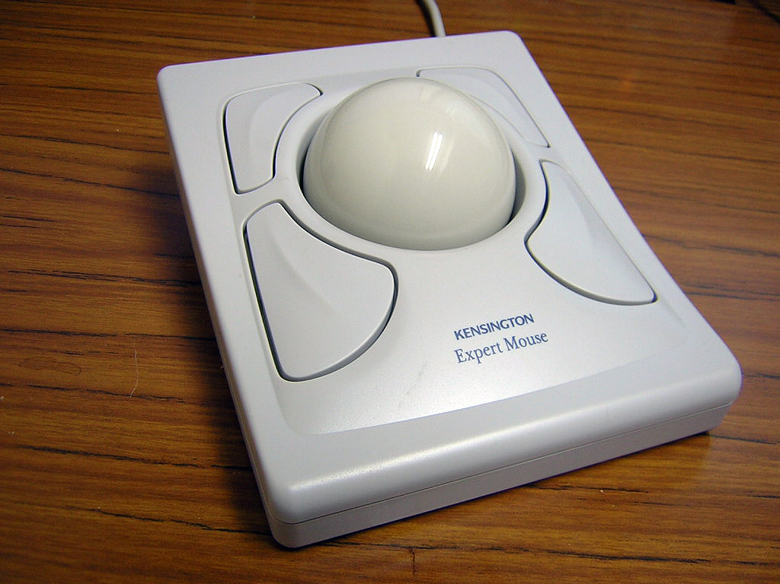
2) Trackball
A trackball is a computer cursor control device used in many notebook and laptop computers. The trackball is usually located in front of the keyboard toward the user. Essentially, the trackball is an upside-down moues that rotates in place within a socket. The user rolls the ball to direct the cursor to the desired place on the screen and can click one of two buttons (identical to mouse buttons) near the trackball to select desktop objects or position the cursor for text entry.

Slide 35
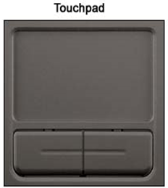
3) Touchpad/ Track Pads
A touchpad is small, flat surface over which user move his finger. The movement of the finger moves the cursor on the screen. Touchpad also have buttons like mouse buttons These are commonly used with notebook computers (Laptops)

Slide 36
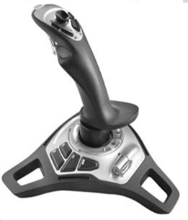
4) Joy Stick
Pointing Device
Play Games
Control Stick in the Airplanes to control the movements
It consists of a handle which can be used to move the cursor position left, right, up and down
Can be attached Television set
USB or Serial port for connection
Faster the Keyboard

Slide 37
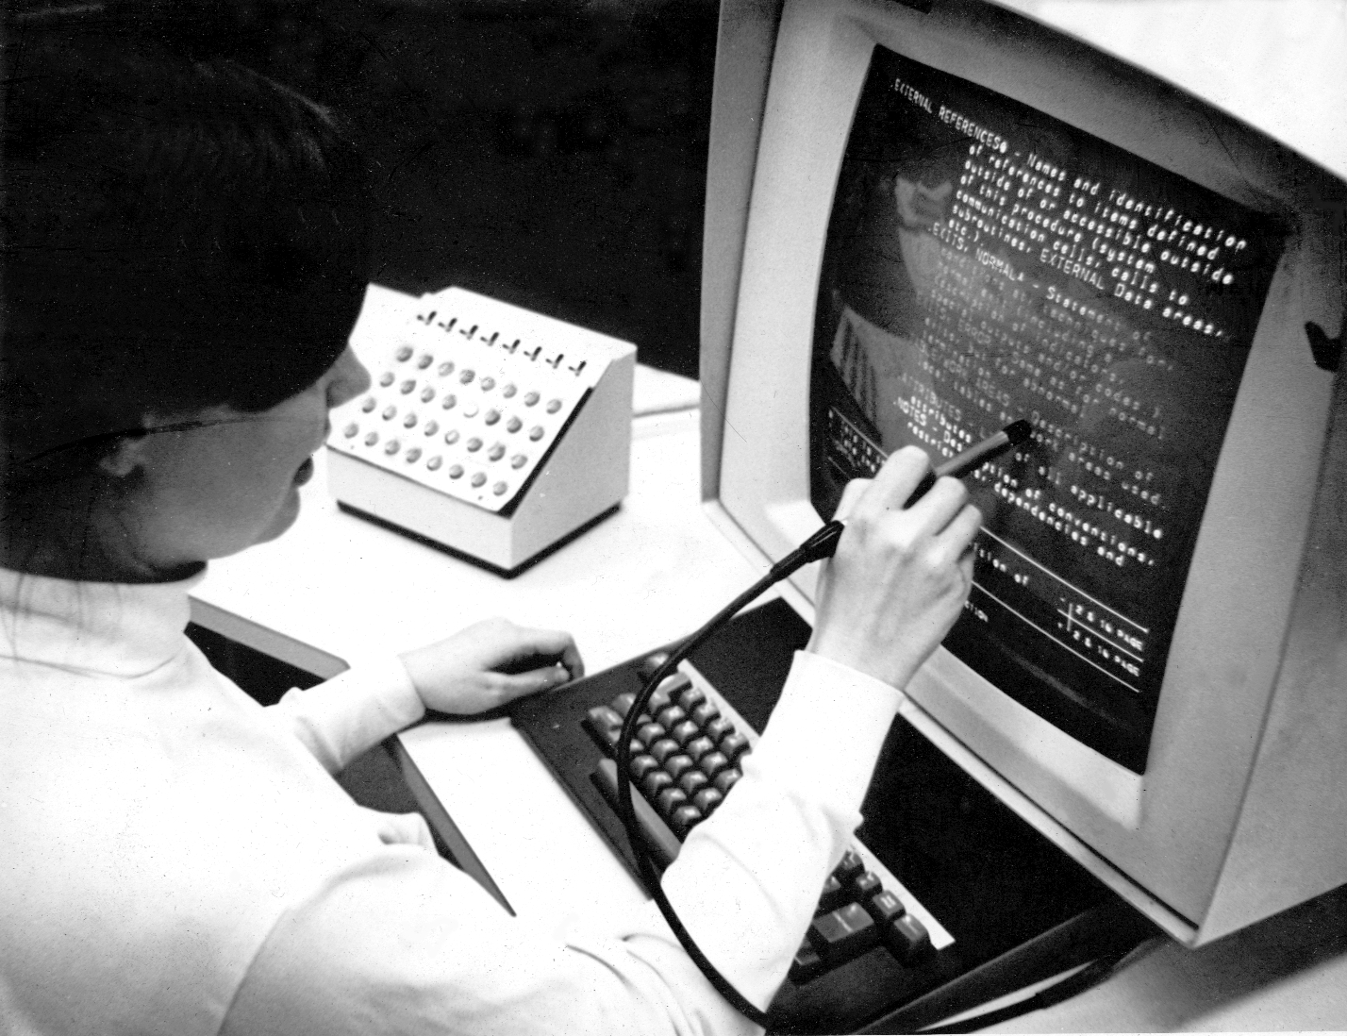
5) Light Pen
Light pens were originally developed around 1955 and in the 1960s, they became more commonly used with graphics terminals, like the IBM 2250.
In the 1980s, light pen usage expanded to home computers, like the BBC Micro computer.
Some graphics cards also included a connection for a light pen.
Today, light pens are no longer used due to the invention of touch

Slide 38
6) Touch Screen
A touch screen is a computer display screen that serves as an input device.
When a touch screen is touched by a finger or stylus, it registers the event and sends it to a controller for processing.
A touch screen may contain pictures or words that the user can touch to interact with the device.

Slide 39
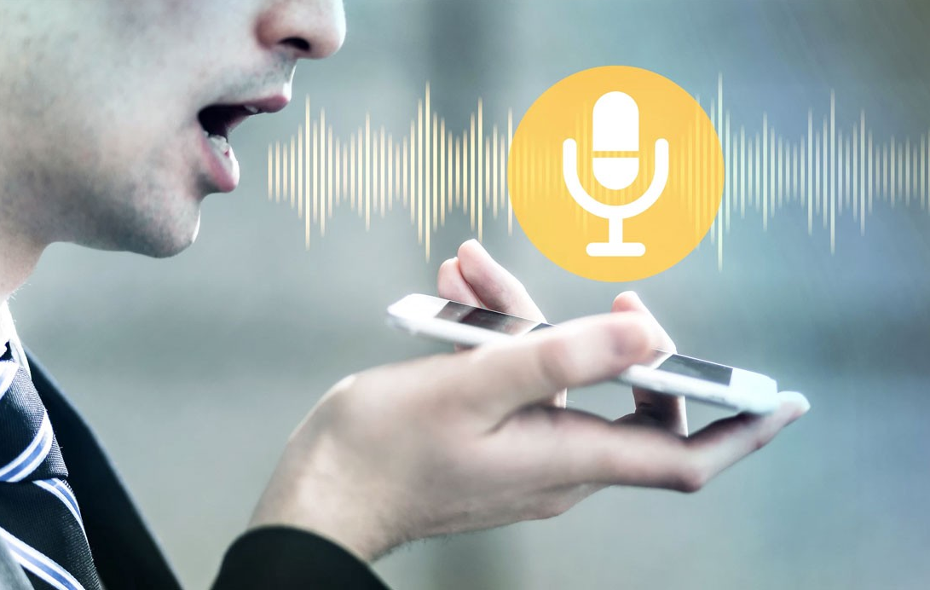
Speech Recognition Device
Allows a person to input data to the computer through speaking or voice
Convert the human voice into text
Disable person
First recognize words with the help of software or device convert into text

