Slide 1
Electromagnetic Field Theory Lecture 5
Ms. Asma Mushtaq
Email: asmamushtaq@gcu.edu.pk

Slide 2
Electric Field Intensity
Coulomb’s law states that a charge will always exert a force on another charge, even when the charges are separated by a large distance. A force acting on one charge due to another is usually referred to as an action at a distance.
As long as the charges are at rest, the action at a distant point of view satisfies all necessary requirements. However, if one charge is moved toward the other, the force experienced by the charges must change instantaneously, in accordance with Coulomb’s law.

Slide 3
Electric Field Intensity
Sometimes it becomes quite useful to define the force acting on charge in the presence of another charge in terms of field.
We say that there exists an electric field or electric filed intensity everywhere in space surrounding the charge. When another charge is brought into this electric field, it experiences a force acting on it.
Such an interaction is considered as an action by contact.

Slide 4
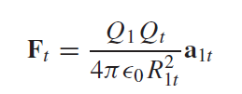
Electric Field Intensity
If we now consider one charge fixed in position, say Q1, and move a second charge slowly around, we note that there exists everywhere a force on this second charge; in other words, this second charge is displaying the existence of a force field that is associated with charge, Q1. Call this second charge a test charge Qt . The force on it is given by Coulomb’s law,
Writing this force as a force per unit charge gives the electric field intensity, E1 arising from Q1:

Slide 5
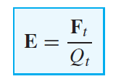
Electric Field Intensity
E1 is interpreted as the vector force, arising from charge Q1, that acts on a unit positive test charge. More generally, we write the defining expression:
in which E, a vector function, is the electric field intensity evaluated at the test charge location that arises from all other charges in the vicinity—meaning the electric field arising from the test charge itself is not included in E.
The units of E would be in force per unit charge (Newtons per coulomb). We measure electric field intensity in the practical units of volts per meter (V/m).

Slide 6
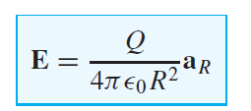
Electric Field Intensity
The electric field of a single point charge becomes:
We remember that R is the magnitude of the vector R, the directed line segment from the point at which the point charge Q is located to the point at which E is desired, and a_{R} is a unit vector in the R direction.

Slide 7
Electrical Field Intensity of a Point Charge
If we arbitrarily locate Q1 at the center of a spherical coordinate system. The unit vector a_{R} then becomes the radial unit vector ar , and R is r . Hence
The field has a single radial component, and its inverse-square-law relationship is quite obvious.

Slide 8
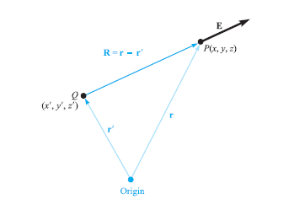
Electric Field Intensity of a point charge (in rectangular coordinate)
For a charge Q located at the source point r = xa_{x} + ya_{y} + za_{z}, as illustrated in figure below, we find the field at a general field point r = xa_{x}+ ya_{y} +za_{z} by expressing R as r − r’ and then

Slide 9
Electric Field Intensity because of Multiple Charges
The electric field intensity arising from two point charges, Q₁ at r₁ and Q₂ at _{r2}, is the sum of the forces on Q_{t} caused by Q₁ and Q₂ acting alone, or
where a₁ and a₂ are unit vectors in the direction of (r−r₁) and (r−r₂), respectively.

Slide 10
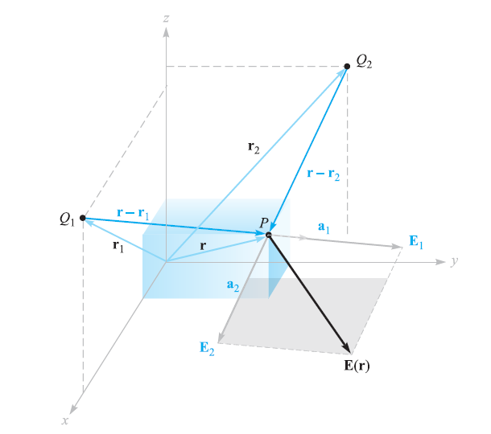
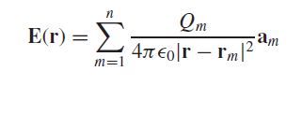
Graphical Depiction

Slide 11
Electric Field Intensity of a Point Charge
https://www.youtube.com/watch?v=lJqqA_ZzF8c

Slide 12
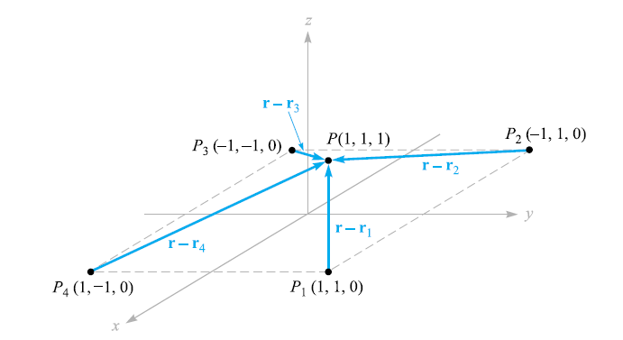
Example
Find E at P(1, 1, 1) caused by four identical 3-nC (nanocoulomb) charges located at P1(1, 1, 0), P2(−1, 1, 0), P3(−1,−1, 0), and P4(1,−1, 0).

Slide 13
Solution

Slide 14
Electric Filed Intensity Because of n Point Charges
Hence the electric field intensity because of n point charges is given as:
Where r_{i} is the distance vector directed from the location of the charge q_{i} toward the point of measurement of E.

Slide 15
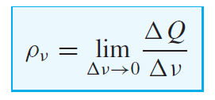
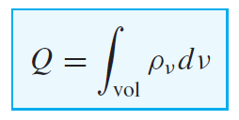
Field Arising from the Continuous Volume Charge Distribution
The small amount of charge $∆$Q in a small volume $∆$ν is
Q = ρ_{ν} $∆$ν
and we may define ρ_{ν} mathematically by using a limiting process on the above equation
The total charge within some finite volume is obtained by integrating throughout that volume,

Slide 16
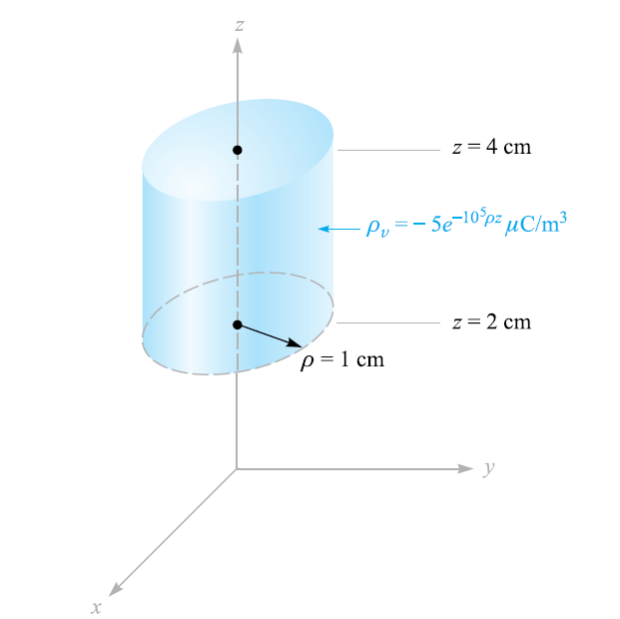
Find the total charge contained in a 2-cm length of the electron beam shown in figure.

Slide 17
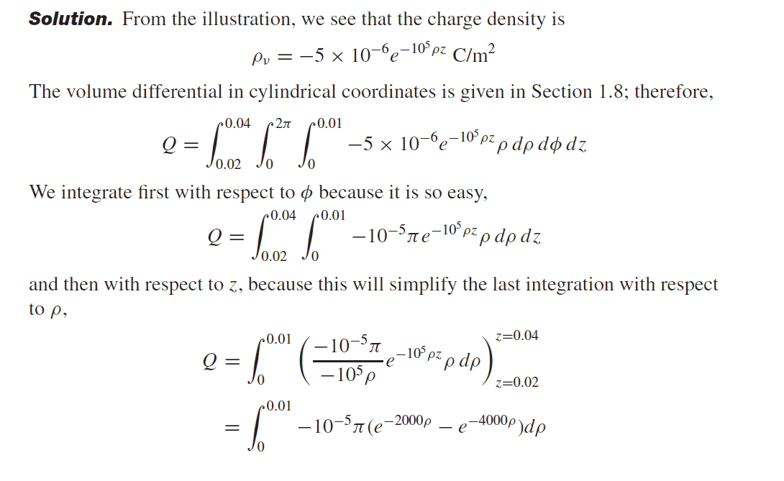
Solution

Slide 18
The incremental contribution to the electric field intensity at r produced by an incremental charge Q at r’ is
If we sum the contributions of all the volume charge in a given region and let the volume element ν approach zero as the number of these elements becomes infinite, the summation becomes an integral,

Slide 19
Drill Problem

Slide 20
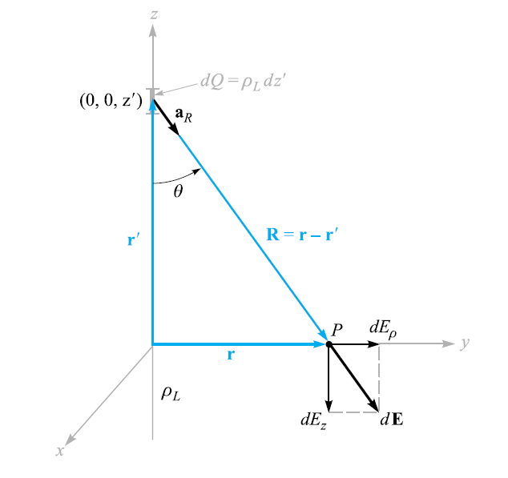
FIELD OF A LINE CHARGE
If we consider a filamentlike distribution of volume charge density, such as a charged conductor of very small radius, we find it convenient to treat the charge as a line charge of density ρ_{L} C/m.
Assume a straight-line charge extending along the z axis in a cylindrical coordinate system from −∞ to ∞, as shown in Figure

Slide 21
FIELD OF A LINE CHARGE
Symmetry should always be considered first in order to determine two specific factors: (1) with which coordinates the field does not vary, and (2) which components of the field are not present.
If we move around the line charge, varying φ while keeping ρ and z constant, the line charge appears the same from every angle. In other words, azimuthal symmetry is present, and no field component may vary with φ.

Slide 22
FIELD OF A LINE CHARGE
Again, if we maintain ρ and φ constant while moving up and down the line charge by changing z, the line charge still recedes into infinite distance in both directions and the problem is unchanged. This is axial symmetry and leads to fields that are not functions of z.
If we maintain φ and z constant and vary ρ, the problem changes, and Coulomb’s law leads us to expect the field to become weaker as ρ increases. Hence, by a process of elimination we are led to the fact that the field varies only with ρ.

Slide 23
Which Components of Field are Present?
Each incremental length of line charge acts as a point charge and produces an incremental contribution to the electric field intensity which is directed away from the bit of charge (assuming a positive line charge). No element of charge produces a φ component of electric intensity; E_{φ} is zero. However, each element does produce an E_{ρ} and an E_{z} component, but the contribution to Ez by elements of charge that are equal distances above and below the point at which we are determining the field will cancel.
We therefore have found that we have only an Eρ component and it varies only with ρ. Now to find this component.

Slide 24
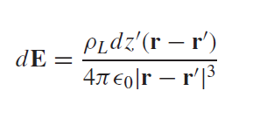
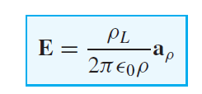
Electric Field of a Line Charge
We choose a point P(0, y, 0) on the y axis at which to determine the field. This is a perfectly general point in view of the lack of variation of the field with φ and z.

Slide 25
Problem
A semi-infinite line extending from -$∞ to 0$along the z-axis carries a uniform charge distribution of 100nC/m. Find the electric field intensity at the point P(0,0,z). If a charge of Q µC is placed at P, calculate the force acting on it.

