Slide 1
Electromagnetic Field Theory
Ms. Asma Mushtaq

Slide 2
Orthogonal Coordinate System
Orthogonal Coordinate Systems are:
Rectangular
cylindrical
Spherical

Slide 3
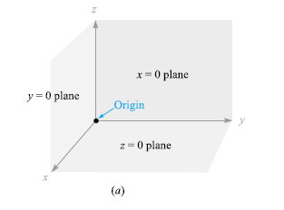
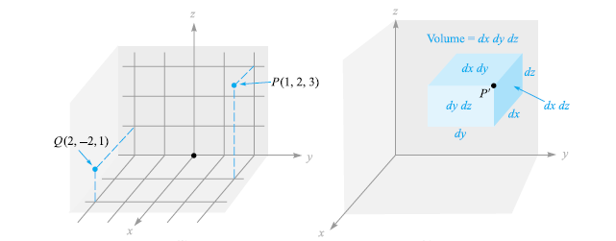
Rectangular Coordinate System
A point is located by giving its x, y, and z coordinates. These are, respectively, the distances from the origin to the intersection of perpendicular lines dropped from the point to the x, y, and z axes.

Slide 4
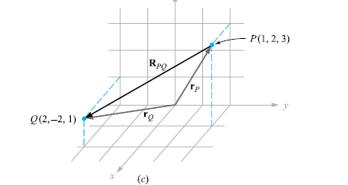
Rectangular Coordinate System

Slide 5
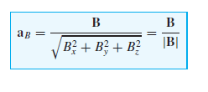
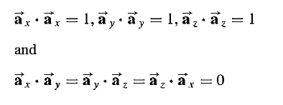
Rectangular Coordinate System

Slide 6
Cylindrical Coordinate System
The circular cylindrical coordinate system is the three-dimensional version of the polar coordinates of analytic geometry. In polar coordinates, a point is located in a plane by giving both its distance ρ from the origin and the angle φ between the line from the point to the origin and an arbitrary radial line taken as φ = 0.

Slide 7
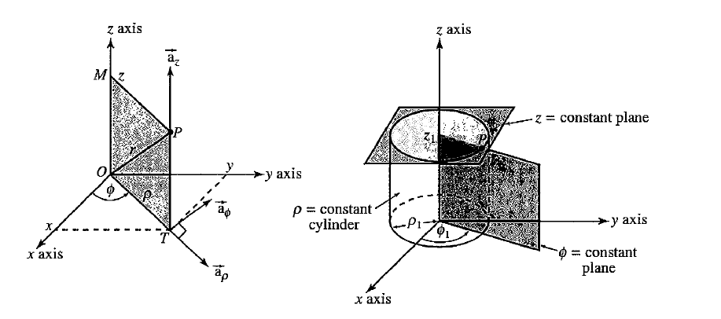
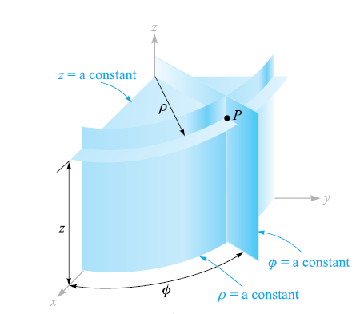
Cylindrical Coordinate System
We represent any point as the intersection of three mutually perpendicular surfaces. These surfaces are a circular cylinder (ρ = constant), a plane (φ = constant), and another plane (z = constant).

Slide 8
Unit Vectors in Cylindrical Coordinate System
Three unit vectors must also be defined, but we may no longer direct them along the “coordinate axes,” for such axes exist only in rectangular coordinates. We may now define three unit vectors in cylindrical coordinates, aρ, aφ, and az . The unit vector aρ at a point P(ρ1, φ1, z1) is directed radially outward, normal to the cylindrical surface ρ = ρ1. It lies in the planes φ = φ1 and z = z1. The unit vector aφ is normal to the plane φ = φ1, points in the direction of increasing φ, lies in the plane z = z1, and is tangent to the cylindrical surface ρ = ρ1. The unit vector az is the same as the unit vector az of the rectangular coordinate system.

Slide 9
Unit Vectors in Cylindrical Coordinate System
In rectangular coordinates, the unit vectors are not functions of the coordinates. Two of the unit vectors in cylindrical coordinates, aρ and aφ, however, do vary with the coordinate φ, as their directions change. In integration or differentiation with respect to φ, then, aρ and aφ must not be treated as constants.

Slide 10
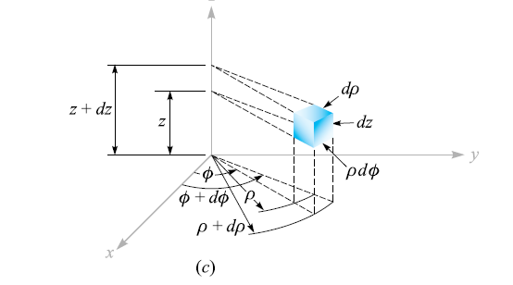
Differential Volume Element
A differential volume element in cylindrical coordinates may be obtained by increasing ρ, φ, and z by the differential increments dρ, dφ, and dz. The two cylinders of radius ρ and ρ + dρ, the two radial planes at angles φ and φ + dφ, and the two “horizontal” planes at “elevations” z and z + dz now enclose a small volume, as shown in Figure below, having the shape of a truncated wedge.

Slide 11
Differential Volume Elements and Areas of Surfaces
As the volume element becomes very small, its shape approaches that of a rectangular parallelepiped having sides of length dρ, ρdφ, and dz. Note that dρ and dz are dimensionally lengths, but dφ is not; ρdφ is the length. The surfaces have areas of:
ρdρdφ,
dρdz, and
ρdφdz, and
the volume becomes ρ dρ dφ dz.

Slide 12
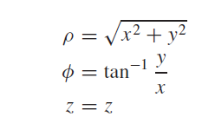
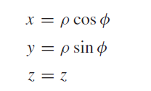
The relationship between the rectangular variables x,y,z and the cylindrical coordinate variables ρ, φ, z.

Slide 14
Example

Slide 15
Question
Write an expression for a position vector at any point in space in rectangular coordinate system. Then transform this position vector into the cylindrical coordinate system.

Slide 16
Practice Question

