Slide 1
Introduction to Embedded Systems
Ms. Asma Mushtaq
Lecture 1
asmamushtaq@gcu.edu.pk

Slide 2
Internal Organization of Computer Systems
The internal working of every computer can be broken down into three main parts:
1. Central Processing Units (CPU): To process the information stored in memory
2. Memory
3. Input/ Output Devices: To provide the means of communication with the external environment.

Slide 3
Internal Organization of Computer Systems

Slide 4
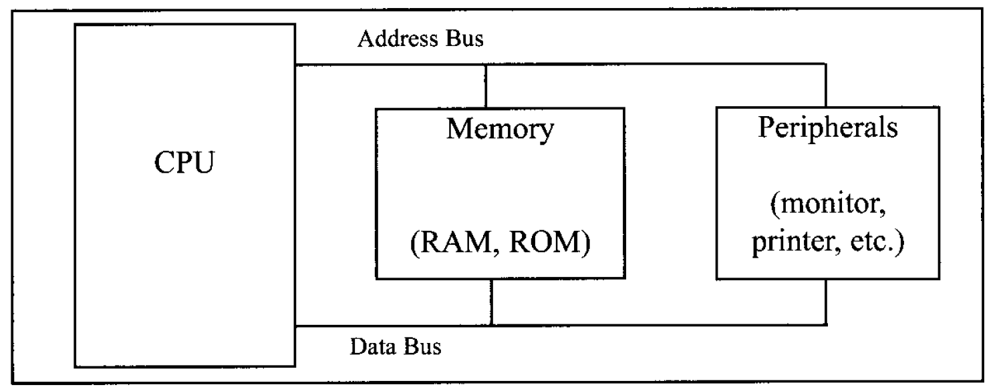
Types of Buses
Address Bus
Data Bus
Control Bus
Address bus and data bus determine the capability of a given CPU.

Slide 5
Types of Buses

Slide 6
Microprocessors Vs Microcontroller

Slide 7
Microprocessors Vs Microcontroller
https://eevibes.com/computing/differentiate-microcontroller-and-microprocessor/
https://eevibes.com/arduino-based-projects/what-is-the-difference-between-microprocessor-and-microcontroller/

Slide 8
What are the Embedded Systems?
An embedded product is controlled by its own microprocessor or microcontroller as opposed to some external controller.
Example
A printer is an example of embedded system because the processor inside it performs only one task.
In an embedded system, typically only one application software is burned into ROM.
An x86 pc PC is connected to several embedded products that perform one specific tasks as they have microcontroller installed on them .

Slide 9
How to Choose a Microcontroller?
There are 5 major 8 bit microcontrollers. These are:
Freescale Semiconductors’s (Formerly Motorola)
Intel’s 8051
Atmel’s AVR
Zilog’s Z8
PIC Microcontroller

Slide 10
How to Choose a Microcontroller?
Meeting the computing needs of task at hand efficiently and cost effectively (Speed, packaging, power consumption, amount of RAM and ROM, cost per unit etc).
Availability of hardware and software tools such as compilers, debuggers, simulation tools.
Wide availability and reliable sources of microcontroller.

Slide 11
PIC Microcontroller Program ROM
ROM is used for storing the program. Although PIC Microcontroller has 2M of program ROM space available, not all the families come up with that much on chip space. Program ROM size can vary from 4k to 128k.
PIC18 program ROM is available in different memory types such as flash, OTP and masked.
PIC Microcontroller with UV-EPROM
PIC18Fxxx with flash
OTP version of PIC
Masked Version of PIC

