Slide 1
Programming Fundamentals
Lecture 2
Asma Mushtaq

Slide 2
Basic Program Construction
Let’s look at a very simple C++ program. This program is called FIRST, so its source file is
FIRST.CPP. It simply prints a sentence on the screen. Here it is:
#include <iostream>
using namespace std;
int main()
{
cout << “Hello World\n”;
return 0;
}

Slide 3
Basic Program Construction
The identifier cout (pronounced “C out”) is actually an object. It is predefined in C++ to correspond to the standard output stream. A stream is an abstraction that refers to a flow of data.
The standard output stream normally flows to the screen display—although it can be redirected to other output devices.
The operator << is called the insertion or put to operator. It directs the contents of the variable on its right to the object on its left.

Slide 4
String Constants
The phrase in quotation marks, “Every age has a language of its own\n”, is an example of a string constant.

Slide 5
Directives
The two lines that begin the FIRST program are directives. The first is a preprocessor directive, and the second is a using directive. They occupy a sort of gray area: They’re not part of the basic C++ language, but they’re necessary anyway.
#include <iostream>
The preprocessor directive #include tells the compiler to insert another file into your source file. In effect, the #include directive is replaced by the contents of the file indicated. Using an #include directive to insert another file into your source file is similar to pasting a block of text into a document with your word processor.

Slide 6
Header Files
IOSTREAM is an example of a header file (sometimes called an include file). It’s concerned with basic input/output operations, and contains declarations that are needed by the cout identifier and the << operator.
Without these declarations, the compiler won’t recognize cout and will think << is being used incorrectly.

Slide 7
The using Directive
A C++ program can be divided into different namespaces. A namespace is a part of the program in which certain names are recognized; outside of the namespace they’re unknown. The directive
using namespace std;
says that all the program statements that follow are within the std namespace. Various program components such as cout are declared within this namespace. If we didn’t use the using directive, we would need to add the std name to many program elements. For example, in the FIRST program we’d need to say
std::cout << “Every age has a language of its own.”;
To avoid adding std:: dozens of times in programs we use the using directive instead

Slide 8
Integer Variables
#include <iostream>
using namespace std;
int main()
{
int var1; //define var1
int var2; //define var2
var1 = 20; //assign value to var1
var2 = var1 + 10; //assign value to var2
cout << “var1+10 is “; //output text
cout << var2 << endl; //output value of var2
return 0;
}

Slide 9
Variable Names
The names given to variables (and other program features) are called identifiers.
What are the rules for writing identifiers?
You can use upper- and lowercase letters, and the digits from 1 to 9. You can also use the underscore (_). The first character must be a letter or underscore. Identifiers can be as long as you like, but most compilers will only recognize the first few hundred characters. The compiler distinguishes between upper- and lowercase letters, so Var is not the same as var or VAR.

Slide 10
Rules for Variable Names
You can’t use a C++ keyword as a variable name.
A variable’s name should make clear to anyone reading the listing the variable’s purpose and how it is used. Thus boilerTemperature is better than something cryptic like bT or t.

Slide 11
Assignment Statements
var1 = 20;
var2 = var1 + 10;
These statements assign values to the two variables. The equal sign (=), as you might guess, causes the value on the right to be assigned to the variable on the left.

Slide 12
The endl Manipulator
This causes a linefeed to be inserted into the stream, so that subsequent text is displayed on the next line. It has the same effect as sending the ‘\n’ character, but is somewhat clearer. It’s an example of a manipulator. Manipulators are instructions to the output stream that modify the output in various ways.

Slide 13
Character Constants
#include <iostream> //for cout, etc.
using namespace std;
int main()
{
char charvar1 = ‘A’; //define char variable as character
char charvar2 = ‘\t’; //define char variable as tab
cout << charvar1; //display character
cout << charvar2; //display character
charvar1 = ‘B’; //set char variable to char constant
cout << charvar1; //display character
cout << ‘\n’; //display newline character
return 0;
}

Slide 14
Escape Sequences
Escape sequences can be used as separate characters or embedded in string constants.
character constant, ‘\t’, is an odd one. Like ‘\n’, which we encountered earlier, it’s an example of an escape sequence. The name reflects the fact that the backslash causes an “escape” from the normal way characters are interpreted. In this case the t is interpreted not as the character ‘t’ but as the tab character. A tab causes printing to continue at the next tab stop. Another character constant, ‘\n’, is sent directly to cout in the last line of the program.

Slide 15
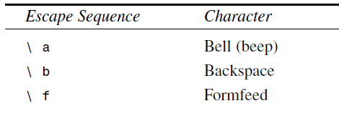
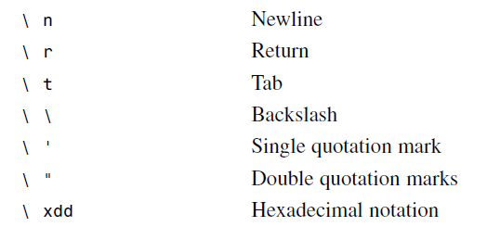
Escape Sequences

Slide 16
\xdd
Sometimes you need to represent a character constant that doesn’t appear on the keyboard, such as the graphics characters above ASCII code 127. To do this, you can use the ‘\xdd’ representation, where each d stands for a hexadecimal digit. If you want to print a solid rectangle,for example, you’ll find such a character listed as decimal number 178, which is hexadecimal number B2 in the ASCII table. This character would be represented by the character constant ‘\xB2’.

Slide 17
Input with cin
#include <iostream>
using namespace std;
int main()
{
int ftemp; //for temperature in fahrenheit
cout << “Enter temperature in fahrenheit: “;
cin >> ftemp;
int ctemp = (ftemp-32) * 5 / 9;
cout << “Equivalent in Celsius is: “ << ctemp << ‘\n’;
return 0;
}
The >> is the extraction or get from operator. It takes the value from the stream object on its left and places it in the variable on its right.

Slide 18
Type bool
Variables of type bool can have only two possible values: true and false. In theory a bool type requires only one bit (not byte) of storage, but in practice compilers often store them as bytes because a byte can be quickly accessed, while an individual bit must be extracted from a byte, which requires additional time.
type bool is most commonly used to hold the results of comparisons. Is alpha less than beta? If so, a bool value is given the value true; if not, it’s given the value false.

Slide 19
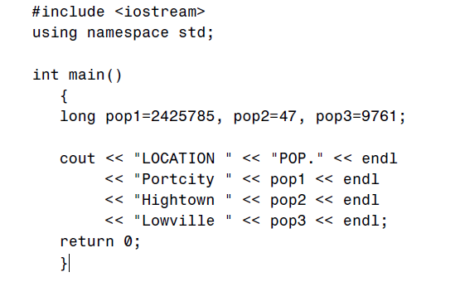
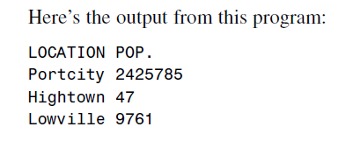
The setw Manipulator
setw changes the field width of output. The WIDTH1 program below prints the names of three cities in one column, and their populations in another.

Slide 20
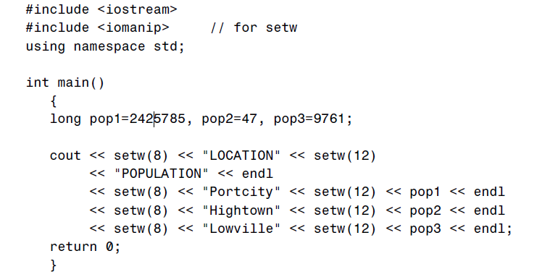
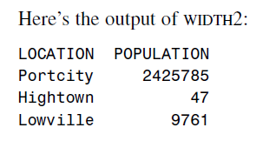
The setw Manipulator
Here’s a variation of this program, WIDTH2, that uses the setw manipulator to eliminate these problems by specifying field widths for the names and the numbers:

Slide 21
Observation
Cascading the Insertion Operator
Multiple Definitions
The IOMANIP Header File

