Slide 1
Electromagnetic Field Theory
Ms. Asma Mushtaq
Lecture 3

Slide 2
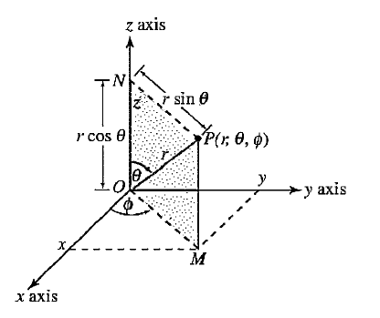
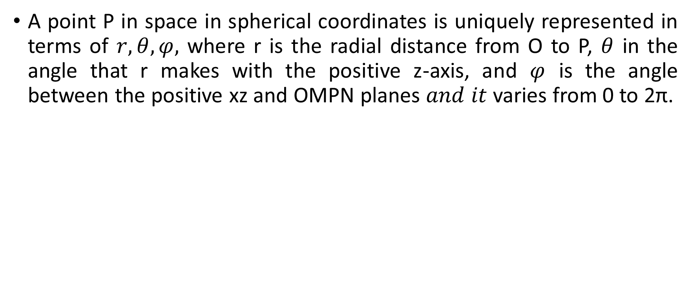
THE SPHERICAL COORDINATE SYSTEM
A point P in space in spherical coordinates is uniquely represented in terms of $r,θ,φ,$ where r is the radial distance from O to P, $θ$ in the angle that r makes with the positive z-axis, and $φ$ is the angle between the positive xz and OMPN planes $and it$ varies from 0 to 2π.

Slide 3
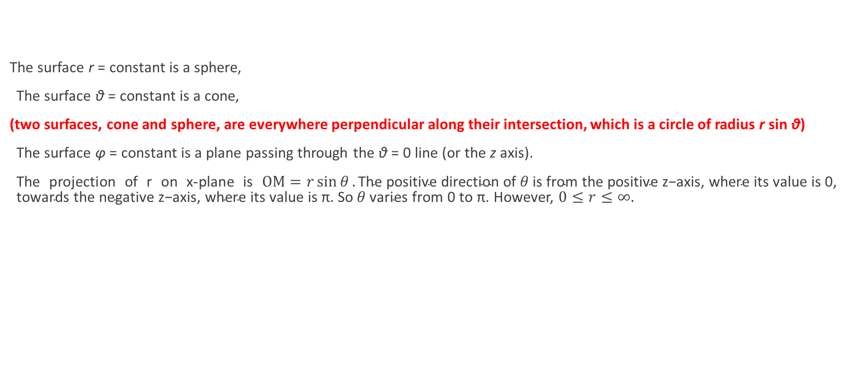
THE SPHERICAL COORDINATE SYSTEM
The surface r = constant is a sphere,
The surface θ = constant is a cone,
(two surfaces, cone and sphere, are everywhere perpendicular along their intersection, which is a circle of radius r sin θ)
The surface φ = constant is a plane passing through the θ = 0 line (or the z axis).
The projection of r on x-plane is $OM=r\sin{θ}.\text{The} \text{positive} \text{direction} \text{of} θ \text{is} \text{from} \text{the} \text{positive} \text{z}\text{−}\text{axis}\text{, }\text{where} \text{its} \text{value} \text{is}\text{ 0, }\text{towards} \text{the} \text{negative} \text{z}\text{−}\text{axis}\text{, }\text{where} \text{its} \text{value} \text{is} \text{π}\text{. }\text{So} θ \text{varies} \text{from}\text{ 0 }\text{to} \text{π}\text{.}$However, $0≤r≤∞.$

Slide 4
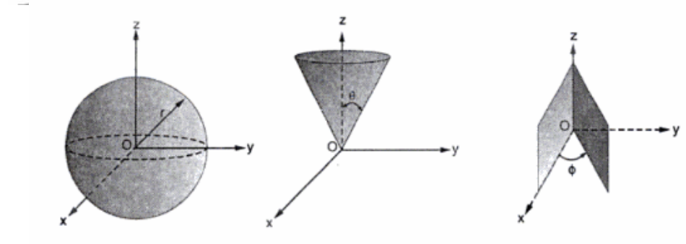
THE SPHERICAL COORDINATE SYSTEM

Slide 5
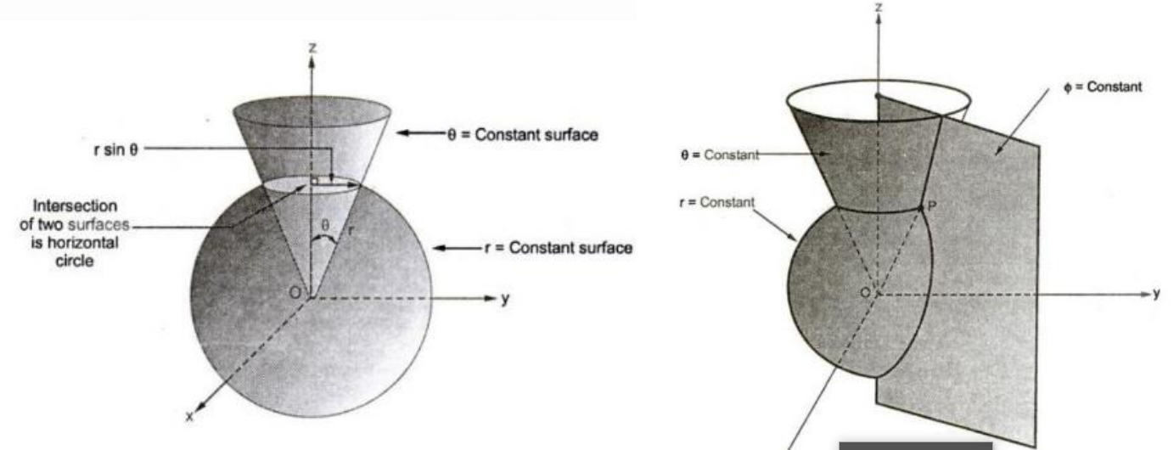
THE SPHERICAL COORDINATE SYSTEM

Slide 6
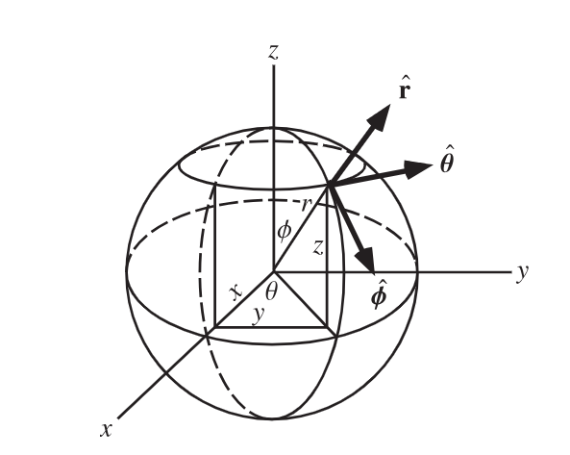
THE SPHERICAL COORDINATE SYSTEM
We consider any point as the intersection of three mutually perpendicular surfaces—a sphere, a cone, and a plane—each oriented in the manner just described.

Slide 7
Unit Vectors in Spherical Coordinate System
The unit vector ar is directed radially outward, normal to the sphere r = constant, and lies in the cone θ = constant and the plane φ = constant.
The unit vector aθ is normal to the conical surface, lies in the plane, and is tangent to the sphere.
The third unit vector aφ is the same as in cylindrical coordinates, being normal to the plane and tangent to both the cone and the sphere.

Slide 8
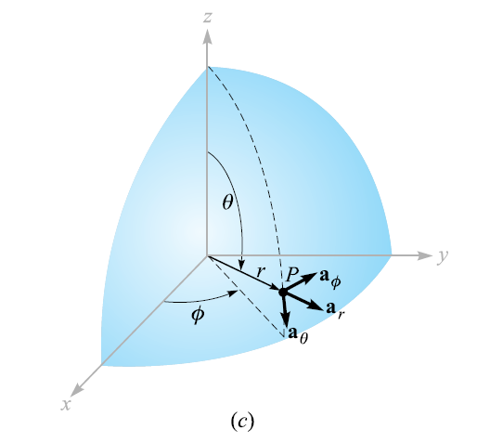
Unit Vectors in Spherical Coordinate System

Slide 9
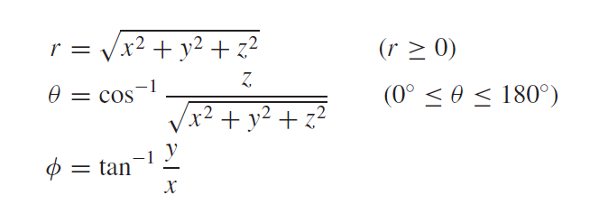
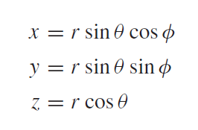
THE SPHERICAL COORDINATE SYSTEM

Slide 10
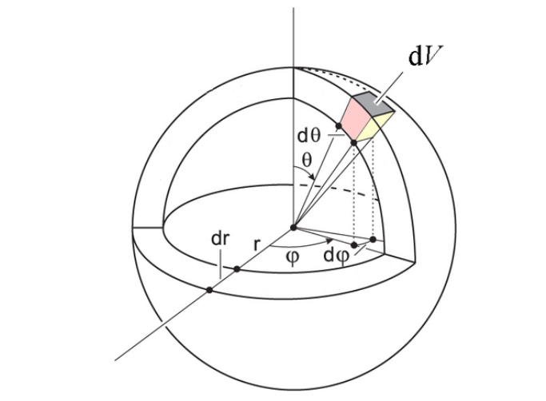
Differential Element in Spherical Coordinate System
A differential volume element may be constructed in spherical coordinates by increasing r , θ, and φ by dr, dθ, and dφ, as shown in figure below:

Slide 11
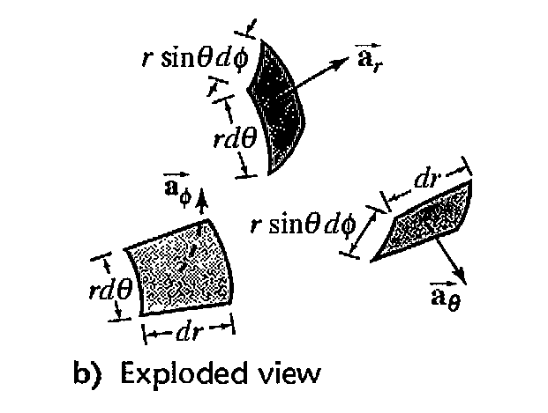
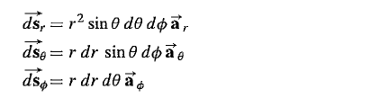
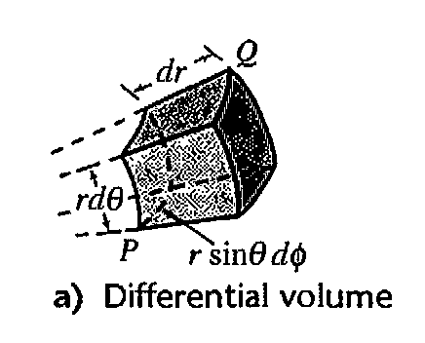

Area of Differential Surfaces
The surfaces have areas of :

Slide 12
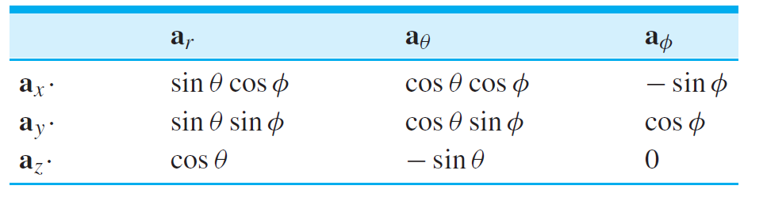
Dot Product of unit Vectors in Spherical and Rectangular Coordinates

Slide 13
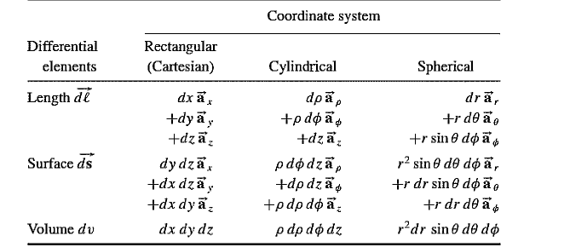
Summary of Coordinate Systems

