Slide 1
Chapter 3 Reversible non-flow Processes
Asma Mushtaq
asmamushtaq@gcu.edu.pk

Slide 2
Constant Volume Process
A reversible non-flow process with constant volume (also called an isochoric process) is one in which the volume of a closed system remains unchanged throughout the process, while the process is carried out in such a way that it could be theoretically reversed without entropy generation. Here are the key characteristics of this specific type of process:

Slide 3
Key Characteristics
Constant Volume: Since the volume remains fixed, there is no expansion or compression work (W=0W = 0W=0) done on or by the system.
Closed System: No mass enters or exits the system, meaning it's a non-flow process. Energy transfer, however, can occur in the form of heat.
For a constant volume process in a closed system:
Q+W=u₂-u₁
ΔU= Q
u₂-u₁=Q
For unit mass
U₂-U₁=Q
Also,
Q=mc_{v}(T₂-T₁)

Slide 4
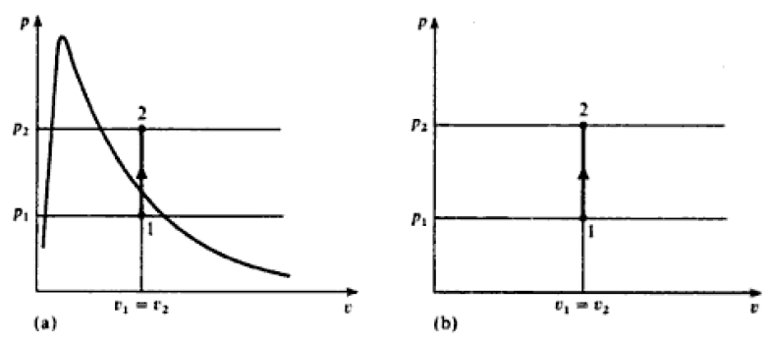
Example
An example of a reversible constant volume process is the heating of an ideal gas in a rigid, sealed container. If the heat is added very slowly, allowing the system to stay in thermal equilibrium, the process can be considered reversible.

Slide 5
Constant Pressure Process
A reversible non-flow process with constant pressure (also known as an isobaric process) is a process in which the pressure of a closed system remains constant while the process occurs in such a way that it could be theoretically reversed. Here are the main aspects of a reversible constant pressure process.
Example:
Fluid in a cylinder behind a piston can be made to undergo a constant pressure process. Since the piston is pushed through a certain distance by the force exerted by the fluid, the work is done by the fluid on its surroundings.

Slide 6
Constant Pressure Process

Slide 7
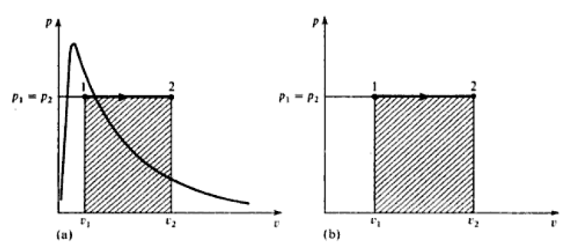
Example of a Reversible Constant Pressure Process
An example of a reversible constant pressure process is the heating of an ideal gas in a piston-cylinder arrangement where the piston is free to move, allowing the gas to expand to maintain constant pressure. If heat is added very slowly to the gas, the system remains close to equilibrium, making the process reversible.

Slide 8
Constant Temperature Process (Isothermal)
A process at constant temperature is called an isothermal process.
Example
When a fluid in a cylinder behind a piston expands from a high pressure to a low pressure there is a tendency for the temperature to fall. In an isothermal expansion heat must be added continuously in order to keep the temperature at the initial value. Similarly in an isothermal compression heat must be removed from the fluid continuously during the process.

Slide 9
Isothermal Process
From state 1 to state A the pressure remains at P1, since in the wet region the pressure and temperature are the corresponding saturation values. Heat supplied from state 1 to state A per kilogram of steam = h_{A}-h₁. In the superheat region the pressure falls to p₂ as shown, and the procedure is not so simple. When states 1 and 2 are fixed then the internal energies u₁ and u₂ may be obtained from tables. When the heat flow is calculated the work done can then be obtained using the non-flow energy equation, for unit mass
Q+W=u₂-u₁

Slide 10
Isothermal Process

Slide 11
Isothermal Process for a Perfect Gas
An isothermal process for a perfect gas is more easily dealt with than an isothermal process for a vapour, since there are definite laws for a perfect gas relating p,v, and T, and the internal energy u.
pv=RT
When temperature is constant
pv=RT=constant
pv=constant
So
p₁v₁=p₂v₂

Slide 12
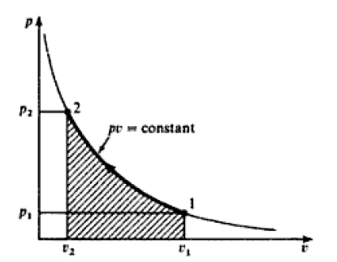
Isothermal Compression
Isothermal compression for a perfect gas is shown in the figure below

Slide 13
Isothermal Compression

Slide 14
Isothermal Compression

Slide 15
Isothermal Compression

Slide 16
Isothermal Compression
For a perfect gas from Joule’s Law
For an isothermal Process, T₂=T_{1. So,}
U₂-U₁=0
This implies that the internal energy remains constant for an isothermal process for a perfect gas.

Slide 17
Isothermal Compression
From non-flow energy equation of unit mass,
Q+W=u₂-u₁
Q+W=0
Note that the heat flow plus the work input is zero in an isothermal process for a perfect gas only. This is not true in case of steam.

Slide 18
Reversible Adiabatic non-flow Processes
A reversible adiabatic non-flow process (also called an isentropic process) is a thermodynamic process that occurs in a closed system without any heat exchange between the system and its surroundings, while being carried out in such a way that it could theoretically be reversed. Since it’s adiabatic and reversible, the process results in no entropy change.
From the non-flow equation
Q+W=u₂-u₁
for an adiabatic process since Q=0
So,
W=u₂-u₁

Slide 19
Reversible Adiabatic non-flow Processes
W=u₂-u₁
This equation is true either the process is reversible or irreversible.
In an adiabatic compression process all the work done on the fluid goes to increasing the internal energy of the fluid. Similarly in an adiabatic expansion process, the work done by the fluid is at the expense of a reduction in the internal energy of the fluid. For an adiabatic process to take place, perfect thermal insulation for the system must be available.

Slide 20
Adiabatic Process for Vapour
For a vapour undergoing a reversible adiabatic process the work done can be found from equation W=u₂-u₁ by evaluating u₁ and u₂ from tables. In order to fix state 2, use must be made of the fact that the process is reversible and adiabatic.

Slide 21
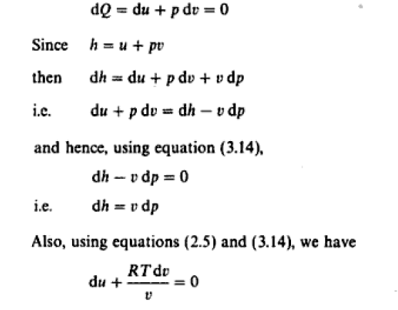
Adiabatic Process for Perfect Gas
For a perfect gas, a law relating p and v may be obtained for a reversible adiabatic process, by considering the non-flow energy equation in differential form. For unit mass:

Slide 22
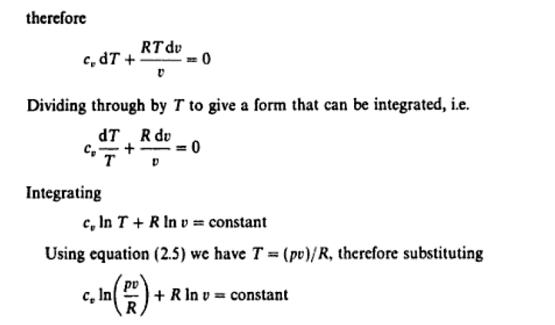
Adiabatic Process for Perfect Gas

Slide 23
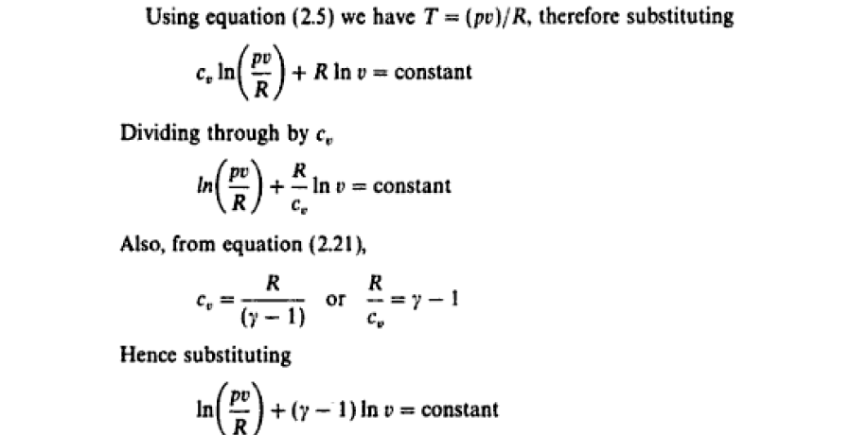
Adiabatic Process for Perfect Gas

Slide 24
Adiabatic Process for Perfect Gas

Slide 25
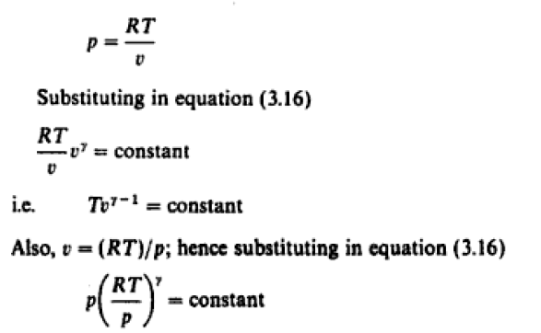
Adiabatic Process for Perfect Gas
Using Ideal gas equation
pv=RT

Slide 26
Adiabatic Process for Perfect Gas

Slide 27
Adiabatic Process for Perfect Gas

Slide 28
Adiabatic Process for Perfect Gas

Slide 29
Adiabatic Process for Perfect Gas

Slide 30
Adiabatic Process for Perfect Gas

