Slide 1
Comprehensive Analysis of T-s Diagrams for Perfect Gases : Detailed Explanation with Solved Example

Slide 2
Introduction to T-s Diagrams
The temperature and entropy variations that occur throughout different thermodynamic processes are graphically represented by the T-s diagram, or temperature-entropy diagram. It is frequently used to examine various thermodynamic processes for ideal gases, such as refrigeration cycles and heat engines.
In this diagram:-
T represents temperature, expressed in Kelvin.
Specific entropy (in J/kg·K or kJ/kg·K) is denoted by s.
The area under a curve in a T-s diagram depicts the heat transfer (Q).

Slide 3
Understanding Perfect Gases
A theoretical gas that obeys the ideal gas law at any temperature and pressure is called a perfect gas, sometimes known as an ideal gas.
PV=nRT
Where, P = Pressure of the gas
V = Volume of the gas
n = Number of moles of gas
R = Universal gas constant (8.314 J/mol·K)
T = Absolute temperature in Kelvin.

Slide 4
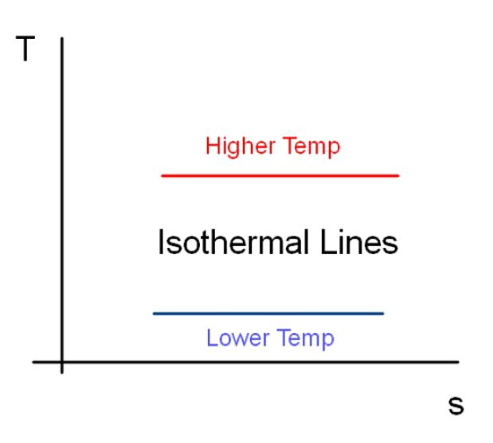
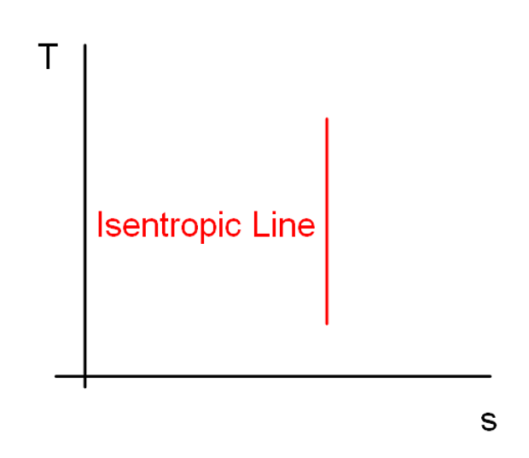
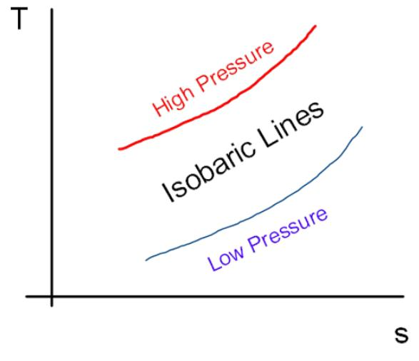
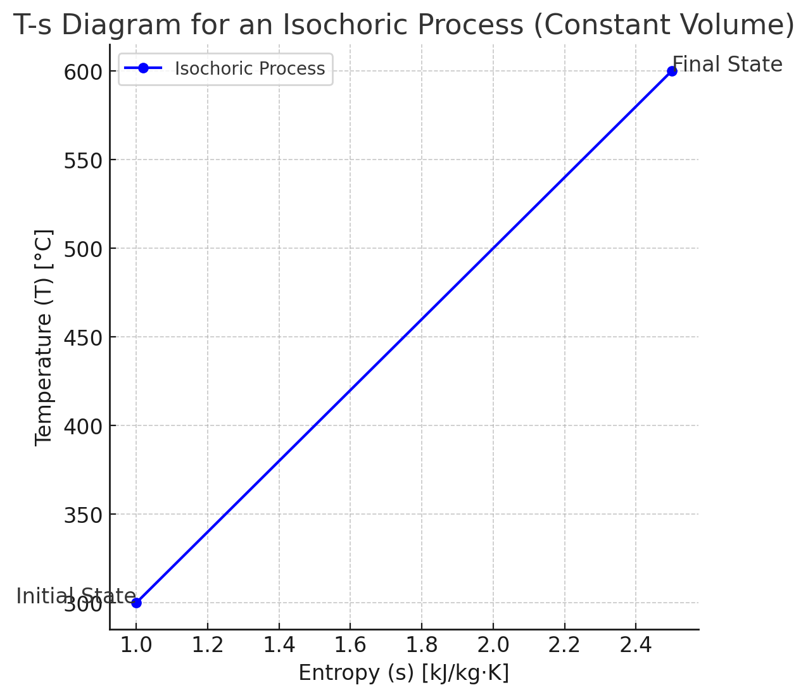
Processes on T-s Diagrams
Isentropic process: Process with no heat transfer (ds = 0). Shown as a vertical line on the T-s diagram.
Isothermal process: Process with constant temperature (dT = 0). Shown as a horizontal line on the T-s diagram.
Isobaric process: Process with constant pressure (dp = 0). Shown as an upward-sloping curve on the T-s diagram.
Isochoric process: Process with constant volume (dv = 0). Shown as a downward-sloping curve on the T-s diagram.

Slide 5
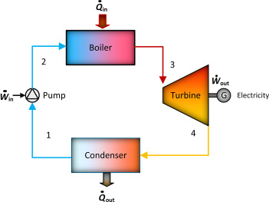
Rankine Cycle
The basic working principle of the majority of power plants, especially steam power plants, is the thermodynamic Rankine cycle. It explains the method—mainly the expansion of steam—by which thermal energy is transformed into mechanical work.
Key Components of the Rankine Cycle:
Boiler
Turbine
Condenser
Pump

Slide 6
Example Problem
Problem: A steam power plant operates on the Rankine cycle with the following conditions: - The steam enters the turbine at 4 MPa and 350°C. - The steam is exhausted from the turbine at 10 kPa. - Assume the condenser pressure is 10 kPa and the pump is ideal (isentropic). Determine the specific enthalpy and entropy at each point of the cycle, and plot the T-s diagram.

Slide 7
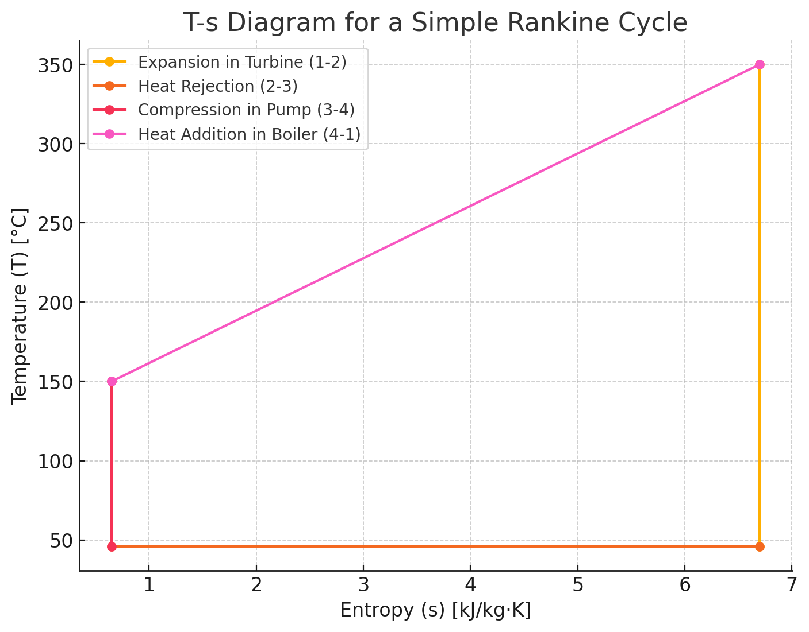
Solution
Step 1: State 1 (Steam at the inlet of the turbine) We are given: Pressure: 𝑃1=4 Mpa Temperature: 𝑇1=350°𝐶 Using steam tables :
Specific enthalpy, h_1 ≈ 3179 kJ/kg Specific entropy, s_1 ≈ 6.7 kJ/kg·K

Slide 8
Step 2: State 2 (Steam at the exit of the turbine)
The steam expands isentropically (constant entropy) in the turbine, so: - s_2 = s_1 = 6.7 kJ/kg·K - Pressure: P_2 = 10 kPa Using steam tables for 10 kPa, we find: - T_sat= 45.8°C - s_f ≈ 0.649 kJ/kg·K (for liquid) - s_g ≈ 8.150 kJ/kg·K (for vapor) Since s_2 is between s_f and s_g, the steam is in the wet region. We calculate the quality x_2 (the fraction of vapor in the mixture) using:
Now, using the quality, we can calculate the specific enthalpy at state 2: h_2 = h_f + x_2 (h_g – h_f) Where: h_f ≈ 191.81 kJ/kg (saturated liquid enthalpy at 10 kPa) h_g ≈ 2392.8 kJ/kg** (saturated vapor enthalpy at 10 kPa) Substituting values: h_2 = 191.81 + 0.78 (2392.8 – 191.81) =1916.5 kJ/kg

Slide 9
Step 3: State 3 (Condensed liquid after the condenser) Pressure: P_3 = 10 kPa As it is saturated liquid at 10 kPa, we use: h_3 = h_f ≈191.81 kJ/kg s_3 = s_f ≈0.649 kJ/kg·K Step 4: State 4 (Water at the exit of the pump) The pump process is isentropic, so s_4 = s_3 . To find the enthalpy at state 4, we use the pump work equation. However, since the work required by the pump is small compared to the turbine, we can approximate the enthalpy: h_4 = h_3 + v (P_4 – P_3) Where: v ≈0.00101 m³/kg (specific volume of liquid at state 3) P_4 = 4 Mpa, P_3 = 10 kPa h_4 = 191.81 + 0.00101 ×(4000 – 10)≈ 195.85 kJ/kg

Slide 10
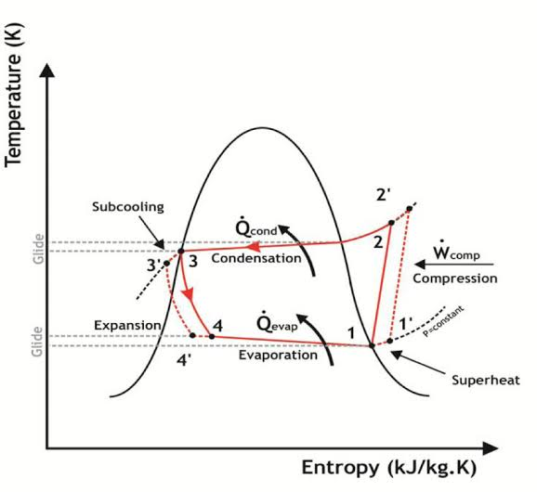
Practical Example: Refrigeration Cycle
A practical example of a T-s diagram can be seen in the vapor compression refrigeration cycle, used in air conditioners and refrigerators. The cycle involves four main processes: 1. Isentropic Compression (1-2): The refrigerant vapor is compressed in the compressor, raising its temperature and pressure without changing entropy (vertical line) 2. Isobaric Heat Rejection (2-3): The high-pressure refrigerant releases heat to the surroundings in the condenser, decreasing entropy as it condenses (curved line to the right). 3. Isenthalpic Expansion (3-4): The refrigerant expands in the expansion valve, dropping in temperature (vertical line down). 4. Isobaric Heat Absorption (4-1): The refrigerant absorbs heat in the evaporator, increasing entropy (curved line to the right).

Slide 11
Conclusion and Future Developments
In conclusion, T-s diagrams are invaluable for analyzing perfect gases in thermodynamics. Future advancements in modeling and simulation techniques will enhance their applicability, making them even more relevant in modern engineering and scientific research.

Slide 12
Thanks!
Any Questions?

