Slide 1
CONSTANT PRESSURE CYCLE with EXAMPLE

Slide 2
Constant Pressure Cycle
Heat is added and rejected at constant pressure, with isentropic compression and expansion.
The Brayton or Joule cycle is used in gas turbines and jet engines.
Energy exchange, work is done by the compressor and turbine, with heat added in the heater and rejected in the cooler.

Slide 3
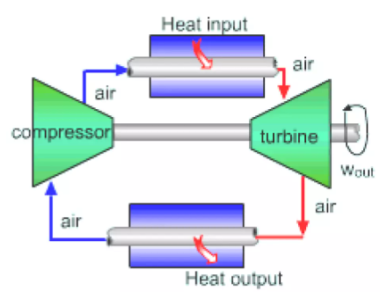
Closed Cycle gas Turbine Unit:

Slide 4
Brayton Cycle Stages
Compression (1-2): Air is compressed isentropically, increasing pressure and temperature.
Heat Addition (2-3): Heat is added at constant pressure, raising the temperature.
Expansion (3-4): The high-temperature air expands isentropically in the turbine, generating work.
Heat Rejection (4-1): Heat is rejected at constant pressure, completing the cycle.

Slide 5
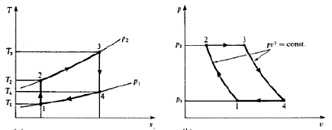
p-v & T-s Diagram

Slide 6
Work Ratio Derivation in the Brayton Cycle
Definition of Work Ratio:
The work ratio expresses how much net work is extracted relative to the gross work produced.
After simplifying:

Slide 7
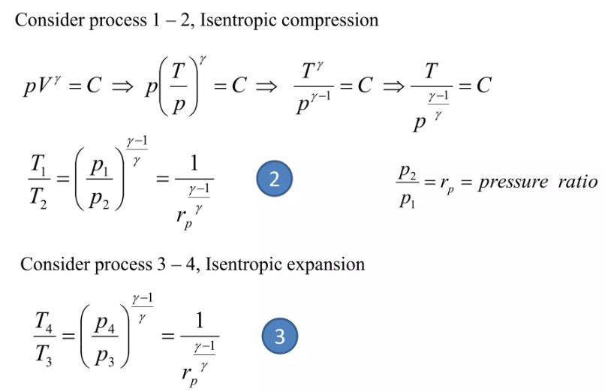

Slide 8
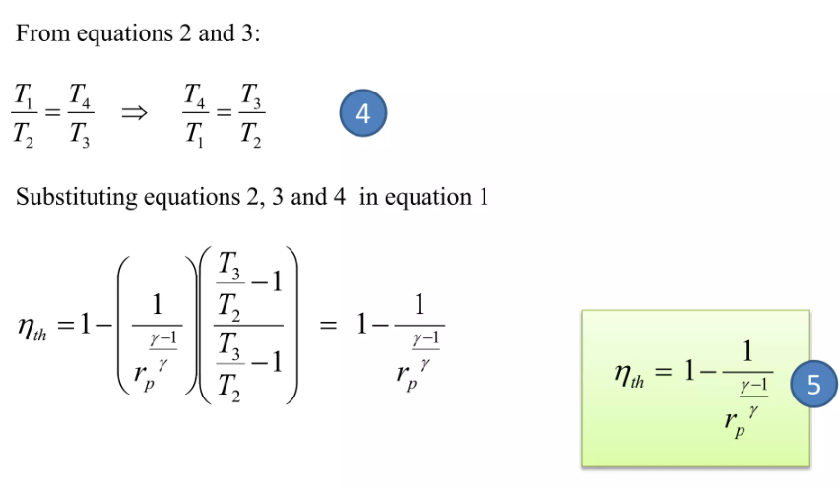

Slide 9
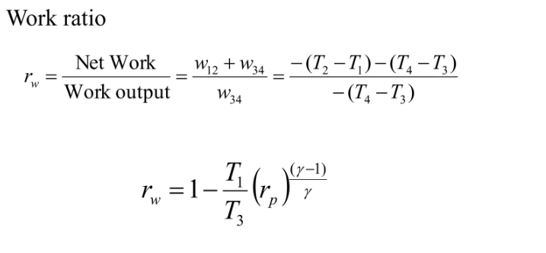

Slide 10
Key Insight:
The work ratio depends not only on the pressure ratio, but also on the ratio of the minimum and maximum temperatures (T₁ and T3).
For maximum efficiency, T3 should be as high as possible, especially in open-cycle gas turbines.

Slide 11
Example:
In a gas turbine unit air is drawn at 1.02 bar and 15°C, and is compressed to 6.12 bar. Calculate the thermal efficiency and the work ratio of the ideal constant pressure cycle, when the maximum cycle temperature is limited to 800 °C.
Solution:

