Slide 1
T-s Diagram for Vapors, Dryness with Solved Examples

Slide 2
The T-s diagram for Vapors:
T-s diagram :
A Temperature-Entropy (T-s) diagram is a thermodynamic chart used to represent various states of a substance, particularly vapors, in a cycle or process. It provides insights into the relationship between temperature (T) and entropy (s), helping to visualize phase changes, such as evaporation and condensation, and the concept of dryness fraction in vapors.

Slide 3
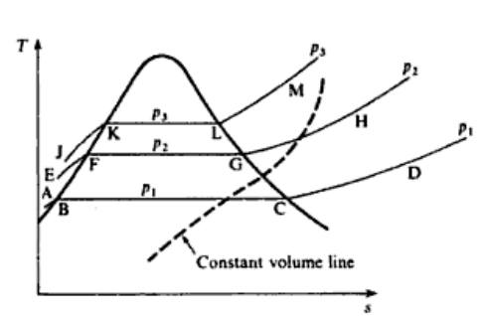
T-s diagram for vapors
The t-s diagram for vapors is shown in the figure.
The three lines of constant pressure(p1,p2,p3)
are shown as line ABCD, EFGH and JKLM.
The pressure lines in the liquid region are
practically coincident with the saturated liquid
line (i.e. portions AB, EF, and JK), and the
difference is usually neglected.

Slide 4
The pressure remains constant with temperature when the latent heat is added, hence the pressure lines are horizontal in the wet region (i.e. portions BC, FG, and KL). The pressure lines curve upwards in the superheat region as shown (i.e. portions CD, GH, and LM). Thus the temperature rises as heating continues at constant pressure.
One constant volume line shown in dotted line.
Lines of constant volume are
concave down in the wet region
and slopeup more steeply than
pressure lines in the superheat
region.

Slide 5
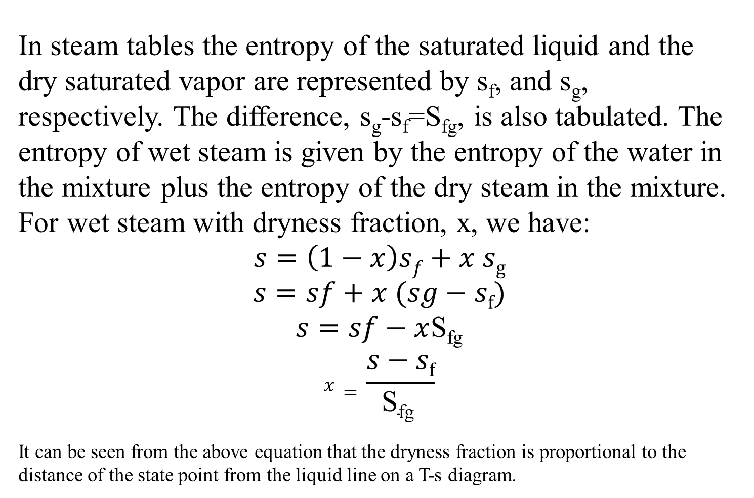
In steam tables the entropy of the saturated liquid and the dry saturated vapor are represented by s_{f}, and s_{g}, respectively. The difference, s_{g}-s_{f}=S_{fg}, is also tabulated. The entropy of wet steam is given by the entropy of the water in the mixture plus the entropy of the dry steam in the mixture. For wet steam with dryness fraction, x, we have:
$$s=\left(1−x\right)sf+x sg$$
$$s=sf+x (sg−sf)$$
$s=sf−x$S_{fg}
$$x=\frac{s−sf}{\text{S}\text{fg} }$$
It can be seen from the above equation that the dryness fraction is proportional to the distance of the state point from the liquid line on a T-s diagram.

Slide 6
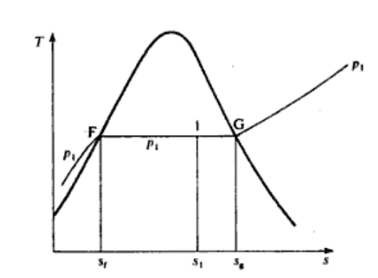
$x=\frac{distance F1}{distance FG}$= $\frac{s−sf}{\text{S}\text{fg}}$
The area under FG line in the given figure represents the specific enthalpy of vaporization h_{fg} . The area under the line F1 is given by x₁ h_{fg.}

Slide 7
Solved example:
1 kg of steam at 7 bar, entropy 6.5 kJ/kg K, is heated reversibly at constant pressure until the temperature is 250°C. Calculate the heat supplied, and show on a T-s diagram the area which represents the heat flow.
Solution:
At 7 bar, s_{g} = 6.709 kJ/kg K, hence the steam is wet, since the actual entropy,
s_{f} is less than s_{g}
From equation
$x= \frac{s1−sf1}{sfg1}$= $\frac{6.5−1.992}{4.717}$=0.955
Then from another equation from chapter 2
h₁ = h_{f1} + x₁h_{fg1} = 697 + (0.955 x 2067)

Slide 8
h₁ = 697+ 1975
h₁₌= 2672 kJ/kg
At state 2 the steam is at 250°C at 7 bar, and is therefore superheated.
From superheat tables,
h₂ = 2955 kJ/kg
At constant pressure from equation (3.3)
Q=h₂-h₁ = 2955 – 2672
Q=283 kJ/kg

Slide 9
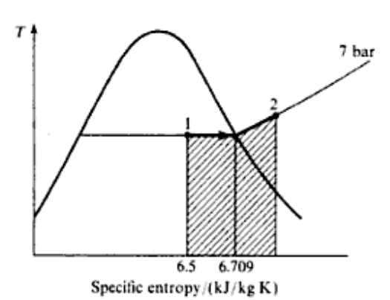
Heat supplied = 283 kJ/kg
The T-s diagram showing the process is given in the figure, the shaded area representing the heat flow.

Slide 10
A rigid cylinder of volume 0.025 m³ contains steam at 80 bar and 350 °C. The cylinder is cooled until the pressure is 50 bar. Calculate the state of the steam after cooling and the amount of heat rejected by the steam. Sketch the process on a T-s diagram indicating the area which represents the heat flow.
Solution:
Steam at 80 bar and 350°C is superheated, and the specific volume from tables is 0.02994 m3/kg. Hence the mass of steam in the cylinder is given by
mass of steam =$\frac{0.025}{0.02994}$= 0.835Kg
For superheated steam above 80 bar the internal energy is found from equation ,
u₁ = h₁ – p₁v₁ =$\frac{80 ×0.02994×105}{103}$= 2990 - 239.5

Slide 11
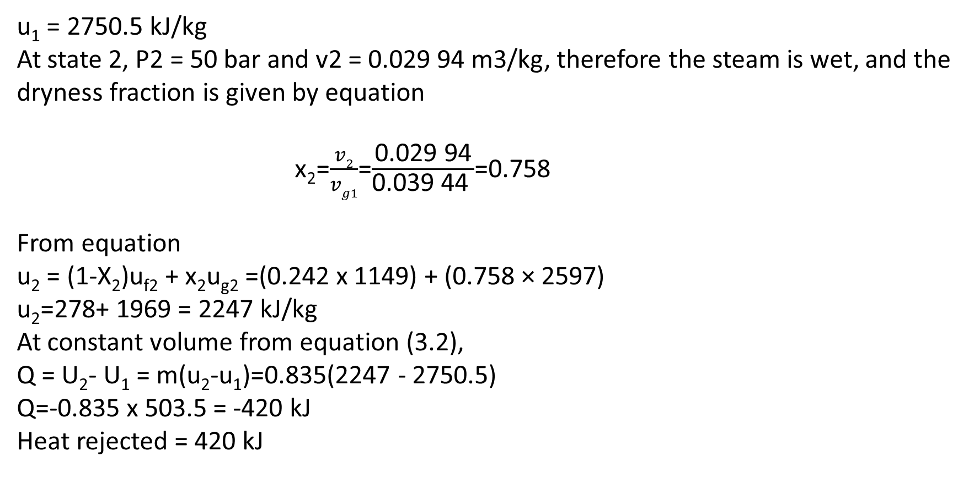
u₁ = 2750.5 kJ/kg
At state 2, P2 = 50 bar and v2 = 0.029 94 m3/kg, therefore the steam is wet, and the dryness fraction is given by equation
x₂=$\frac{v2}{vg1}$=$\frac{\text{0.029 94}}{\text{0.039 44 }}$=0.758
From equation
u₂ = (1-X₂)u_{f2} + x₂u_{g2} =(0.242 x 1149) + (0.758 × 2597)
u₂=278+ 1969 = 2247 kJ/kg
At constant volume from equation (3.2),
Q = U₂- U₁ = m(u₂-u₁)=0.835(2247 - 2750.5)
Q=-0.835 x 503.5 = -420 kJ
Heat rejected = 420 kJ

Slide 12
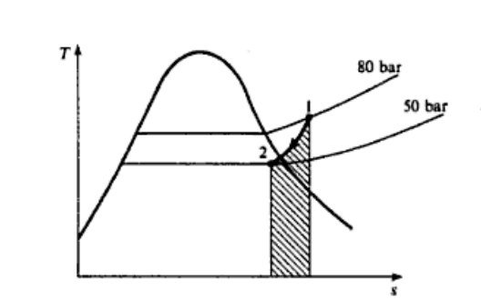
Figure shows the process drawn on a T-s diagram, the shaded area representing the heat rejected by the steam.

