Slide 1
Carnot cycle
Muhammad Jahanzeb Zaid Hassan
(0032-BSc. EE-21) (0042-BSc.EE-21)

Slide 2
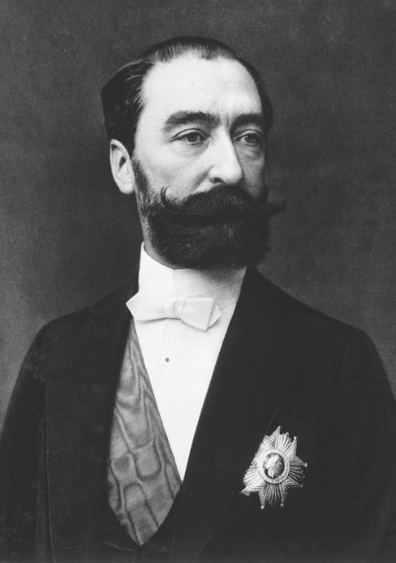
INTRODUCTION
The Carnot cycle, a theoretical thermodynamic cycle proposed by Nicolas Léonard Sadi Carnot in 1824, serves as the foundation for understanding the maximum possible efficiency of any heat engine. This presentation will delve into the intricacies of the Carnot cycle, exploring its theoretical construct, practical implications, and the limitations that prevent its direct implementation.

Slide 3
CARNOT CYCLE OVERVIEW
Definition:
A series of four reversible processes that define the operation of an ideal heat engine. The Carnot cycle is a theoretical thermodynamic cycle that represents the most efficient possible engine operating between two heat reservoirs.
The efficiency of a Carnot engine is determined by the temperatures of the two reservoirs and is given by the formula:
$$η=1 − \frac{T_{c}}{T_{H}}$$

Slide 4
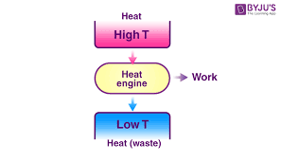
THE CARNOT PRINCIPLES
The Carnot cycle is a theoretical thermodynamic cycle that serves as a standard for the efficiency of heat engines. Here are its key principles:
1. The efficiency of an irreversible heat engine is always less than the efficiency of a reversible one operating between same two thermal reservoirs.
2. The efficiencies of all reversible heat engines operating between the same two thermal reservoirs are the same.

Slide 5
Implications of the Carnot Principle
1. The Second Law of Thermodynamics
Establishes the direction of heat transfer (from hot to cold).
The Carnot Principle reinforces the concept that no engine can be 100% efficient.
2. Significance in Real Engines
Provides a benchmark for comparing actual engine performance.
Real engines are subject to factors like friction, heat losses, and irreversible processes.

Slide 6
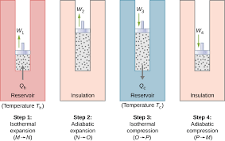
FOUR STAGES OF THE CYCLE FOR IDEAL GAS
Isothermal Expansion
Adiabatic Expansion
Isothermal Compression
Adiabatic Compression

Slide 7
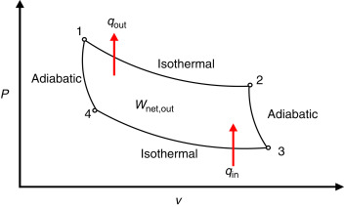
PROCESS BREAKDOWN
1. Isothermal Expansion:
The gas in the system absorbs heat (Qh) from a high-temperature heat source (Th) at constant temperature.
The gas expands, doing work on the surroundings.
2. Adiabatic Expansion:
The system is thermally insulated, and the gas continues to expand without exchanging heat with the surroundings.
The gas cools down to a lower temperature (Tl).
3. Isothermal Compression:
The gas releases heat (Ql) to a low-temperature heat sink (Tl) at constant temperature.
The surroundings do work on the gas, compressing it.
4. Adiabatic Compression:
The system is again thermally insulated, and the gas is further compressed without exchanging heat with the surroundings.
The gas heats up back to the initial temperature (Th).

Slide 8
Work and Heat Exchange in the Carnot Cycle
Isothermal Expansion (Process 1-2):
QH ​=W12 ​(Heat absorbed equal work done)
Isothermal Compression( Process 3 – 4)
QL​=−W34​ (Heat rejected equals work done on the gas)
Adiabatic Compression (Process 4 – 1) ΔU=−W41​ (No heat exchange, work increases internal energy)
Adiabatic Expansion (Process 2 -3)
ΔU=W23 ​(No heat exchange, work done decreases internal energy)

Slide 9
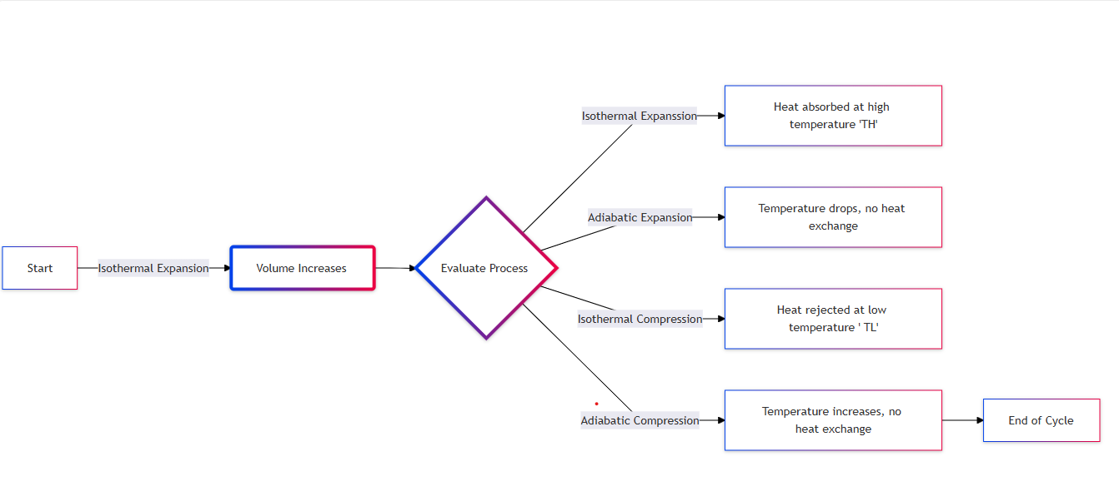

Slide 10
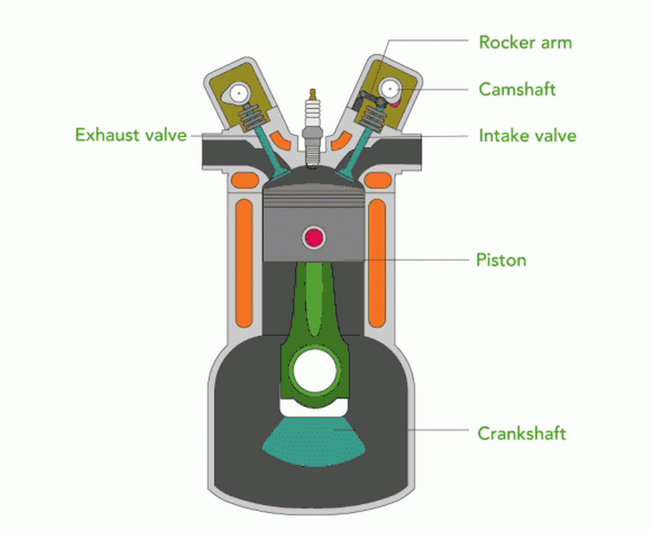
HEAT ENGINES: THE CARNOT CYCLE
All standard heat engines (steam, gasoline, diesel) work by supplying heat to a gas, the gas then expands in a cylinder and pushes a piston to do its work. So it’s easy to see how to turn heat into work, but that’s a one shot deal. We need it to keep repeating to have a useful engine. The heat and/or the gas must therefore be dumped out of the cylinder before the next cycle begins, otherwise all the work the gas delivered on expanding will be used up compressing it back. This simplest heat engine is called the Carnot Engine , for which one complete heating/cooling, expanding/contracting cycle back to the original gas volume and temperature is a Carnot cycle.

Slide 11
Numerical Problem
Consider a Carnot engine operating between a hot reservoir $T_{H}=500 K$ and a cold reservoir at${ T}_{C}=300 K$. The engine uses an ideal gas as the working substance. The gas expands from a volume $V_{1}=0.1m^{3}$ to $V_{2}=0.4m^{3}$ during the isothermal expansion phase at $T_{H}$, and is compressed from $V_{2}=0.4m^{3 }$to $V_{1}=0.1m^{3}$during the isothermal compression phase at $T_{c}$
Calculate the efficiency of the Carnot engine.
If the engine absorbs 500 J of heat from the hot reservoir during the isothermal expansion, calculate the amount of heat rejected to the cold reservoir during the isothermal compression.
Solution:
Efficiency of the Carnot engine:
The efficiency $η$of a Carnot engine is given by:
$$η=1 − \frac{T_{c}}{T_{H}}$$
​​Substituting the values
$η=1 − \frac{300}{500}$ = 1 – 0.6 = 0.4
So, the efficiency of the engine is 40%.

Slide 12
Heat rejected to the cold reservoir:
In a Carnot cycle, the heat rejected to the cold reservoir $Q_{c}$​ is related to the heat absorbed by the hot reservoir
$Q_{H}$ by the efficiency:
$$η=1 − \frac{Q_{C}}{Q_{H}}$$
Rearranging the equation:
$$Q_{C}= Q_{H}\left(1 − η\right)$$
Substituting the known values:
$Q_{c}=500j \left( 1 −0.4\right)$
$Q_{c}=$500j x 0.6
$Q_{c}$= 300 j
So, the amount of heat rejected to the cold reservoir is 300 j

Slide 13
Is carnot cycle reversible?
Yes, The Carnot cycle is theoretically a reversible cycle that itself consists of four reversible processes. A reversible process is a process that is carried out infinitely slow, so that the entire process can be through of as consisting of a series of equilibrium states.
Efficiency
The efficiency of a reversible Carnot cycle is the upper limit for the thermal efficiency of heat engines that operate between the same temperature limits.
Practically
The Carnot cycle is reversible in theory, but in real life heat engines are not because of friction and heat transfer to the insulating wall. The processes in a Carnot cycle are also extremely slow, while real-life engines work faster.

Slide 14
SUMMARY
The Carnot cycle is a theoretical concept that describes the most efficient way a heat engine can operate between two temperature sources: a hot one and a cold one. It sets an upper limit on how efficiently any engine can convert heat into work. The basic idea is that the engine takes in heat from the hot reservoir, performs work, and then releases some of that energy to the cold reservoir.

Slide 15
THANK YOU

