Slide 1
Applied Thermodynamics
Instructor: Ms. Asma Mushtaq
Electrical Engineering Department, GCU Lahore
Email: asmamushtaq@gcu.edu.pk

Slide 2
Polytropic Process
A polytropic process is a thermodynamic process that follows the relationship:
PV^{n}=constant
where: P is the pressure, V is the volume, and n is the polytropic index, which can vary depending on the type of process.
This equation describes how pressure and volume change relative to each other during the process. The value of n determines the specific nature of the process, as follows:
Isothermal Process (n=1): The temperature remains constant, and the relationship reduces to the ideal gas law.
Adiabatic Process (n=γ): No heat is transferred to or from the system. Here, γ is the heat capacity ratio (C_{p}/C_{v}).
Isobaric Process (n=0): The pressure remains constant throughout the process.
Isochoric Process (n→∞): The volume remains constant.
Polytropic Process (n≠1,γ): A general case where heat transfer occurs, but not in a way that follows isothermal or adiabatic conditions.

Slide 3
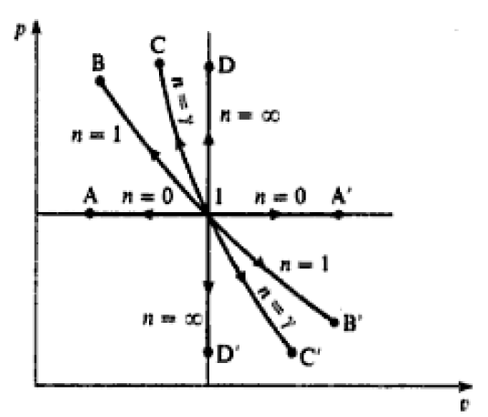
Polytropic Process
state 1 to state A is constant pressure cooling (n= 0)
state 1 to state B is isothermal compression (n = 1)
state 1 to state C is reversible adiabatic compression (n =γ )
state 1 to state D is constant volume heating (n=∞)

Slide 4
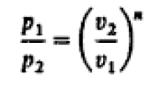
Polytropic Process

Slide 5
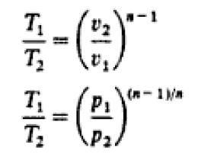
Polytropic Process for Perfect Gas

Slide 6
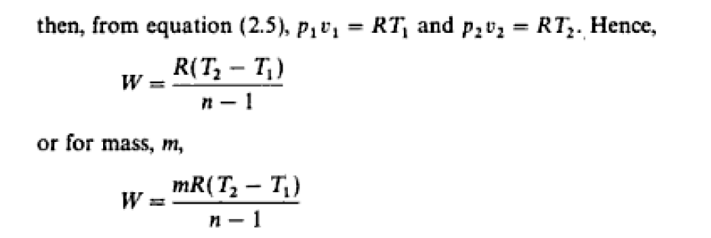
Polytropic Process for Ideal Gas
Note: The previously derived equations do not apply to vapours as they were formed in case of Ideal Gas.

Slide 7
Polytropic Process for Ideal Gas

Slide 8
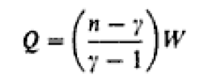
Polytropic Process for Ideal Gas
Above equation is a convenient and concise expression relating the heat supplied and the work input in a polytropic process. In a compression process work is done on the gas, and hence the term W is positive. Therefore it can be seen from equation that when the polytropic index n is greater than γ in a compression process, then the right-hand side of the equation is positive (i.e. heat is supplied during the process). Conversely, when n is less than γ in a compression process, then heat is rejected by the gas. Similarly, the work input in an expansion process is negative, therefore when n is greater than γ. in an expansion process, heat is rejected; and when n is less than γ, in an expansion process, heat must be supplied to the gas during the process. For all perfect gases γ has a value greater than unity.

Slide 9
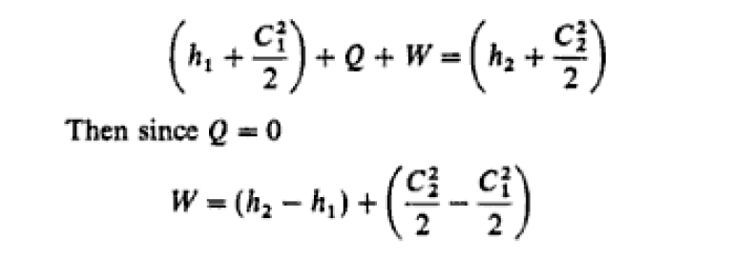
Reversible Flow Process
In thermodynamics, a reversible process is an idealized process that happens in such a way that the system remains in thermodynamic equilibrium at all times, and it can be reversed by infinitesimally small changes in external conditions. Reversible processes are useful in analysis because they represent the most efficient processes possible, with no entropy generation or energy dissipation.

Slide 10
Reversible Flow Process
Also, since the process is assumed to be reversible, then for a perfect gas, pv^{γ} = constant. This equation can be used to fix the end states. Note that even if the kinetic energy terms are negligibly small the work input in a reversible adiabatic flow process between two states is not equal to the work input in a reversible adiabatic non-flow process between the same states.

Slide 11
Irreversible Processes
An irreversible process in thermodynamics is a process that cannot be reversed, meaning the system and its surroundings cannot be returned to their original states by simply reversing the process. In irreversible processes, there is always an increase in entropy, as they involve dissipative factors like friction, unrestrained expansion, or rapid compression, which generate entropy and reduce the efficiency of energy conversion.
The temperature of the cooling or heating medium external to the system would be required to change correspondingly. Ideally a way of achieving reversibility can be imagined, but in practice it cannot even be approached as an approximation. Nevertheless, if we accept inevitable irreversibilities in the surroundings, we can still have processes which are internally reversible. That is, the system undergoes a process which can be reversed, but the surroundings undergo an irreversible change. Most processes occurring in a cylinder behind a piston can be assumed to be internally reversible to a close approximation, and the equations of sections 3.1, 3.2, and 3.3 can be used where applicable. Certain processes cannot be assumed to be internally reversible, and the important cases will now be considered.

