Slide 1
Programming Fundamentals
Ms. Asma Mushtaq
asmamushtaq@gcu.edu.pk
LECTURE 5
03-03-2025

Slide 2
Some Problems using switch statements
Write a C++ program for checking the day of week. For example, if user presses 1 then its Monday, 2 its Tuesday and so on.
Write a C++ Program to Convert Number to Month Name
1-January
2-February
Write a program that displays your location in 2D using (x,y). Then ask the user to shift the location in (e,w,n,s) by typing e (east), w (west), n (north), and s(south). Do this problem using nested if-else and switch statements.

Slide 3
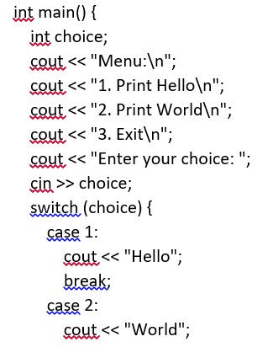
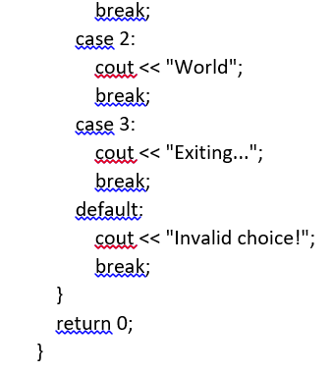
Menu-Driven Program
This program displays a menu to the user and performs different actions based on the user's choice using a switch statement.

Slide 4
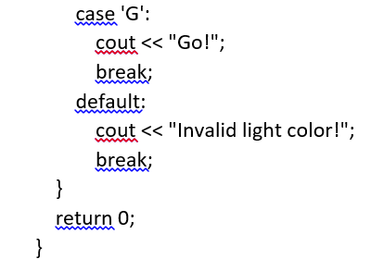
This program simulates a traffic light and prints the appropriate action based on the light color using a switch statement.

Slide 5
The Conditional Operator
The conditional operator consists of two symbols, which operate on three operands. It’s the only such operator in C++; other operators operate on one or two operands.
min = (alpha<beta) ? alpha : beta;
The part of this statement to the right of the equal sign is called the conditional expression:
(alpha<beta) ? alpha : beta // conditional expression
The question mark and the colon make up the conditional operator. The expression before the question mark (alpha<beta) is the test expression. Min, alpha and beta are the three operands.

Slide 6
The Conditional Operator
If the test expression is true, the entire conditional expression takes on the value of the operand following the question mark: alpha in this example. If the test expression is false, the conditional expression takes on the value of the operand following the colon: beta. The parentheses around the test expression aren’t needed for the compiler, but they’re customary; they make the statement easier to read

Slide 7
Flow Chart

Slide 8
Guess the output of the following program
int main()
{
for(int j=0; j<80; j++) //for every column,
{ //ch is ‘x’ if column is
char ch = (j%8) ? ‘ ‘ : ‘x’; //multiple of 8, and
cout << ch; //’ ‘ (space) otherwise
}
return 0;
}

Slide 9
Write a statement that uses a conditional operator to set ticket to 1 if speed is greater than 55, and to 0 otherwise.
ticket = (speed > 55) ? 1 : 0;
Write an expression involving a logical operator that is true if limit is 55 and speed is greater than 55.
(limit == 55 && speed > 55)

Slide 10
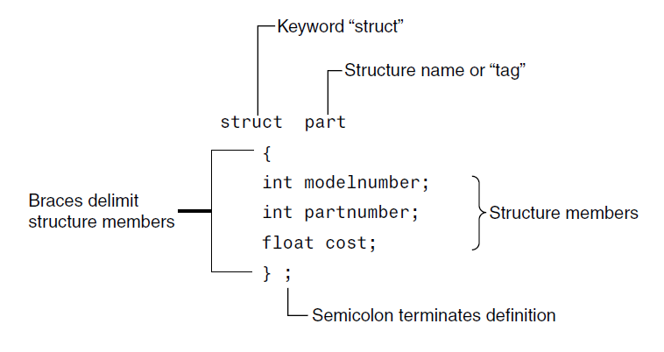
Structures in C++
A structure is a collection of simple variables. The variables in a structure can be of different types: Some can be int, some can be float, and so on.

Slide 11
Structures in C++ (Example)
struct part //declare a structure
{
int modelnumber; //ID number of widget
int partnumber; //ID number of widget part
float cost; //cost of part
};

Slide 12
Structures in C++
int main()
{
part part1; //define a structure variable
part1.modelnumber = 6244; //give values to structure members
part1.partnumber = 373;
part1.cost = 217.55F;
//display structure members
cout << “Model “ << part1.modelnumber;
cout << “, part “ << part1.partnumber;
cout << “, costs $” << part1.cost << endl;
return 0;
}

Slide 13
Structures in C++
The structure definition serves only as a blueprint for the creation of variables of type part. It does not itself create any structure variables; that is, it does not set aside any space in memory or even name any variables. This is unlike the definition of a simple variable, which does set aside memory. A structure definition is merely a specification for how structure variables will look when they are defined.

Slide 14
Suppose you want to create a drawing or architectural program that uses the English system. It will be convenient to store distances as two numbers, representing feet and inches.
struct Distance //English distance
{
int feet;
float inches;
};
int main()
{
Distance d1, d3; //define two lengths
Distance d2 = { 11, 6.25 }; //define & initialize one length
//get length d1 from user
cout << “\nEnter feet: “; cin >> d1.feet;
cout << “Enter inches: “; cin >> d1.inches;

Slide 15
d3.inches = d1.inches + d2.inches; //add the inches
d3.feet = 0; //(for possible carry)
if(d3.inches >= 12.0) //if total exceeds 12.0,
{ //then decrease inches by 12.0
d3.inches -= 12.0; //and
d3.feet++; //increase feet by 1
}
d3.feet += d1.feet + d2.feet; //add the feet
//display all lengths
cout << d1.feet << “\’-” << d1.inches << “\” + “;
cout << d2.feet << “\’-” << d2.inches << “\” = “;
cout << d3.feet << “\’-” << d3.inches << “\”\n”;
return 0;
}

