Slide 1
Programming Fundamentals Ms. Asma Mushtaq asmamushtaq@gcu.edu.pk LECTURE 6

Slide 2
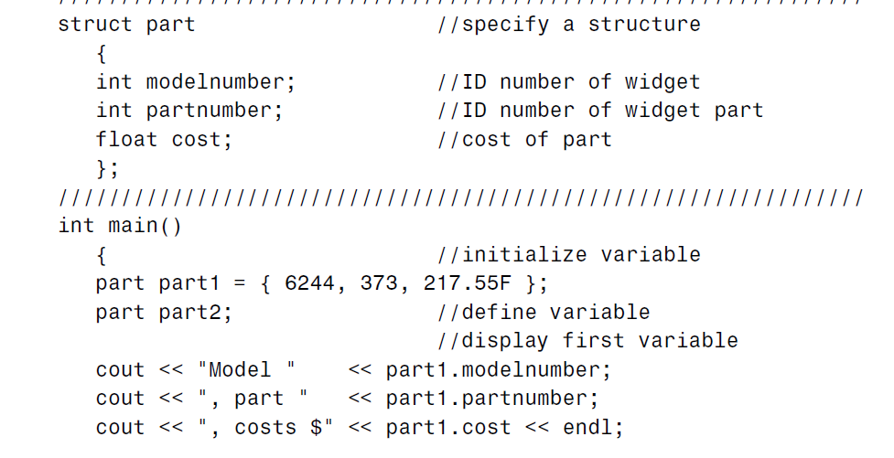
Example Program for structures

Slide 3
Example Program for structures

Slide 4
Structure Variables in Assignment Statements
One structure variable can be assigned to another:
part2 = part1;
The value of each member of part1 is assigned to the corresponding member of part2. Since a large structure can have dozens of members, such an assignment statement can require the computer to do a considerable amount of work.
Note that one structure variable can be assigned to another only when they are of the same structure type. If you try to assign a variable of one structure type to a variable of another type, the compiler will complain.

Slide 5
Suppose you want to create a drawing or architectural program that uses the English system. It will be convenient to store distances as two numbers, representing feet and inches.
struct Distance //English distance
{
int feet;
float inches;
};
int main()
{
Distance d1, d3; //define two lengths
Distance d2 = { 11, 6.25 };

Slide 6
cout << “\nEnter feet: “; cin >> d1.feet;
cout << “Enter inches: “; cin >> d1.inches;
//add lengths d1 and d2 to get d3
d3.inches = d1.inches + d2.inches; //add the inches
d3.feet = 0; //(for possible carry)
if(d3.inches >= 12.0) //if total exceeds 12.0,
{ //then decrease inches by 12.0
d3.inches -= 12.0; //and
d3.feet++; //increase feet by 1
}
d3.feet += d1.feet + d2.feet; //add the feet
cout << d1.feet << “\’-” << d1.inches << “\” + “;
cout << d2.feet << “\’-” << d2.inches << “\” = “;
cout << d3.feet << “\’-” << d3.inches << “\”\n”;
return 0;
}

Slide 7
cout << d1.feet << “\’-” << d1.inches << “\” + “;
cout << d2.feet << “\’-” << d2.inches << “\” = “;
cout << d3.feet << “\’-” << d3.inches << “\”\n”;
return 0;
}

Slide 8
Another Example of Structures
struct employee {
char firstName[20];
char lastName[20];
unsigned int age;
char gender;
double hourlySalary;
};

Slide 9
int main() { employee s1;
cout<<"enter the first name of employee"<<endl;
cin>>s1.firstName;
cout<<"enter the last name of employee"<<endl;
cin>>s1.lastName;
cout<<"enter the age of employee"<<endl;
cin>>s1.age;
cout<<"enter the gender of employee"<<endl;
cin>>s1.gender;
cout<<"enter the hourly salary of employee"<<endl;
cin>>s1.hourlySalary;
cout<<"Employee Details are as follows:"<<endl;
cout<<s1.firstName<<"\t"<<s1.lastName<<"\t"<<s1.age<<"\t"<<s1.gender<<"\t"<<s1.hourlySalary<<endl;
return 0;
}

Slide 10
Practice Questions
1. A phone number, such as (212) 767-8900, can be thought of as having three parts: the area code (212), the exchange (767), and the number (8900). Write a program that uses a structure to store these three parts of a phone number separately. Call the structure phone. Create two structure variables of type phone. Initialize one, and have the user input a number for the other one. Then display both numbers. The interchange might look like this:
Enter your area code, exchange, and number: 415 555 1212
My number is (212) 767-8900
Your number is (415) 555-1212

Slide 11
Practice Questions
2. A point on the two-dimensional plane can be represented by two numbers: an x coordinate and a y coordinate. For example, (4,5) represents a point 4 units to the right of the vertical axis, and 5 units up from the horizontal axis. The sum of two points can be defined as a new point whose x coordinate is the sum of the x coordinates of the two points, and whose y coordinate is the sum of the y coordinates. Write a program that uses a structure called point to model a point. Define three points, and have the user input values to two of them. Then set the third point equal to the sum of the other two, and display the value of the new point. Interaction with the program might look like this:
Enter coordinates for p1: 3 4
Enter coordinates for p2: 5 7
Coordinates of p1+p2 are: 8, 11

Slide 12
Practice Questions
3. Create a structure of type date that contains three members: the month, the day of the month, and the year, all of type int. (Or use day-month-year order if you prefer.) Have the user enter a date in the format 12/31/2001, store it in a variable of type struct date, then retrieve the values from the variable and print them out in the same format.

Slide 13
Thank you

