Slide 1
Programming Fundamentals
Ms. Asma Mushtaq
asmamushtaq@gcu.edu.pk
LECTURE 1

Slide 2
Basic Program Construction
#include <iostream>
using namespace std;
int main()
{
cout << “we are learning programming\n”;
return 0;
}

Slide 3
Description of each Statement
#include, is a preprocessor directive,
string constants: we are learning programming”
The identifier cout (pronounced “C out”) is actually an object. It is predefined in C++ to correspond to the standard output stream. A stream is an abstraction that refers to a flow of data.
The operator << is called the insertion or put to operator. It directs the contents of the variable on its right to the object on its left.
The ‘\n’ character at the end of the string constant is an example of an escape sequence.

Slide 4
Directives
The two lines that begin the FIRST program are directives. The first is a preprocessor directive, and the second is a using directive. They occupy a sort of gray area: They’re not part of the basic C++ language, but they’re necessary anyway.
A preprocessor directive, on the other hand, is an instruction to the compiler. A part of the compiler called the preprocessor deals with these directives before it begins the real compilation process.

Slide 5
Headerfiles
IOSTREAM is an example of a header file (sometimes called an include file). It’s concerned with basic input/output operations, and contains declarations that are needed by the cout identifier and the << operator.
Without these declarations, the compiler won’t recognize cout and will think << is being used incorrectly.

Slide 6
The using Directive
A C++ program can be divided into different namespaces. A namespace is a part of the program in which certain names are recognized; outside of the namespace they’re unknown. The directive
using namespace std;
std::cout << “we are learning programming.”;
To avoid adding std:: dozens of times in programs we use the using directive instead.

Slide 7
Comments
Single line comment
  //This is my first C++ Class
Multiline Comment
  /* this
  is a
  potentially
  very long
  multiline
  comment
  */

Slide 8
Meaning
C++ data types are defined as the data storage format that a variable can store a data to perform a specific operation. Data types are used to define a variable before to use in a program.
Uses
Identify the type of a variable when it declared.
Identify the type of the return value of a function.
Identify the type of a parameter expected by a function.

Slide 9
Why Data Types?
  Every variable must have a type
2. Every variable should get some space in the memory
  3. Help the compiler decide how many bits should be reserved for a variable

Slide 10
Data Types In C
Data Types in C++
Primary
Derived
User Defined
Integer
Float (Real)
Character
Void
Arrays
Pointers
Structure
Union
Enumeration
Typedef

Slide 11
A. Primary Data Types
These are fundamental or basic data types in C++ namely
Integer
Real
Character
void

Slide 12
Int Data Type
Integer variables exist in several sizes, but the most commonly used is type int. The amount of memory occupied by the integer types is system dependent. On a 32-bit system such as Windows, an int occupies 4 bytes (which is 32 bits) of memory. This allows an int to hold numbers in the range from –2,147,483,648 to 2,147,483,647.

Slide 13
Size of Data Types
While type int occupies 4 bytes on current Windows computers, it occupied only 2 bytes in MS-DOS and earlier versions of Windows.
Modern systems (32-bit and 64-bit) typically use a 4-byte int by default. This is defined by the C++ standard, which specifies that int should have a natural size suggested by the system architecture. For most modern systems, this is 4 bytes.

Slide 14
Declarations and Definitions
A declaration introduces a variable’s name (such as var1) into a program and specifies its type (such as int). However, if a declaration also sets aside memory for the variable, it is also called a definition. The statements
int var1;
int var2;
are definitions, as well as declarations, because they set aside memory
for var1 and var2.

Slide 15
Variable Names
The names given to variables (and other program features) are called identifiers.
What are the rules for writing identifiers?
You can use upper and lowercase letters, and the digits from 1 to 9. You can also use the underscore (_).
The first character must be a letter or underscore. Identifiers can be as long as you like, but most compilers will only recognize the first few hundred characters.
The compiler distinguishes between upper- and lowercase letters, so Var is not the same as var or VAR.

Slide 16
Rules for writing Identifiers
You can’t use a C++ keyword as a variable name.
A keyword is a predefined word with a special meaning. int, class, if, and while are examples of keywords.
A variable’s name should make clear to anyone reading the listing the variable’s purpose and how it is used.

Slide 17
Assignment Statements
The statements
var1 = 20;
var2 = var1 + 10;
assign values to the two variables. The equal sign (=), as you might guess, causes the value on the right to be assigned to the variable on the left.

Slide 18
Integer Constants
The number 20 is an integer constant. Constants don’t change during the course of the program.
An integer constant consists of numerical digits. There must be no decimal point in an integer constant, and it must lie within the range of integers.

Slide 19
Output Variations
The statement
cout << “var1+10 is “;
displays a string constant. The next statement
cout << var2 << endl;
displays the value of the variable var2. As you can see in your console output window, the output of the program is
var1+10 is 30
Note that cout and the << operator know how to treat an integer and a string differently. If we send them a string, they print it as text. If we send them an integer, they print it as a number.

Slide 20
The endl Manipulator
Manipulators are instructions to the output stream that modify the output in various ways.
endl causes a linefeed to be inserted into the stream, so that subsequent text is displayed on the next line.

Slide 21
Other Integer Types
There are several numerical integer types besides type int. The two most common types are long and short.
We noted that the size of type int is system dependent. In contrast, types long and short have fixed sizes no matter what system is used.
Type long always occupies four bytes, which is the same as type int on 32-bit Windows systems.
Thus it has the same range, from –2,147,483,648 to 2,147,483,647. It can also be written as long int; this means the same as long.

Slide 22
Other Integer Types
On all systems type short occupies two bytes, giving it a range of –32,768 to 32,767. There’s probably not much point using type short on modern Windows systems unless it’s important to save memory. Type int, although twice as large, is accessed faster than type short.
If you want to create a constant of type long, use the letter L following the numerical value, as in
longvar = 7678L; // assigns long constant 7678 to longvar
__int8 | __int8 type corresponds to char
__int16 | __int16 corresponds to short
__int32 | __int32 corresponds to both int and long
__int64 | __int64 type holds huge integers with up to 19 decimal digits

Slide 23
Character Variables
Type char stores integers that range in value from –128 to 127. Variables of this type occupy only 1 byte (eight bits) of memory. Character variables are sometimes used to store numbers that confine themselves to this limited range, but they are much more commonly used to store ASCII characters.
As you may already know, the ASCII character set is a way of representing characters such as ‘a’, ‘B’, ‘$’, ‘3’, and so on, as numbers.

Slide 24
Character Constants
Character constants use single quotation marks around a character, like ‘a’ and ‘b’. (Note that this differs from string constants, which use double quotation marks.) When the C++ compiler encounters such a character constant, it translates it into the corresponding ASCII code. The constant ‘a’ appearing in a program, for example, will be translated into 97.
Character variables can be assigned character constants as values.

Slide 25
Difference between Character Variables and Character Constants
int main() {
// Character variable
char myChar = 'A'; // 'A' is a character constant
cout << "Character variable: " << myChar << endl;
// Changing the value of the character variable
myChar = 'B';
cout << "Updated character variable: " << myChar << endl;
// Using character constant directly
cout << "Character constant: " << 'C' << endl;
return 0;
}

Slide 26
Escape Sequences
This name reflects the fact that the backslash causes an “escape” from the normal way characters are interpreted. In case ‘\t’ the t is interpreted not as the character ‘t’ but as the tab character. A tab causes printing to continue at the next tab stop.
Another character constant, ‘\n’, is sent directly to cout in the last line of the program.

Slide 27
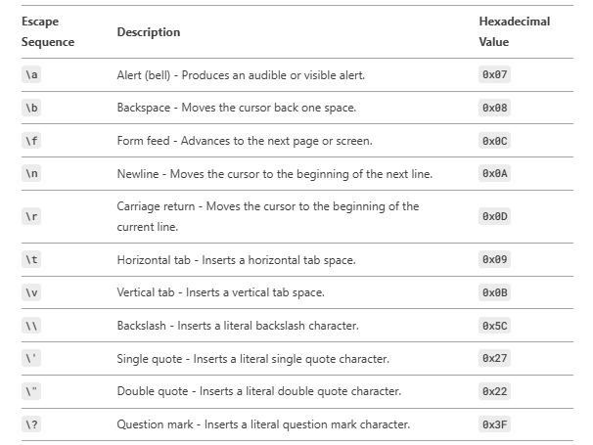
Escape Sequences

Slide 28
Input with cin
The statement:
cin >> variablename;
causes the program to wait for the user to type in a number. The resulting number is placed in the variablename. The keyword cin (pronounced “C in”) is an object, predefined in C++ to correspond to the standard input stream.
This stream represents data coming from the keyboard (unless it has been redirected). The >> is the extraction or get from operator.
It takes the value from the stream object on its left and places it in the variable on its right.

Slide 29
Example
#include <iostream>
using namespace std;
int main()
{
int ftemp; //for temperature in fahrenheit
cout << “Enter temperature in fahrenheit: “;
cin >> ftemp;
int ctemp = (ftemp-32) * 5 / 9;
cout << “Equivalent in Celsius is: “ << ctemp << ‘\n’;
return 0;
}

Slide 30
Floating Point Types
Floating-point variables represent numbers with a decimal place—like 3.1415927, 0.0000625, and –10.2.
They have both an integer part, to the left of the decimal point, and a fractional part, to the right. Floating-point variables represent what mathematicians call real numbers, which are used for measurable quantities such as distance, area, and temperature.
They typically have a fractional part.

Slide 31
Types of Floats
There are three kinds of floating-point variables in C++:
  type float,
  type double, and
  Type long double.
Type float stores numbers in the range of about 3.4x10 ^{–38} to 3.4x10 ³⁸, with a precision of seven digits. It occupies 4 bytes (32 bits) in memory.

Slide 32
Write Program for calculating the are of a Circle
#include <iostream> //for cout, etc.
using namespace std;
int main()
{
float rad; //variable of type float
const float PI = 3.14159F; //type const float
cout << “Enter radius of circle: “; //prompt
cin >> rad;
float area = PI * rad * rad; //find area
cout << “Area is “ << area << endl; //display answer
return 0;
}

Slide 33
Type double and long double
The larger floating point types, double and long double, are similar to float except that they require more memory space and provide a wider range of values and more precision. Type double requires 8 bytes of storage and handles numbers in the range from 1.7x10 ⁻³⁰⁸ to 1.7x10 ³⁰⁸ with a precision of 15 digits. Type long double is compiler-dependent but is often the same as double.

Slide 34
The const Qualifier
const float PI = 3.14159F; //type const float
The keyword const (for constant) precedes the data type of a variable. It specifies that the value of a variable will not change throughout the program. Any attempt to alter the value of a variable defined with this qualifier will elicit an error message from the compiler.
The #define Directive
Constants can also be specified using the preprocessor directive #define.
#define PI 3.14159
NOT So RECOMMENDED!

Slide 35
Type bool
Variables of type bool can have only two possible values:
true and false.
In theory a bool type requires only one bit (not byte) of storage, but in practice compilers often store them as bytes because a byte can be quickly accessed, while an individual bit must be extracted from a byte, which requires additional time.

Slide 36
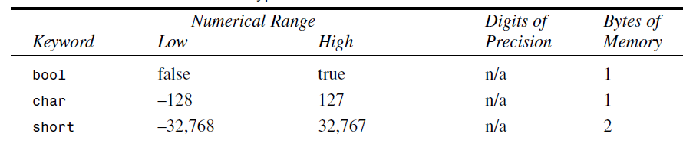
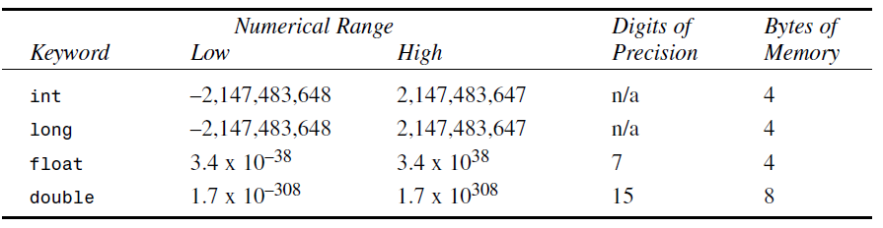
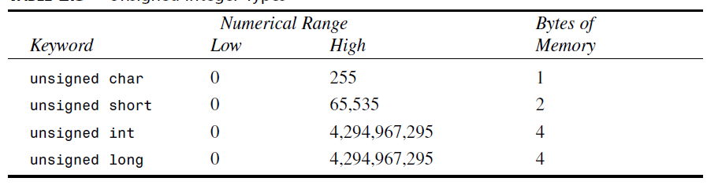
Summary of Data Types

Slide 37
Arithmetic Operators
The Remainder Operator
#include <iostream>
using namespace std;
int main()
{
cout << 6 % 8 << endl // 6
<< 7 % 8 << endl // 7
<< 8 % 8 << endl // 0
<< 9 % 8 << endl // 1
<< 10 % 8 << endl; // 2
return 0;
}

Slide 38
Arithmetic Assignment Operators
total = total + item; // adds “item” to “total”
total += item; // adds “item” to “total”
Increment Operators
count = count + 1;
++count;
Prefix and Postfix
the increment operator can be used in two ways: as a prefix, meaning that the operator precedes the variable; and as a postfix, meaning that the operator follows the variable.

Slide 39
Prefix and Postfix
totalWeight = avgWeight * ++count;
#include <iostream>
using namespace std;
int main()
{
int count = 10;
cout << “count=” << count << endl; //displays 10
cout << “count=” << ++count << endl; //displays 11 (prefix)
cout << “count=” << count << endl; //displays 11
cout << “count=” << count++ << endl; //displays 11 (postfix)
cout << “count=” << count << endl; //displays 12
return 0;
}

