Slide 1
Programming Fundamentals
Ms. Asma Mushtaq
asmamushtaq@gcu.edu.pk
LECTURE 2&3

Slide 2
The setw Manipulator
We’ve mentioned that manipulators are operators used with the insertion operator (<<) to modify—or manipulate—the way data is displayed.
The setw manipulator causes the number (or string) that follows it in the stream to be printed within a field n characters wide, where n is the argument to setw(n). The value is rightjustified within the field.

Slide 3
The setw Manipulator-Example
#include <iostream>
#include <iomanip> // Required for setw
using namespace std;
int main() {
cout << setw(10) << "Name" << setw(10) << "Age" << setw(15) << "City" << endl;
cout << "-----------------------------------------" << endl;
cout << setw(10) << "Alice" << setw(10) << 25 << setw(15) << "New York" << endl;
cout << setw(10) << "Bob" << setw(10) << 30 << setw(15) << "Los Angeles" << endl;
cout << setw(10) << "Eve" << setw(10) << 22 << setw(15) << "Chicago" << endl;
return 0;
}

Slide 4
Generating Output with Single cout command
#include <iostream>
#include <iomanip> // Required for setw
using namespace std;
int main() {
cout << setw(6) << "1990" << setw(8) << "135" << endl
<< setw(6) << "1991" << setw(8) << "7290" << endl
<< setw(6) << "1992" << setw(8) << "11300" << endl
<< setw(6) << "1993" << setw(8) << "16200" << endl;
return 0;
}

Slide 5
Problems
You can convert temperature from degrees Celsius to degrees Fahrenheit by multiplying by 9/5 and adding 32. Write a program that allows the user to enter a floating-point number representing degrees Celsius, and then displays the corresponding degrees Fahrenheit.
End Problem 9 ,11,

Slide 6
Loops and Decisions
Relational Operators
A relational operator compares two values. The values can be any built-in C++ data type, such as char, int, and float, or—they can be user-defined classes. The comparison involves such relationships as equal to, less than, and greater than. The result of the comparison is true or false; for example, either two values are equal (true), or they’re not (false).

Slide 7
Example
#include <iostream>
using namespace std;
int main()
{
int numb;
cout << "Enter a number:";
cin >> numb;
cout << "numb<10 is " << (numb < 10) << endl;
cout << "numb>10 is" << (numb > 10) << endl;
cout << "numb==10 is " << (numb == 10) << endl;
return 0;
}

Slide 8
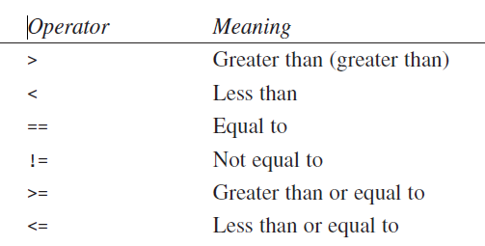
List of Relational Operators

Slide 9
Loops in C++
Loops cause a section of your program to be repeated a certain number of times. The repetition continues while a condition is true. When the condition becomes false, the loop ends and control passes to the statements following the loop. There are three kinds of loops in C++:
the for loop,
the while loop,
and the do-while loop.

Slide 10
The for Loop
The for loop executes a section of code a fixed number of times. It’s usually (although not always) used when you know, before entering the loop, how many times you want to execute the code.
Examples:
  Printing the square of numbers from 1 to 14
  Printing tables of numbers
  Finding sum of first 10 natural numbers
  Reverse loop (countdown)
  Finding the factorial of a number
Program for swapping the values of two variables.

Slide 11
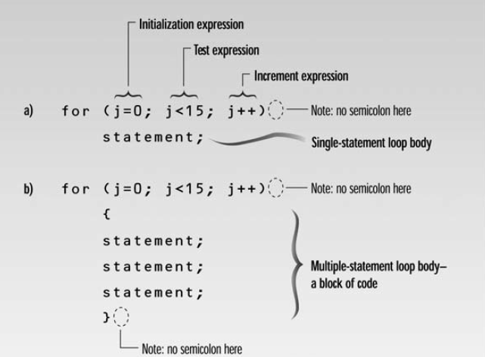
For loop

Slide 12
Example
#include <iostream>
using namespace std;
int main() {
for (int i = 1; i <= 10; i++) {
cout << i << " ";
}
return 0;
}

Slide 13
How for Loop Works?
The Initialization Expression
The initialization expression is executed only once, when the loop first starts. It gives the loop variable an initial value. In the FORDEMO example it sets j to 0.
The Test Expression
The test expression usually involves a relational operator. It is evaluated each time through the loop, just before the body of the loop is executed. It determines whether the loop will be executed again. If the test expression is true, the loop is executed one more time. If it’s false, the loop ends, and control passes to the statements following the loop.

Slide 14
Continue…
The Increment Expression
The increment expression changes the value of the loop variable, often by incrementing it. It is always executed at the end of the loop, after the loop body has been executed. Here the increment operator ++ adds 1 to j each time through the loop.

Slide 15
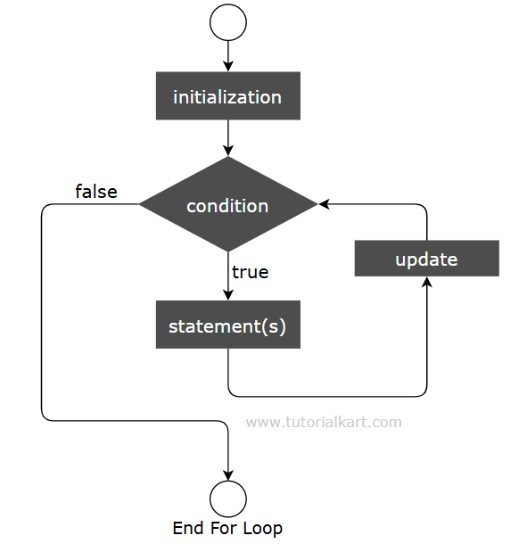
Flowchart

Slide 16
For Loop with break Statement
You can break the for loop abruptly using break statement. Break statement ends the execution of the wrapping loop. In the following example, we shall write a for loop that prints numbers from 1 to 10. But, then we include a break statement such that when i is 4, we break the for loop.
#include <iostream>
using namespace std;
int main() {
for (int i = 1; i <= 10; i++) {
if (i == 4) {
break;
}
cout << i << "\n";
}
}

Slide 17
For Loop with continue Statement
You can skip the execution of statements in a for loop during an iteration using continue statement. continue statement takes the control to the condition without executing further statements in the loop.
In the following example, we shall write a for loop that prints numbers from 1 to 7. But, then we include a continue statement such that when i is 4, we skip the execution for i=4 and execute further statements inside for loop.

Slide 18
For Loop with continue Statement
#include <iostream>
using namespace std;
int main() {
for (int i = 1; i <= 7; i++) {
if (i == 4) {
continue;
}
cout << i << "\n";
}
}

Slide 19
Multiple Initialization and Test Expressions
You can put more than one expression in the initialization part of the for statement, separating the different expressions by commas. You can also have more than one increment expression. You can have only one test expression. Here’s an example:
for( j=0, alpha=100; j<50; j++, alpha-- )
{
// body of loop
}
for(;;) is the same as a while loop with a test expression of true (infinite loop)

Slide 20
Example
int main() {
int count = 0;
for (;;) { // Infinite loop
cout<<"Count:“<<count;
count++;
if (count >= 10) {
break; // Exit the loop when count reaches 10
}
}
cout<<"Loop exited.";
return 0;
}

Slide 21
The while Loop
The for loop does something a fixed number of times. What happens if you don’t know how many times you want to do something before you start the loop? In this case a different kind of loop may be used: the while loop.
int main()
{
int n = 99; // make sure n isn’t initialized to 0
while( n != 0 )
{
cin >> n; // read a number into n
cout <<n<< endl;
}
return 0;
}

Slide 22
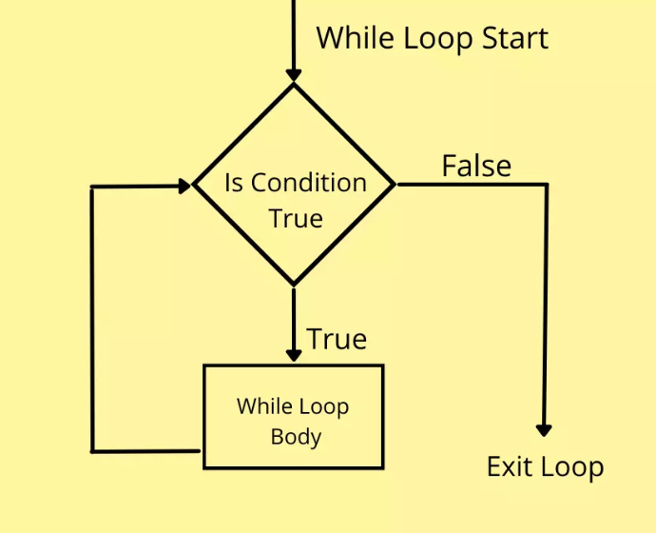
Flowchart of While Loop

Slide 23
Fibonacci series.
Here is the famous sequence of numbers called the Fibonacci series. Here are the first few terms of the series:
1 2 3 5 8 13 21 34 55…..
Write program for printing first 10 numbers of Fibonacci series

Slide 24
The do Loop
In a while loop, the test expression is evaluated at the beginning of the loop. If the test expression is false when the loop is entered, the loop body won’t be executed at all. In some situations this is what you want. But sometimes you want to guarantee that the loop body is executed at least once, no matter what the initial state of the test expression. When this is the case you should use the do loop, which places the test expression at the end of the loop.

Slide 25
Example-Division of Numbers
int main()
{
long dividend, divisor;
char ch;
do //start of do loop
{ //do some processing
cout << “Enter dividend: “; cin >> dividend;
cout << “Enter divisor: “; cin >> divisor;
cout << “Quotient is “ << dividend / divisor;
cout << “, remainder is “ << dividend % divisor;
cout << “\nDo another? (y/n): “; //do it again?
cin >> ch;
}
while( ch != ‘n’ ); //loop condition
return 0;
}

Slide 26
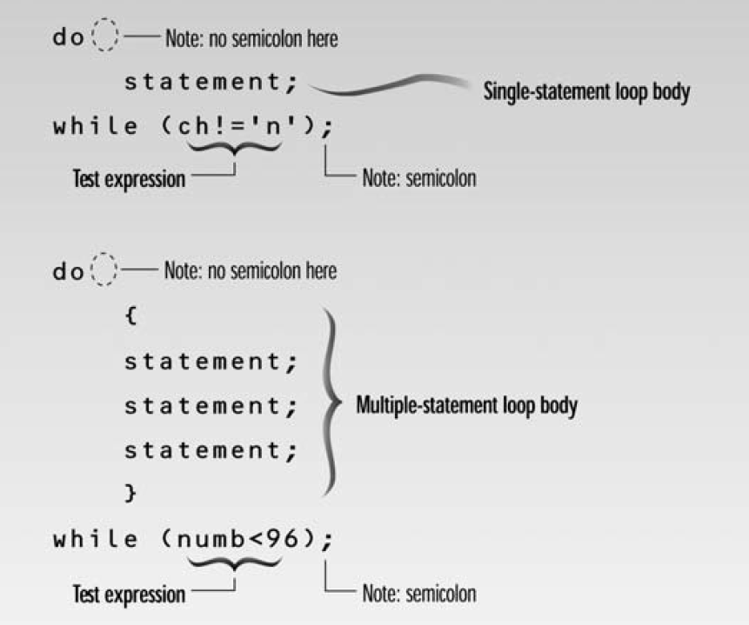

Slide 27
When to Use Which Loop
The for loop is appropriate when you know in advance how many times the loop will be executed. The while and do loops are used when you don’t know in advance when the loop will terminate (the while loop when you may not want to execute the loop body even once, and the do loop when you’re sure you want to execute the loop body at least once).

