Slide 1
Computer Fundamentals
Arrays

Slide 2
Definition
An array is a consecutive group of memory locations that all have the same type and sane name.
Declaring an array:
type arrayName [ arraySize ];
The arraySize must be an integer constant greater than zero and type can be any valid C++ data type

Slide 3
Example
To declare a 5-element array called num of type int, use this statement:
int num[5];
The components are num[0], num[1], num[2], num[3], and num[4]

Slide 4
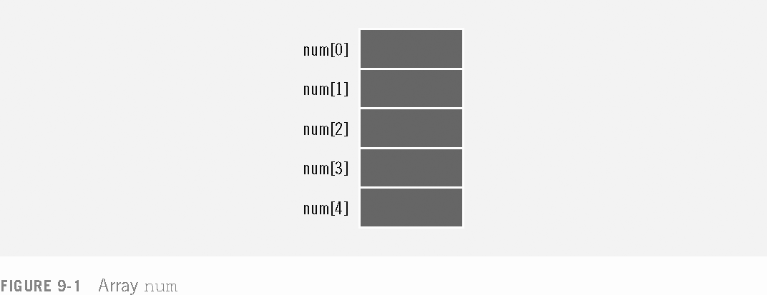

Slide 5
Accessing Array Components
The general form (syntax) of accessing an array component is:
arrayName[indexExp]
where indexExp, called index, is any expression whose value is a nonnegative integer
Index value specifies the position of the component in the array
The [] operator is called the array subscripting operator
The array index always starts at 0

Slide 6
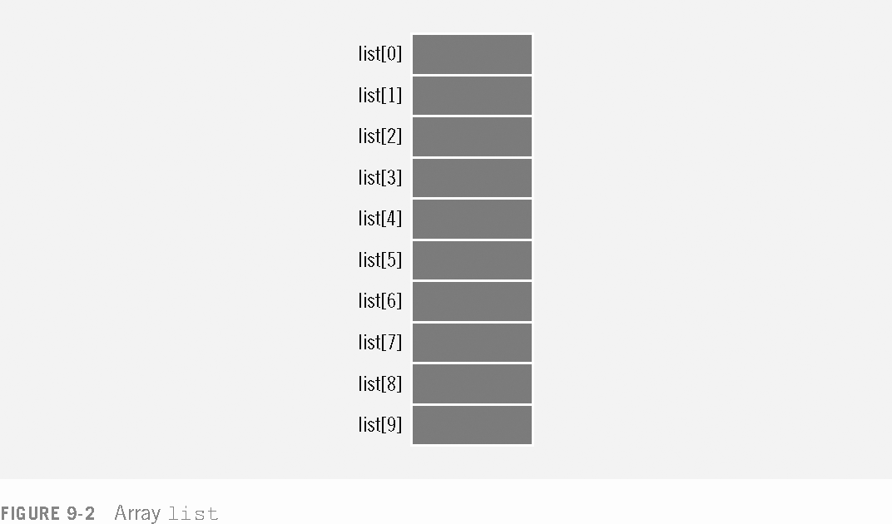

Slide 7
You can also declare arrays as follows:
const int array_size=10;
int list[array_size];
That is, you can first declare a name constant and then use the values of named constant to declare an array and specify its size

Slide 8
Note
Only constants can be used to declare the size of static arrays. Not using constants for this purpose is a compilation error! Why??
not assigning a value to a constant variable when it is declared is a compilation error.
const int x;// error: x must be initialized
x=7; //error: can not modify a constant variable

Slide 9
Processing One-Dimensional Arrays
Some basic operations performed on a one-dimensional array are:
Initialize
Input data
Output data stored in an array
Find the largest and/or smallest element
Each operation requires ability to step through the elements of the array
Easily accomplished by a loop

Slide 10
Accessing Array Components (continued)
Consider the declaration
int list[100]; //list is an array
//of the size 100
This for loop steps through each element of the array list starting at the first element
for (int i = 0; i < 100; i++)//Line 1
//process list[i] //Line 2

Slide 11
Accessing Array Components (continued)
If processing list requires inputting data into list
The statement in Line 2 takes the form of an input statement, such as the cin statement
for (i = 0; i < 100; i++) //Line 1
cin >> list[i]; // Line 2

Slide 14
Array Initialization
As with simple variables
Arrays can be initialized while they are being declared
When initializing arrays while declaring them
Not necessary to specify the size of the array
Size of array is determined by the number of initial values in the braces
For example:
double sales[] = {12.25, 32.50, 16.90, 23,
45.68};

Slide 15
Partial Initialization
The statement
int list[10] = {0};
declares list to be an array of 10 components and initializes all components to zero
The statement
int list[10] = {8, 5, 12};
declares list to be an array of 10 components, initializes list[0] to 8, list[1] to 5, list[2] to 12 and all other components are initialized to 0

Slide 16
Partial Initialization (continued)
The statement
int list[] = {5, 6, 3};
declares list to be an array of 3 components and
initializes list[0] to 5, list[1] to 6, and list[2] to 3
The statement
int list[25]= {4, 7};
declares list to be an array of 25 components
The first two components are initialized to 4 and 7 respectively
All other components are initialized to 0

Slide 17
Restrictions on Array Processing
Assignment does not work with arrays
In order to copy one array into another array we must copy component-wise

Slide 18
Restrictions on Array Processing (continued)

Slide 19
Strings (Character Arrays)
Character array - an array whose components are of type char
String - a sequence of zero or more characters enclosed in double quote marks
C++ stings are null terminated (‘\0’)
The last character in a string is the null character

Slide 20
Strings (Character Arrays) (continued)
There is a difference between 'A' and "A"
'A' is the character A
"A" is the string A
Because strings are null terminated, "A" represents two characters, 'A' and '\0‘
Similarly, "Hello" contains six characters, 'H', 'e', 'l', 'l', 'o', and '\0'

Slide 21
Strings (Character Arrays) (continued)
Consider the statement
char name[16];
Because strings are null terminated and name has sixteen components
the largest string that can be stored in name is 15
If you store a string of length, say 10 in name
the first 11 components of name are used and the last 5 are left unused

Slide 22
Strings (Character Arrays) (continued)
The statement
char name[16] = "John";
declares a string variable name of length 16 and stores "John" in it
The statement
char name[] = "John";
declares a string variable name of length 5 and stores "John" in it

Slide 23
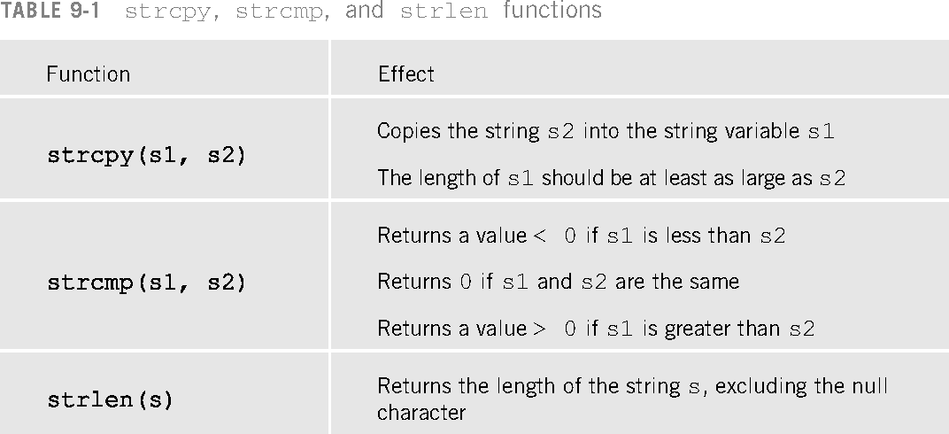

Slide 24
Passing arrays to Functions
C++ passes arrays to functions by reference.
The symbol & is not used when declaring an array as a formal parameter
To pass an array argument to a function, specify the name of array without any brackets.
Since arrays are passed by reference-the called function can modify the element values in the callers’ original arrays.

Slide 25
Example
If array “hourly_temp” is declared as
Int hourly_temp[24];
The function call
modify(hourly_temp,24);
passes array hourly_temp and its size to function modify
When passing an array to a function the array size is normally passed as well, so the function can process the specific number of elements in the array.

Slide 26
Continued…
Although arrays are passed by reference, Individual array elements are passed by value exactly as simple variables are.
To pass an element of an array to a function, use the subscripted name of array element as an argument in the function call.

Slide 27
Continued…
The header of the function who receives an array through function call is like
void modify(int b[], int arraysize)
and prototype will be like
void modify(int [],int);
This prototype could have been written
Void modify(int array_name[],int array_size );
C++ compiler ignores the variable names in prototypes.

Slide 28
void modifyarray(int[],int);
void modifyelement(int);
int main()
{
const int arraysize=5;
int a[arraysize]={0,1,2,3,4};
cout<<"effect of passing entire array by reference:"<<endl;
cout<<"the value of original array are:"<<endl;
for(int i=0;i<arraysize;i++)
cout<<setw(3)<<a[i];
cout<<endl;
modifyarray(a,arraysize);
cout<<"the values of modifyarray are:"<<endl;
for(int j=0;j<arraysize;j++)
cout<<setw(3)<<a[j];
cout<<endl;
cout<<"effect of passing array element by value"<<endl;
cout<<"a[3] before modifyelement"<<a[3]<<endl;
modifyelement(a[3]);
cout<<"a[3] after modify element"<<a[3]<<endl;
return 0;
}

Slide 29
void modifyarray(int b[ ], int sizeofarray)
{
for(int k=0;k<sizeofarray;k++)
b[k]*=2;
}
void modifyelement(int e)
{
cout<<"value of element in modify element"<<(e*=2)<<endl;
}
}

Slide 30
Continued…
The reserved word const in the declaration of the formal parameter can prevent the function from changing the actual parameter

Slide 31
Void trytomodifyarray(const int[],int);
Int main()
{
Clrscr();
Int a[3]={10,20,30};
trytomodifyarray(a,3);
Cout<<a[0]<<a[1]<<a[2]<<endl;
Return 0;
}
Void trytomodifyarray(const int b[],int x)
{
b[0]=3; //error
b[1]=9; //error
b[2]=11; //error
}

Slide 32
Two-Dimensional Arrays
Two-dimensional Array: a collection of a fixed number of components arranged in two dimensions
All components are of the same type
The syntax for declaring a two-dimensional array is:
dataType arrayName[intexp1][intexp2];
where intexp1 and intexp2 are expressions yielding positive integer values

Slide 33
Two-Dimensional Arrays (continued)
The two expressions intexp1 and intexp2 specify the number of rows and the number of columns, respectively, in the array
Two-dimensional arrays are sometimes called matrices or tables

Slide 34
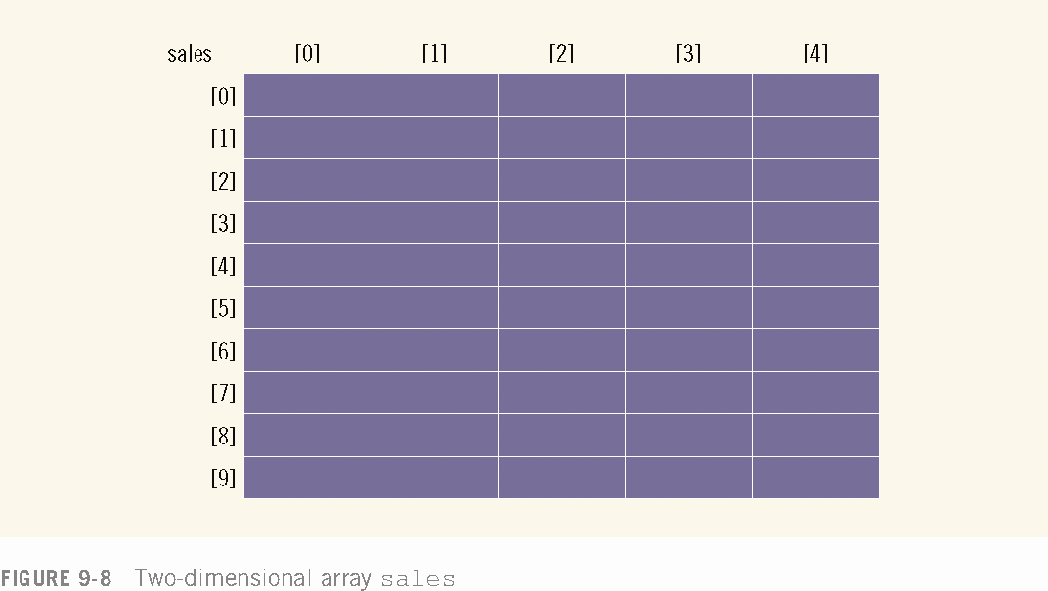

Slide 35
Accessing Array Components
The syntax to access a component of a two-dimensional array is:
arrayName[indexexp1][indexexp2]
where indexexp1 and indexexp2 are expressions yielding nonnegative integer values
indexexp1 specifies the row position and indexexp2 specifies the column position

Slide 36
Initialization
Like one-dimensional arrays
Two-dimensional arrays can be initialized when they are declared
To initialize a two-dimensional array when it is declared
Elements of each row are enclosed within braces and separated by commas
All rows are enclosed within braces
For number arrays, if all components of a row are not specified, the unspecified components are initialized to zero

Slide 37
Processing Two-Dimensional Arrays
A two-dimensional array can be processed in three different ways:
Process the entire array
Process a particular row of the array, called row processing
Process a particular column of the array, called column processing

Slide 38
Processing Two-Dimensional Arrays (continued)
Each row and each column of a two-dimensional array is a one-dimensional array
When processing a particular row or column of a two-dimensional array
we use algorithms similar to processing one-dimensional arrays

Slide 42
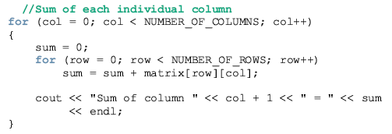

Slide 43
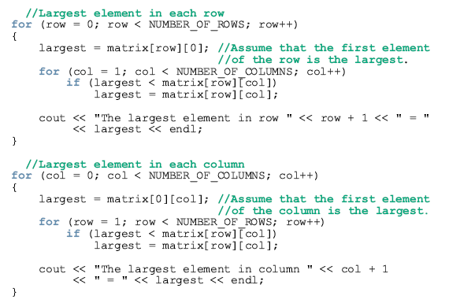

Slide 44
Sorting array elements
Sorting array means placing the elements of an array in some particular order
You can sort the arrays either in ascending order or descending order
Types of sorting algorithm
Insertion sort
Bubble Sort
Merge sort
Selection sort

Slide 45
Insertion Sort
Algorithm
The first iteration of this algorithm takes the second element and, if it is less than the first element, swaps it with the first element(means program inserts the second element in front of the first element ). The second iteration looks at the third element and inserts it into the correct position with respect to the first two elements, so all three elements are in order. At the ith iteration of this algorithm, the first I elements in the original array will be sorted.

Slide 46
main()
{
clrscr();
const int array_size=10;
int data[array_size]={12,1,5,66,0,9,54,23,11,18};
int insert;
cout<<"unsorted array:"<<endl;
for(int i=0;i<array_size;i++)
cout<<setw(4)<<data[i];
for(int next =1;next<array_size;next++)
{
insert=data[next];
int moveitem=next;
while((moveitem>0)&& (data[moveitem-1]>insert))
{
data[moveitem]=data[moveitem-1];
moveitem--;
}
data[moveitem]=insert;
}
cout<<endl;
cout<<"sorted array:"<<endl;
for(int k=0;k<array_size;k++)
cout<<data[k]<<" ";
cout<<endl;
getch();
return 0;
}

Slide 47
Bubble sort
Algorithm
It works by comparing two neighboring values of list and swapping(exchanging) them if they required.
To sort an array of ‘n’ elements, n-1 passes(iterations)are required. In first pass, the largest value is shifted to the last element of array. In the second pass, the second largest value moves to the second last element of the array and so on.

Slide 48
"Bubbling Up" the Largest Element
Traverse a collection of elements
Move from the front to the end
“Bubble” the largest value to the end using pair-wise comparisons and swapping
1 2 3 4 5 6
77
42
35
12
101
5

Slide 49
"Bubbling Up" the Largest Element
Traverse a collection of elements
Move from the front to the end
“Bubble” the largest value to the end using pair-wise comparisons and swapping
Swap
1 2 3 4 5 6
42
77
77
42
35
12
101
5

Slide 50
"Bubbling Up" the Largest Element
Traverse a collection of elements
Move from the front to the end
“Bubble” the largest value to the end using pair-wise comparisons and swapping
1 2 3 4 5 6
Swap
35
77
42
77
35
12
101
5

Slide 51
"Bubbling Up" the Largest Element
Traverse a collection of elements
Move from the front to the end
“Bubble” the largest value to the end using pair-wise comparisons and swapping
1 2 3 4 5 6
Swap
12
77
42
35
77
12
101
5

Slide 52
"Bubbling Up" the Largest Element
Traverse a collection of elements
Move from the front to the end
“Bubble” the largest value to the end using pair-wise comparisons and swapping
1 2 3 4 5 6
42
35
12
77
101
5
No need to swap

Slide 53
"Bubbling Up" the Largest Element
Traverse a collection of elements
Move from the front to the end
“Bubble” the largest value to the end using pair-wise comparisons and swapping
1 2 3 4 5 6
Swap
5
101
42
35
12
77
101
5

Slide 54
"Bubbling Up" the Largest Element
Traverse a collection of elements
Move from the front to the end
“Bubble” the largest value to the end using pair-wise comparisons and swapping
1 2 3 4 5 6
101
42
35
12
77
5
Largest value correctly placed

Slide 55
#include<iostream.h>
#include<conio.h>
main()
{
clrscr();
int a[10]={76,12,4,89,0,23,1,1,65,112};
cout<<"unsorted array is:"<<endl;
for(int l=0;l<10;l++)
{
cout<<a[l]<<" "<<endl;
}
for(int i=0;i<9;i++)
{
for(int k=0;k<10;k++)
{
if(a[k]>a[k+1])
{
int temp=a[k];
a[k]=a[k+1];
a[k+1]=temp;
}
}
}
cout<<"sorted array is:"<<endl;
for(int u=0;u<10;u++)
{
cout<<a[u]<<" ";
}
getch();
return 0;
}

