Slide 1
Programming Fundamentals
Ms. Asma Mushtaq
asmamushtaq@gcu.edu.pk

Slide 2
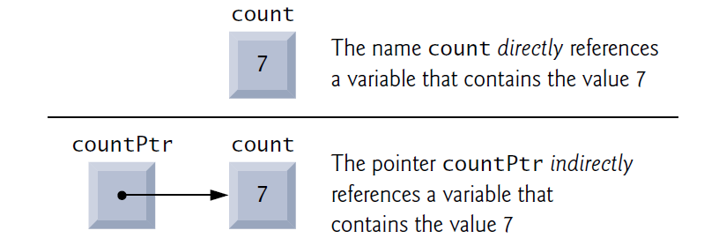
Pointers in C++
Pointers are variables whose values are memory addresses. Normally, a variable directly contains a specific value. A pointer, however, contains an address of a variable that contains a specific value. In this sense, a variable name directly references a value, and a pointer indirectly references a value. Referencing a value through a pointer is called indirection.

Slide 3
What are pointers for?
Here are some common uses:
Accessing array elements.
Passing arguments to a function when the function needs to modify the original argument.
Passing arrays and strings to functions.
Obtaining memory from the system.
Creating data structures such as linked lists.

Slide 4
Declaring Pointers
Pointers, like all variables, must be defined before they can be used. The definition
int *countPtr, count;
specifies that variable countPtr is of type int * (i.e., a pointer to an integer) and is read (right to left), “countPtr is a pointer to int” or “countPtr points to an object2 of type int.”

Slide 5
The Address-of Operator &
You can find the address occupied by a variable by using the address-of operator &. Here’s a short program, VARADDR, that demonstrates how to do this:
int main()
{
int var1 = 11; //define and initialize
int var2 = 22; //three variables
int var3 = 33;
cout << &var1 << endl //print the addresses Output
<< &var2 << endl //of these variables
<< &var3 << endl;
return 0;
}

Slide 6
Declaring Pointers
Also, the variable count is defined to be an int, not a pointer to an int. The * applies only to countPtr in the definition. When * is used in this manner in a definition, it indicates that the variable being defined is a pointer. Pointers can be defined to point to objects of any type.
We prefer to include the letters Ptr in pointer variable names to make it clear that these variables are pointers and need to be handled appropriately.
float flovar = 98.6;
int* ptrint = &flovar; //ERROR: can’t assign float* to int*

Slide 7
Initializing and Assigning Values to Pointers
int main()
{
int var1 = 11; //two integer variables
int var2 = 22;
cout << &var1 << endl //print addresses of variables
<< &var2 << endl << endl;
int* ptr; //pointer to integers
ptr = &var1; //pointer points to var1
cout << ptr << endl; //print pointer value
ptr = &var2; //pointer points to var2
cout << ptr << endl; //print pointer value
return 0;
}

Slide 8
Pointers to other variable types
The problem is that the compiler needs to know what kind of variable the pointer points to. The syntax used in C++ allows pointers to any type to be declared:
char* cptr; // pointer to char
int* iptr; // pointer to int
float* fptr; // pointer to float
Distance* distptr; // pointer to user-defined Distance class
and so on.

Slide 9
Accessing the Variable Pointed To
Suppose that we don’t know the name of a variable but we do know its address. Can we access the contents of the variable?
There is a special syntax to access the value of a variable using its address instead of its name.
int main()
{
int var1 = 11; //two integer variables
int var2 = 22;
int* ptr; //pointer to integers
ptr = &var1; //pointer points to var1
cout << *ptr << endl; //print contents of pointer (11)
ptr = &var2; //pointer points to var2
cout << *ptr << endl; //print contents of pointer (22)
return 0;
}

Slide 10
Another Example
You can use a pointer not only to display a variable’s value, but also to perform any operation you would perform on the variable directly. Here’s a program, that uses a pointer to assign a value to a variable, and then to assign that value to another variable:
int main()
{
int var1, var2; //two integer variables
int* ptr; //pointer to integers
ptr = &var1; //set pointer to address of var1
*ptr = 37; //same as var1=37
var2 = *ptr; //same as var2=var1
cout << var2 << endl; //verify var2 is 37
return 0;
}

Slide 11
Pointers and Arrays
There is a close association between pointers and arrays.
int main()
{
int intarray[5] = { 31, 54, 77, 52, 93 };
for(int j=0; j<5; j++) //for each element,
cout << *(intarray+j) << endl; //print value dereference operator (*).
return 0;
}

Slide 12
Another Example
int main()
{
int intarray[] = { 31, 54, 77, 52, 93 }; //array
int* ptrint; //pointer to int
ptrint = intarray; //points to intarray
for(int j=0; j<5; j++) //for each element,
cout << *(ptrint++) << endl; //print value
return 0;
}

