Slide 1
Programming Fundamentals
Functions in C++
Ms. Asma Mushtaq
asmamushtaq@gcu.edu.pk

Slide 2
What are the functions ?
A function groups a number of program statements into a unit and gives it a name. This unit can then be invoked from other parts of the program.
The most important reason to use functions is to aid in the conceptual organization of a program. Dividing a program into functions is, “The Big Picture,” one of the major principles of structured programming.

Slide 3
Another reason to use functions (and the reason they were invented, long ago) is to reduce program size. Any sequence of instructions that appears in a program more than once is a candidate for being made into a function. The function’s code is stored in only one place in memory, even though the function is executed many times in the course of the program.

Slide 4
Main Parts of a Function in C++?
In C++, a function typically consists of several main parts that define how it works and interacts with other code. Here's a breakdown:
Return Type
Specifies the type of value the function will return.
If the function doesn't return anything, use void.
Example
int add(int a, int b); // returns an int
void greet(); // returns nothing

Slide 5
Function Prototype (Declaration)
This tells the compiler about the function's name, return type, and parameters before its actual definition. It's usually written at the top of the program or in a header file.
return_type function_name(parameter_list);
Example
int add(int, int); // function prototype
Note: You don’t need to include parameter names in the prototype, just types are enough.
(You can also use the keyword void in parentheses to indicate that the function takes no arguments, as is often done in C, but leaving them empty is the more common practice in C++.)

Slide 6
Function Definition
This is where the actual logic of the function is written. It matches the prototype in terms of return type, name, and parameters.
Syntax:
return_type function_name(parameter_list)
{
// function body (logic)
}
Example
int add(int a, int b)
{
return a + b;
}

Slide 7
Function Call
This is where you use the function — typically in main() or another function — by passing actual arguments.
Syntax:
function_name(argument_list);
Example
int result = add(5, 3); // function call

Slide 8
Function Name
Identifies the function.
Should follow naming rules (no spaces, start with a letter or underscore, etc.)
Example
int add(int a, int b); // 'add' is the function name

Slide 9
Parameter List
Inside parentheses (), it specifies the input(s) the function takes.
Each parameter has a type and a name.
Example
int add(int a, int b); // two parameters: a and b of type int

Slide 10
Function Body
Enclosed in { }, it contains the statements that define what the function does.
May include local variables, logic, return statements, etc.
Example
int add(int a, int b)
{
return a + b;
}

Slide 11
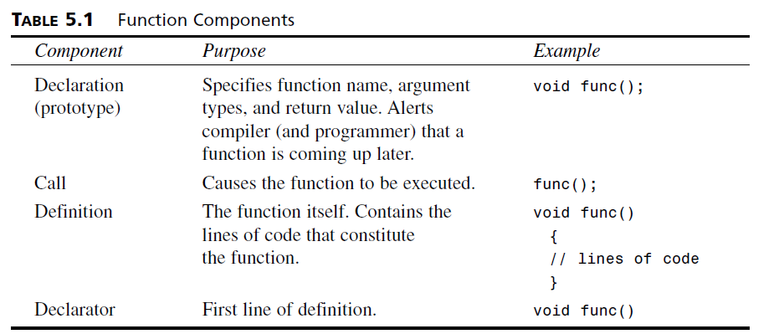
Function Components

Slide 12
Simple Functions
int main()
{
starline(); //call to function
cout << “Data type Range” << endl;
starline(); //call to function
cout << “char -128 to 127” << endl
<< “short -32,768 to 32,767” << endl
<< “int System dependent” << endl
<< “long -2,147,483,648 to 2,147,483,647” << endl;
starline(); //call to function
return 0;
}

Slide 13
function definition
void starline() //function declarator
{
for(int j=0; j<45; j++) //function body
cout << ‘*’;
cout << endl;
}

Slide 14
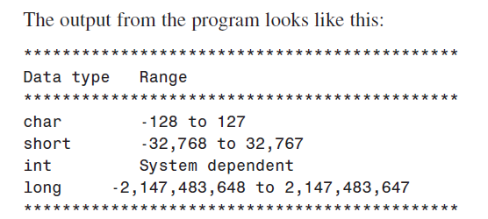
Output

Slide 15
Eliminating the Declaration
The second approach to inserting a function into a program is to eliminate the function declaration and place the function definition (the function itself) in the listing before the first call to the function.

Slide 16
// starline() //function definition
void starline()
{
for(int j=0; j<45; j++)
cout << ‘*’;
cout << endl;
}
//--------------------------------------------------------------
int main() //main() follows function
{
starline(); //call to function
cout << “Data type Range” << endl;
starline(); //call to function
cout << “char -128 to 127” << endl
<< “short -32,768 to 32,767” << endl
<< “int System dependent” << endl
<< “long -2,147,483,648 to 2,147,483,647” << endl;
starline(); //call to function
return 0;
}

