Slide 1
Electromagnetic Field Theory
By: Ms. Asma Mushtaq
asmamushtaq@gcu.edu.pk

Slide 2
Why circuit theory fails at high frequency ?
Circuit theory, which is based on the principles of Kirchhoff's laws and Ohm's law, is a powerful and widely used tool for analyzing electrical circuits at low to moderate frequencies. However, it does have limitations when applied to high-frequency circuits, and these limitations arise from several factors:
Parasitic Elements Electromagnetic Radiation
Transmission Line Effects Wave Nature of Signals
Non-Ideal Components
Skin Effect and Dielectric Loss

Slide 3
Parasitic Capacitance
Capacitance has an impedance that decreases with increasing frequency, following the relation:
Z=1/2πfC​
At high frequencies, even small parasitic capacitances can present low impedance paths, allowing high-frequency signals to couple or leak between circuit nodes.

Slide 4
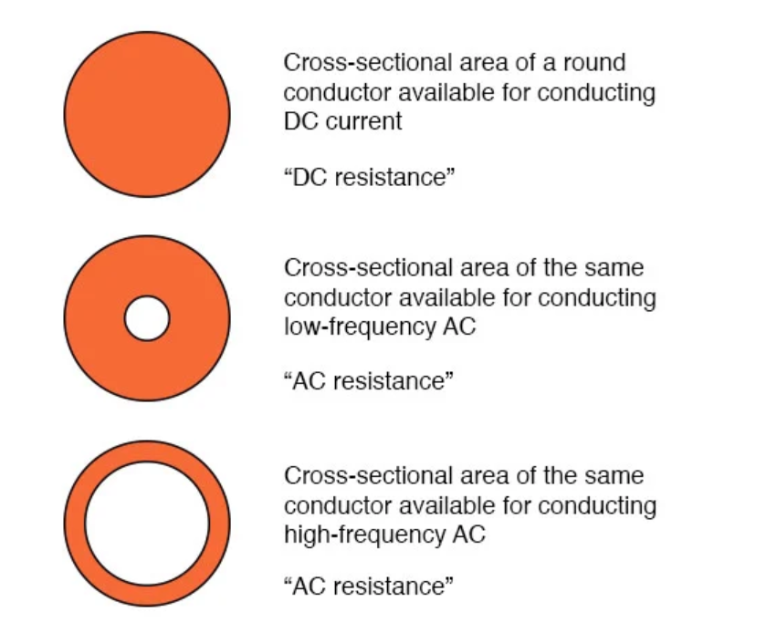
Skin Effect
skin effect is where alternating current tends to avoid travel through the center of a solid conductor, limiting itself to conduction near the surface.

Slide 5
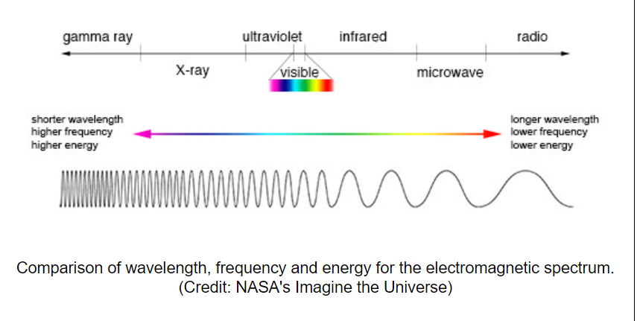
Electromagnetic Spectrum
The electromagnetic (EM) spectrum is the range of all types of EM radiation. Radiation is energy that travels and spreads out as it goes – the visible light that comes from a lamp in your house and the radio waves that come from a radio station are two types of electromagnetic radiation. The other types of EM radiation that make up the electromagnetic spectrum are microwaves, infrared light, ultraviolet light, X-rays and gamma-rays.

Slide 6
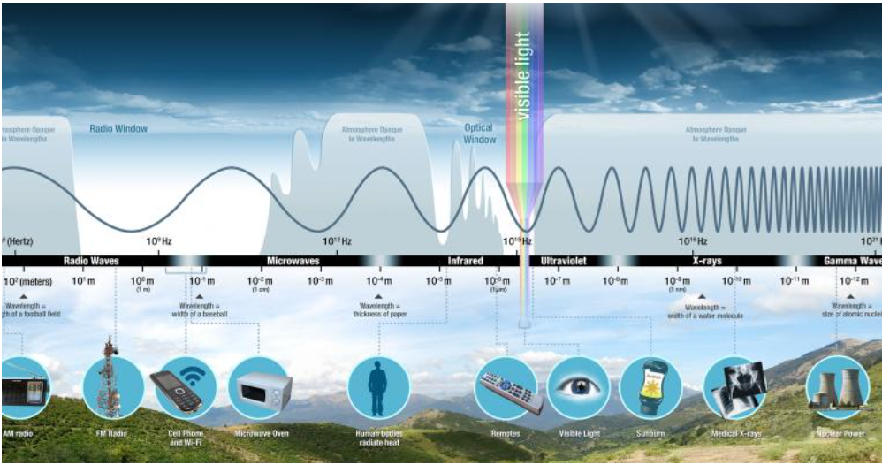
Electromagnetic Spectrum
https://science.nasa.gov/ems/01_intro

Slide 7
Electromagnetic Spectrum
Electromagnetic energy travels in waves and spans a broad spectrum from very long radio waves to very short gamma rays. The human eye can detect only a small portion of this spectrum called visible light. A radio detects a different portion of the spectrum, and an x-ray machine uses yet another portion.
When you tune your radio, watch TV, send a text message, or pop popcorn in a microwave oven, you are using electromagnetic energy.

Slide 8
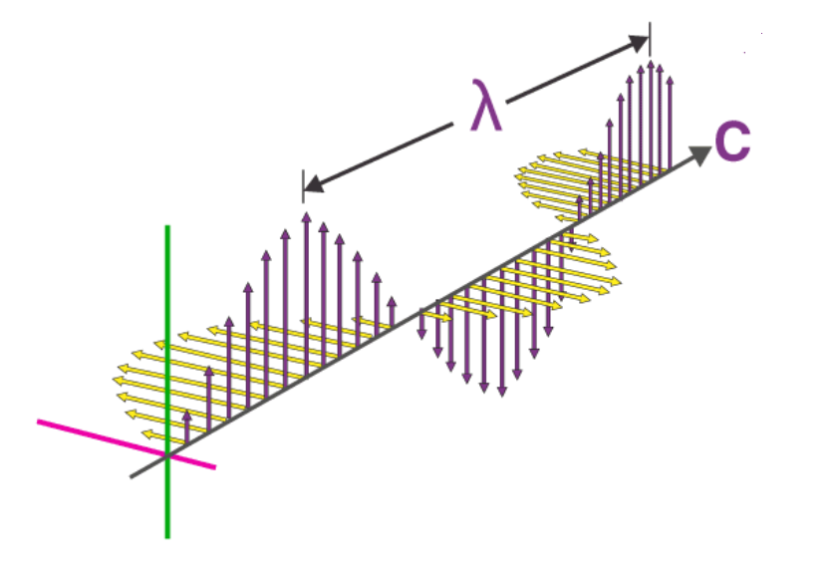
Properties of Electromagnetic Waves
Electric and Magnetic Fields: Electromagnetic waves consist of both electric and magnetic fields that oscillate perpendicular to each other and to the direction of wave propagation. The changing electric field induces a magnetic field, and vice versa, creating a self-sustaining wave.

Slide 9
Properties of Electromagnetic Waves
Transverse Waves: Direction of oscillation (vibration) of the electric and magnetic fields is perpendicular to the direction of wave propagation.
Speed of Light: Electromagnetic waves, including visible light, radio waves, microwaves, and X-rays, all travel at the speed of light in a vacuum, which is approximately 3 x 10⁸ m/s.
Wavelength: Electromagnetic waves have a characteristic wavelength, denoted by the Greek letter lambda (λ). Wavelength is the distance between two consecutive points in the wave that are in phase (e.g., two consecutive crests or troughs).

Slide 10
Properties of Electromagnetic Waves
Frequency: Electromagnetic waves have a frequency, denoted by the symbol 'f,' which is the number of oscillations (cycles) per unit of time. Frequency is inversely proportional to wavelength, and the relationship is given by the equation:
f=c/ λ
Propagation through a Vacuum: Electromagnetic waves can propagate through a vacuum, such as outer space, without the need for a medium (unlike mechanical waves like sound, which require a medium like air, water, or solids for transmission).

Slide 11
SCALARS AND VECTORS
The term scalar refers to a quantity whose value may be represented by a single (positive or negative) real number. The x, y, and z we use in basic algebra are scalars, and the quantities they represent are scalars.
Example:
If a body falling a distance L in a time t
the temperature T at any point in a bowl of soup whose coordinates are x, y, and z.
Other scalar quantities are mass, density, pressure (but not force), volume, resistivity, and voltage.

Slide 12
SCALARS AND VECTORS
A vector quantity has both a magnitude and a direction in space.
Example
Force, velocity, acceleration, and a straight line from the positive to the negative terminal of a storage battery are examples of vectors. Each quantity is characterized by both a magnitude and a direction.
vectors may be defined in n-dimensional space in more advanced applications.

Slide 13
What is a Scalar and a Vector Field?
A field (scalar or vector) may be defined mathematically as some function that connects an arbitrary origin to a general point in space. We usually associate some physical effect with a field, such as the force on a compass needle in the earth’s magnetic field, or the movement of smoke particles in the field defined by the vector velocity of air in some region of space. Note that the field concept invariably is related to a region. Some quantity is defined at every point in a region. Both scalar fields and vector fields exist.

Slide 14
Vector Field
The temperature throughout the bowl of soup and the density at any point in the earth are examples of scalar fields. The gravitational and magnetic fields of the earth, the voltage gradient in a cable, and the temperature gradient in a soldering-iron tip are examples of vector fields. The value of a field varies in general with both position and time.

Slide 15
Vector Analysis
Vector Algebra (Vectors Addition, Subtraction, Multiplication-Dot and Cross Product)
Orthogonal Coordinate Systems (Cartesian, cylindrical, Spherical)
Vector Calculus (Integration and Differentiation)

Slide 16
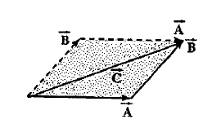

Vector Algebra
Vector Addition
$\vec{A}+\vec{B}$=$\vec{B}+\vec{A}$ commutative property
$\vec{A}+(\vec{B}+\vec{C}$)=$(\vec{A}+\vec{B})+\vec{C}$ Associativity

Slide 17
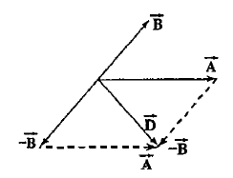

Vector Algebra
Vector Subtraction

Slide 18
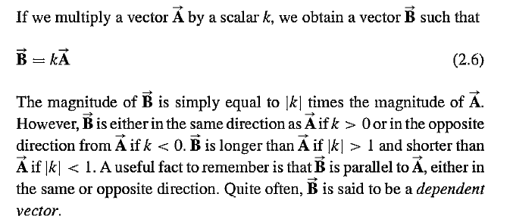
Multiplication of a Vector by Scalar

Slide 19
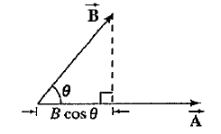
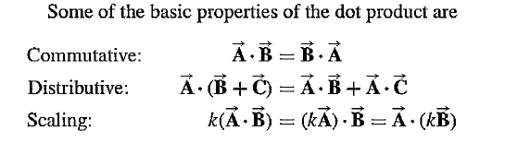


Product of Two Vectors
Product of two vectors is defined in two ways:
Dot Product
Cross Product

Slide 20




Scalar projection of a vector onto another Vector

Slide 21

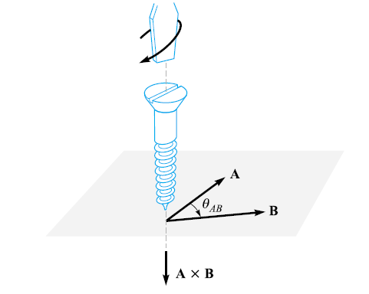
Vector or Cross Product

Slide 22
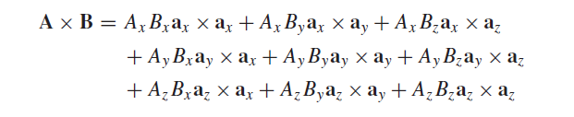
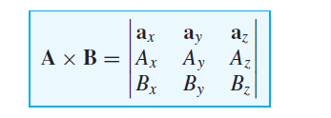
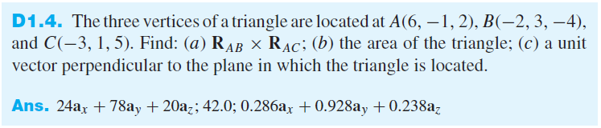
Vector or Cross Product

Slide 23
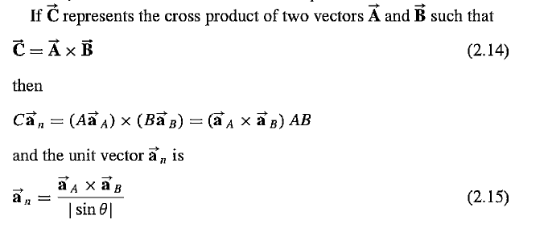
Cross Product

Slide 24
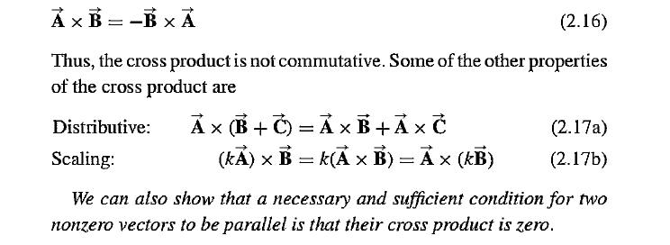
Properties of Cross Product

Slide 25
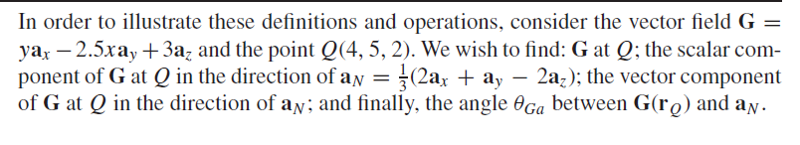
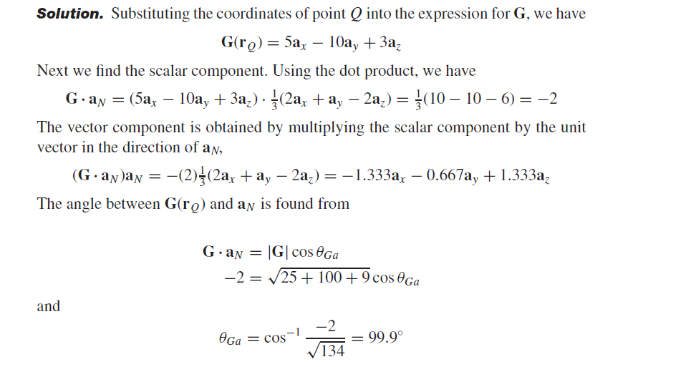

Slide 26
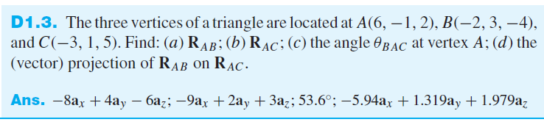
Numerical

Slide 27
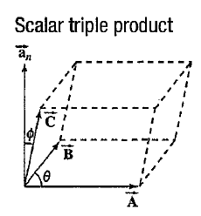

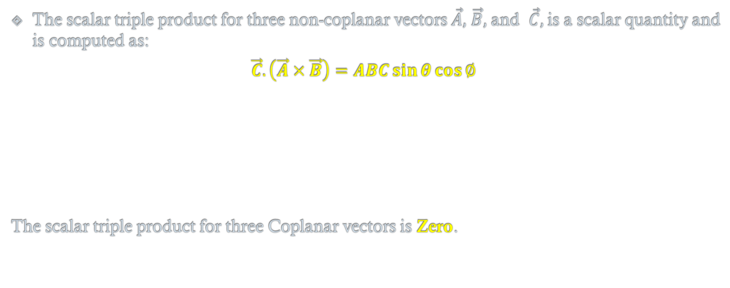
Scalar Triple Product
The scalar triple product for three non-coplanar vectors $\vec{A},$ $\vec{B},$ and $\vec{C},$is a scalar quantity and is computed as:
$$\vec{C}.\left(\vec{A}×\vec{B}\right)=ABC\sin{θ}\cos{∅}$$
The scalar triple product for three Coplanar vectors is Zero.

Slide 28
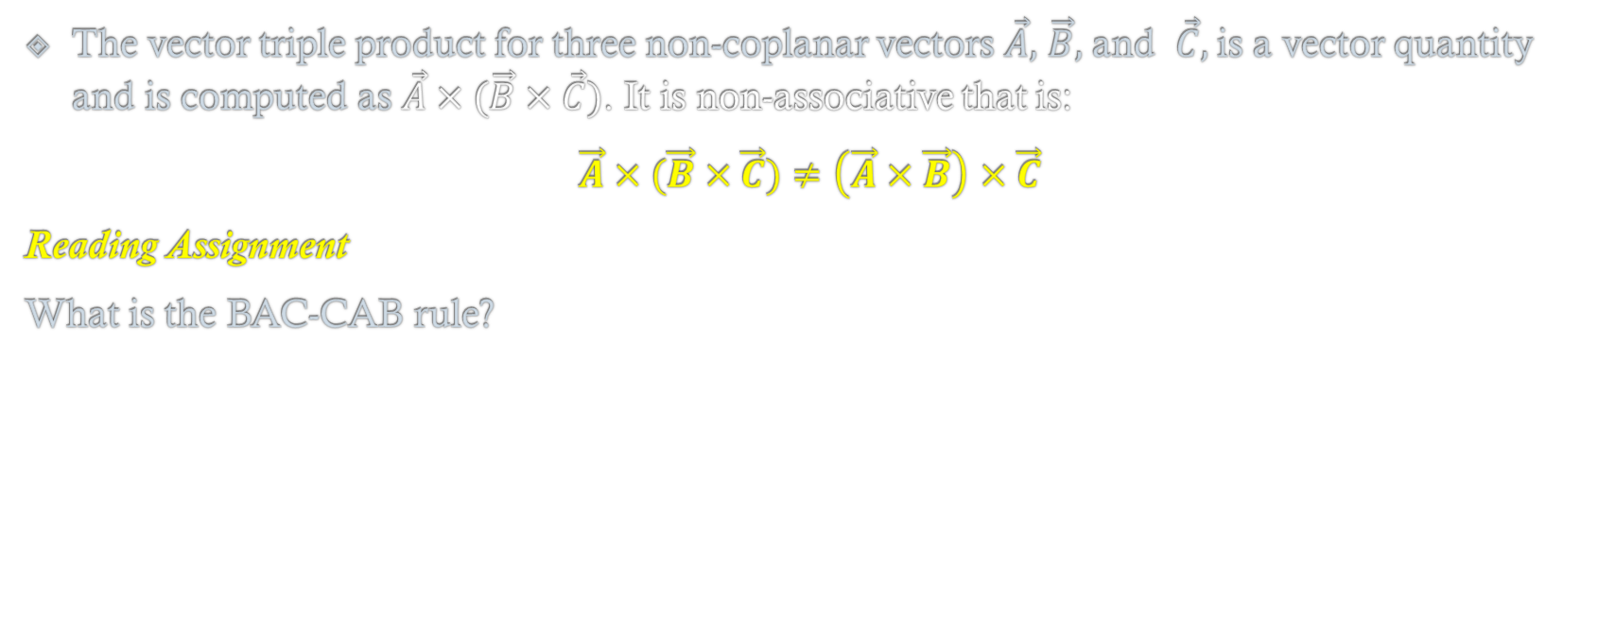
Vector Triple Product
The vector triple product for three non-coplanar vectors $\vec{A},$ $\vec{B},$ and $\vec{C},$is a vector quantity and is computed as $\vec{A}×(\vec{B}×\vec{C})$. It is non-associative that is:
$\vec{A}×(\vec{B}×\vec{C})≠\left(\vec{A}×\vec{B}\right)$ $×\vec{C}$
Reading Assignment
What is the BAC-CAB rule?

