Slide 1
Applied Thermodynamics
3rd Lecture
Asma Mushtaq
Electrical Engineering Department,
GCU, Lahore
asmamushtaq@gcu.edu.pk

Slide 2
Working Fluid
In thermodynamics, independent properties of a fluid are characteristics that can be used to describe the state of the fluid without being dependent on each other. Here are two independent properties commonly used for fluids:
Pressure
Temperature
Why They Are Independent?
Pressure and temperature are considered independent because you can change one without directly affecting the other in certain conditions. For example, in a closed system, you can heat a gas at a constant pressure or compress it at a constant temperature.

Slide 3
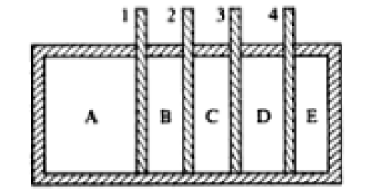
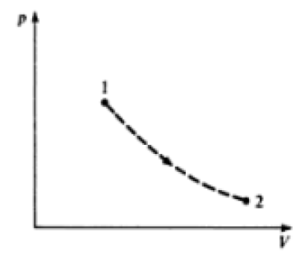

Work done by the working fluid
For a reversible process:
The work done=-$\int{pdv}$
For an irreversible process the work done is not equal to -$\int{pdv}$

Slide 4
Free Expansion
When a fluid expands without a restraining force being exerted by the surroundings as explained in the previous example the process is known as free expansion.
Free expansion is highly irreversible.

Slide 5
Conservation of Energy and 1st Law of Thermodynamics
The Principle of Conservation of Energy states that:
Energy can neither be created nor destroyed; it can only change from one form to another. The total energy of an isolated system always remains constant over time.
When a system undergoes a complete thermodynamic cycle the intrinsic energy of the system is the same at the beginning and end of the cycle. During the various processes that make up the cycle work is done on or by the fluid and heat is supplied or rejected; the network input can be defined as ΣW, and the net heat supplied as ΣQ, where the symbol Σ represents the sum for a complete cycle.

Slide 6
1st Law of Thermodynamics
Since the intrinsic energy of the system is unchanged the First Law of Thermodynamics states that:
When a system undergoes a thermodynamic cycle then the net heat supplied to the system from its surroundings plus the net work input to the system from its surroundings must be equal zero.
That is:
ΣW+ ΣQ=0
ΣQ

Slide 7
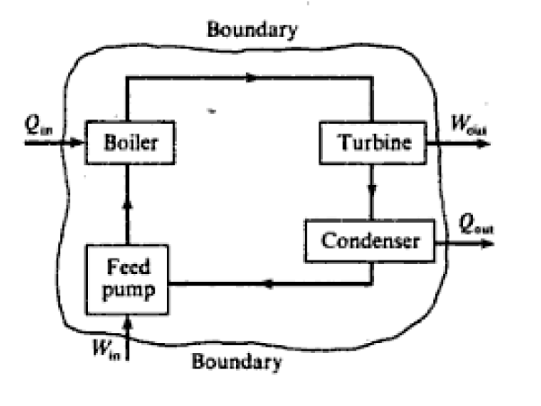
Example
In a certain steam plant the turbine develops 1000 kW. The heat supplied to the steam in the boiler is 2800 kJ/kg, the heat rejected by the steam to the cooling water in the condenser is 2100 kJ/kg and the feed-pump work required to pump the condensate back into the boiler is 5 kW. Calculate the steam flow rate.
https://www.youtube.com/watch?v=QFZN71MY71o

Slide 8
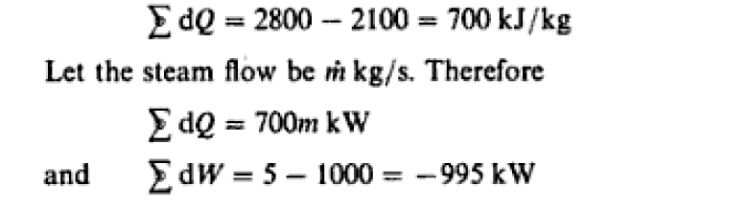
Solution
For unit mass flow rate:
1Watt (W)=1 Joule per second (J/s)

Slide 9
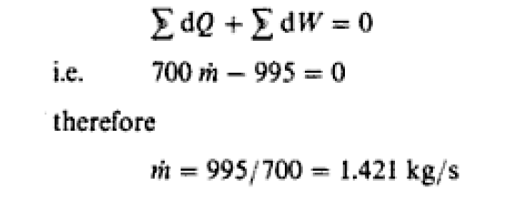

Slide 10
The non-flow Equation
It is stated that when a system possessing a certain intrinsic energy is made to undergo a cycle by heat and work transfer, then the net heat supplied plus the net work input is zero. This is true for a complete cycle when the final intrinsic energy of the system is equal to its initial value.
Consider now a process in which the intrinsic energy of the system is finally greater than the initial intrinsic energy. The sum of the net heat supplied and the net work input has increased the intrinsic energy of the system, i.e.
Gain in intrinsic energy=Net heat supplied + net work input

Slide 11
The non-flow Equation
When the net effect is to transfer energy from the system, then there will be a loss in the intrinsic energy of the system.
When a fluid is not in motion then its intrinsic energy per unit mass is known as the specific internal energy of the fluid and is given the symbol u. The specific internal energy of a fluid depends on its pressure and temperature, and is itself a property.

Slide 12

The non-flow Equation
The internal energy of mass, m, of a fluid is written as U, i.e. mu= U. The units of internal energy, U, are usually written as kJ. Since internal energy is a property, then gain in internal energy in changing from state 1 to state 2 can be written U2- U1. Also,
gain in internal energy net heat supplied + net work input,
This equation is true for a process or series of processes between state 1 and state 2 provided there is no flow of fluid into or out of the system. In any one non-flow process there will be either heat supplied or heat rejected, but not both; similarly there will be either work input or work output, but not both. Hence,
U2- U1 =Q+W for a non-flow process

Slide 13
The non-flow Equation
For a unit mass
u2- u1 =Q+W
For small amount of heat supplied dQ, a small amount of work done on the fluid dW, and the small gain in specific internal energy du, then
dQ+dW=du

Slide 14
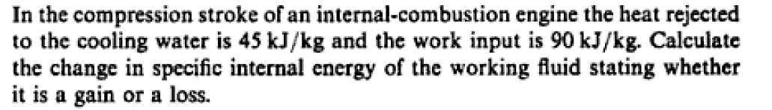
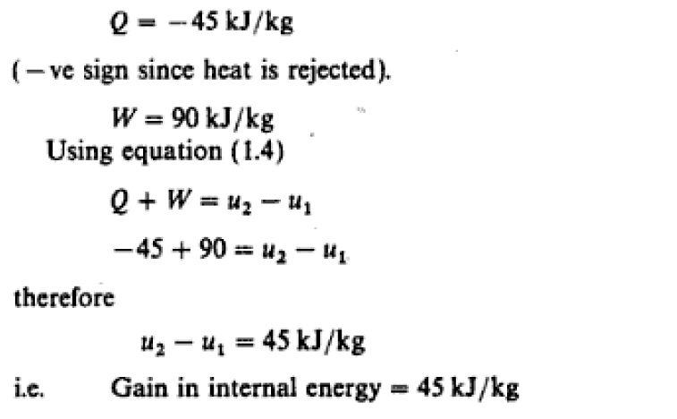

Slide 15
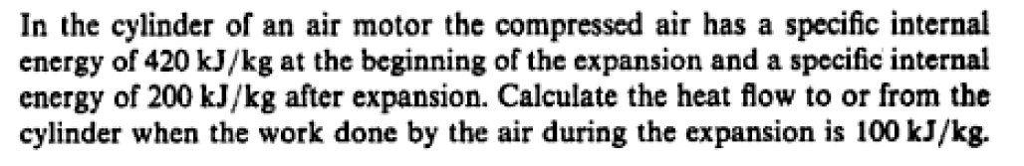
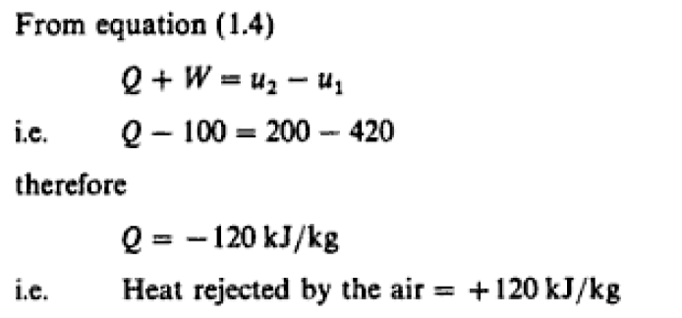

Slide 16
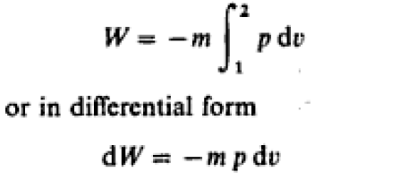
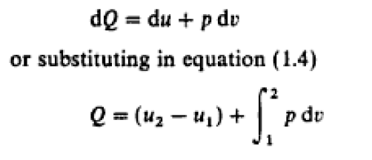
Important Point
The previous equations are true whether or not a process is reversible. These are energy equations. For a reversible non-floe process:

Slide 17
Note
It is found that the volume occupied by 1kg of boiling liquid at a higher pressure is slightly higher than the volume occupied by 1kg of the same liquid when it is boiling at the lower pressure.
Reason
When a liquid boils, it transitions from the liquid phase to the vapor phase, forming a mixture of liquid and vapor. At a higher pressure, the boiling point of the liquid is elevated, requiring the liquid to reach a higher temperature before it can boil.
At this higher temperature, the molecules have more kinetic energy, causing them to move apart slightly more than they would at a lower boiling point.

Slide 18
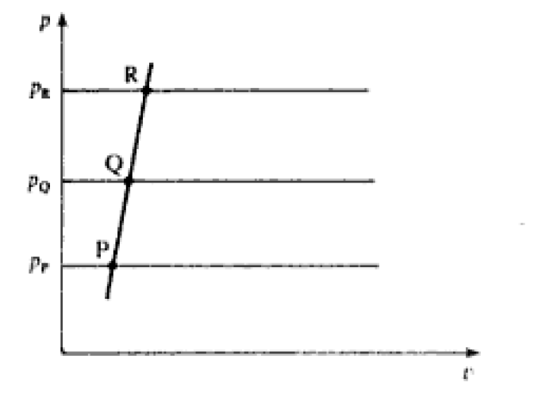
Boiling Points Plotted on p-v Diagram

Slide 19
Vaporization
When a liquid is heated further at its boiling point, several important processes and phenomena occur:
1. Phase Change to Vapor
At the boiling point, the liquid is already undergoing a phase change where some of the liquid molecules gain enough energy to escape into the vapor phase.
If the liquid continues to be heated, more molecules will gain sufficient kinetic energy to transition from the liquid phase to the vapor phase, leading to an increase in the amount of vapor generated.

Slide 20
Vaporization
2. Constant Temperature During Boiling
During the phase change, the temperature of the liquid remains constant despite the addition of heat. This is because the energy supplied is used for the phase transition (latent heat of vaporization) rather than increasing the temperature.
The heat added during this process goes into breaking intermolecular forces in the liquid, allowing the molecules to escape as vapor.
The heat supplied is called specific enthalpy of vaporization.

Slide 21
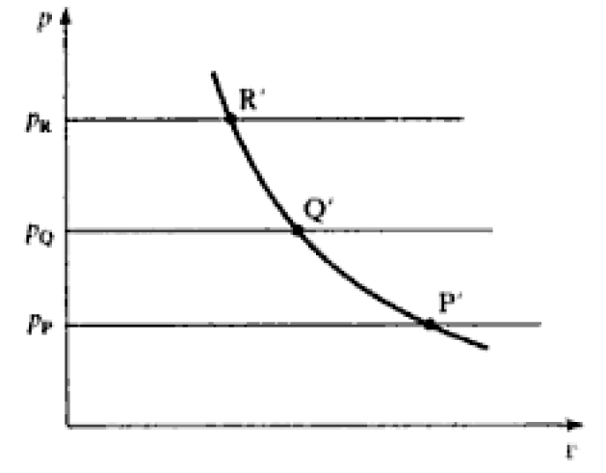
Points of Vaporization Plotted on P-V Diagram

Slide 22
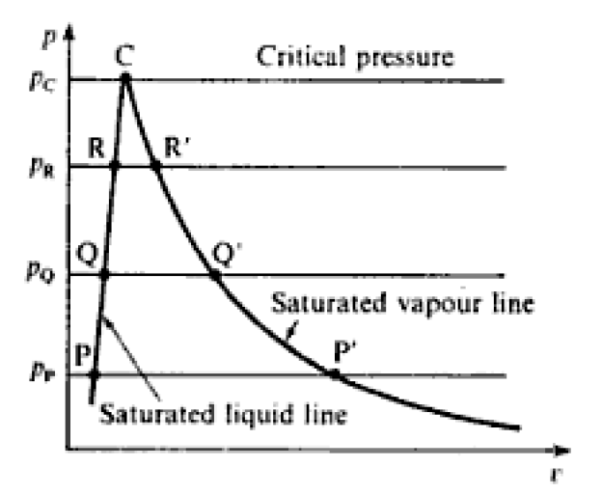
Boiling and Vaporization Combined Together

Slide 23
What is the critical Point?
The critical point is defined as the temperature and pressure at which a substance can coexist as both liquid and vapor. Beyond this point, the distinction between liquid and vapor phases disappears, resulting in a single phase known as the supercritical fluid.
At the critical point, the liquid and vapor phases become indistinguishable, meaning:
Density of liquid = Density of vapor.
Temperature and pressure are at their critical values (e.g., for water, Tc≈374∘C, Pc​≈22.064MPa

Slide 24
Prove that the specific enthalpy of vaporization is zero at the critical point
Phase Equilibrium: At the critical point, the liquid and gas phases are indistinguishable. This means that there is no phase transition occurring.
No Energy Required: If there is no phase transition, no additional energy is required to convert the substance from a liquid to a gas or vice versa.
Zero Enthalpy of Vaporization: Since no energy is required for the phase transition, the specific enthalpy of vaporization must be zero.

Slide 25
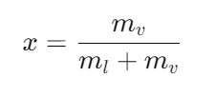
Wet Vapor
Wet vapor, also known as saturated vapor, refers to a mixture of liquid and vapor phases of a substance at the saturation point. Here are the key characteristics and concepts related to wet vapor:
Wet vapor is the state of a vapor that contains both liquid droplets and gaseous vapor. It exists at the boiling point of the liquid at a given pressure. The term indicates that the vapor has not completely transitioned to the vapor phase and still has some liquid present.
The state of wet vapor is often described using the dryness fraction (or quality), denoted by xxx, which is the ratio of the mass of vapor to the total mass of the mixture (liquid + vapor):

Slide 26
Saturation State
A saturation state is defined as a state at which change of phase may occur without change of pressure and temperature. The boiling points P,Q, and R are in saturation states and series of such boiling points joined up is called the saturated liquid line.
Example:
Consider a pot of water on a stove. As the water is heated, its temperature increases. Eventually, the water reaches its boiling point. At this point, the water is in a saturated state. If we continue to heat the water, the temperature will remain constant until all the water has vaporized. During this phase change, the pressure of the water vapor remains constant.

Slide 27
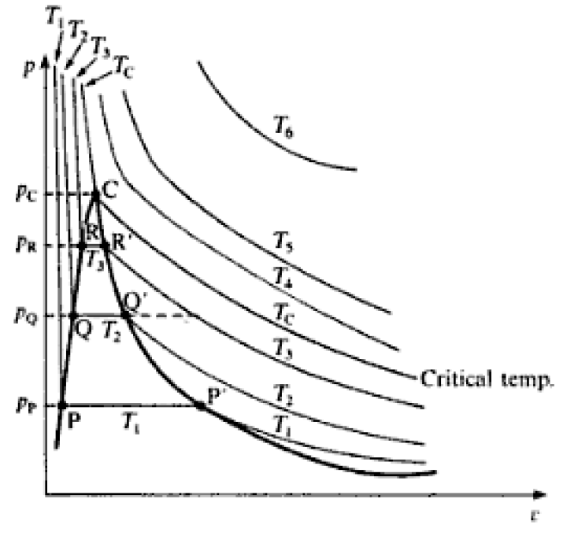

Slide 28
Saturated Temperature
A saturated temperature is the temperature at which a substance, under a given pressure, will change its phase from a liquid to a vapor or vice versa. In other words, it's the temperature at which a substance can coexist in both liquid and vapor phases in equilibrium.
Example
If water is heated in an open container at standard atmospheric pressure, the saturated temperature is 100°C. At this temperature, the water will boil and change from a liquid to a vapor state. If the temperature is lowered below 100°C, the vapor will condense back into a liquid.

Slide 29
What is the Triple Point?
The triple point is a unique condition where the three phases of a substance—solid, liquid, and vapor—can coexist in thermodynamic equilibrium. For water:
Pressure: 611.7 Pa (0.006112 bar)
Temperature: 0.01°C (273.16 K)
At this point, the energy difference between phases is minimal, making it a natural baseline.

Slide 30
Why is the Specific Internal Energy Set to Zero?
Simplifies Thermodynamic Calculations
  Setting the internal energy of saturated liquid to zero at the triple point makes energy calculations more straightforward.
  Any change in internal energy during a process is then measured relative to this zero reference.
The specific internal energy of saturated liquid is taken as zero at the triple point for simplicity, convenience, and consistency in thermodynamics. This convention ensures that energy changes across different phases and processes can be measured relative to a well-defined, universal baseline.

Slide 31
Superheated vapor
Superheated vapor refers to a vapor that is heated beyond its saturation temperature at a given pressure. This state occurs after the vapor has been completely vaporized and is no longer in equilibrium with its liquid phase.

