Slide 1
Applied Thermodynamics
4th Lecture
Asma Mushtaq
Electrical Engineering Department,
GCU, Lahore
asmamushtaq@gcu.edu.pk

Slide 2
The Study Flow Equation
The steady flow energy equation (SFEE) is an application of the First Law of Thermodynamics to a control volume where mass continuously enters and leaves.
It is mainly applied to turbines, compressors, pumps, nozzles, diffusers, boilers, condensers, and heat exchangers under steady-state conditions.

Slide 3
Assumptions of Steady Flow
Steady State – All properties at any point in the control volume do not change with time.
Control Volume – A fixed region in space through which fluid flows.
Energy Transfer – Energy can cross the boundary as heat, work, or mass.
Mass Conservation – Mass flow rate entering = mass flow rate leaving (continuity equation).

Slide 4
The Study Flow Equation
The specific internal energy (u=U/m) of a fluid was said to be the intrinsic energy of the fluid due to its thermodynamic properties. When unit mass of a fluid with specific internal energy, u, is moving with velocity C and is a height Z above a datum level, then it possesses a total energy of u+ (C²/2) + Zg, where C²/2 is the kinetic energy of unit mass of the fluid and Zg is the potential energy of unit mass of the fluid.
In most practical problems the rate at which the fluid flows through a machine or piece of apparatus is constant. This type of flow is called steady flow.

Slide 5
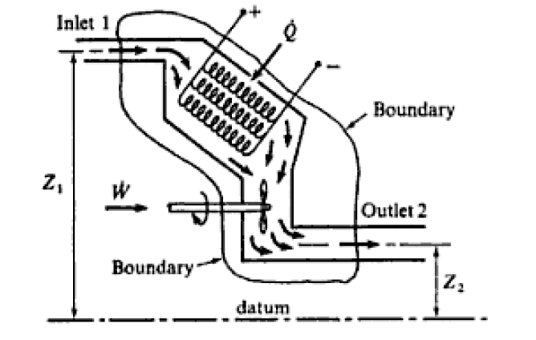
The Study Flow Equation
Consider a fluid flowing in steady flow with a mass flow rate, m, through a piece of apparatus shown in the figure below. This constitutes an open system. The boundary is shown cutting the inlet pipe at section 1 and the outlet pipe at section 2. This boundary is sometimes called a control surface, and the system encompassed, a control volume.

Slide 6
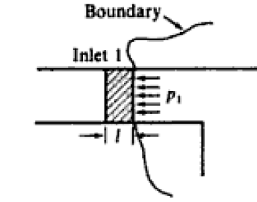
The Study Flow Equation
Let it be assumed that a steady rate of flow of heat Q units is supplied, and that W is the rate of work input on the fluid as it passes through the apparatus. Now in order to introduce the fluid across the boundary an expenditure of energy is required; similarly in order to push the fluid across the boundary at exit, an expenditure of energy is required. Consider an element of fluid, length I, and let the cross-sectional area of the inlet pipe be A,. Then we have
Energy required to push element across boundary= (P₁ A₁) x l = P₁ x (volume of fluid element)

Slide 7
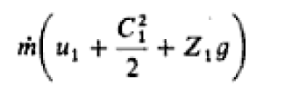
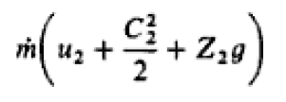
The Study Flow Equation
Therefore, Energy required for unit mass flow rate of fluid = p₁v₁
Where v₁ is the specific volume of the fluid at section 1. Similarly it can be shown that
Energy required at exit to push unit mass flow rate of fluid across the boundary =p₂v₂
Consider now the energy entering and leaving the system. The energy entering the system consists of the energy of the flowing fluid at inlet
the energy term mp₁v₁, the heat supplied Q, and the rate of work input, W. The energy leaving the system consists of the energy of the flowing fluid at the outlet section

Slide 8
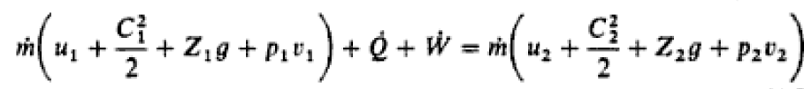
The Study Flow Equation
and the energy term mp₂v₂. Since there is steady flow of fluid into and out of the system, and there are steady flows of heat and work, then the energy entering must exactly equal the energy leaving.
In nearly all problems in applied thermodynamics, changes in height are negligible and the potential energy terms can be omitted from the equation. The terms in u and pv occur on both sides of the equation and always will do so in a flow process, since a fluid always possesses a certain internal energy, and the term pv always occurs at inlet and outlet as seen in the above proof. The sum of specific internal energy and the pv term is given the symbol h, and is called specific enthalpy.

Slide 9
The Study Flow Equation
Specific Enthalpy:
h=u+pv
The specific enthalpy of a fluid is a property of the fluid, since it consists of the sum of a property and the product of two properties. Since specific enthalpy is a property like specific internal energy, pressure, specific volume, and temperature, it can be introduced into any problem whether the process is a flow process or a non-flow process. The enthalpy of mass, m, of a fluid can be written as H (i.e. mh = H). The units of h are the same as those of internal energy.

Slide 10
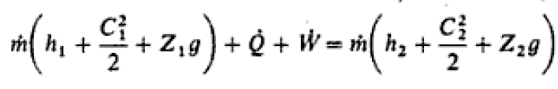
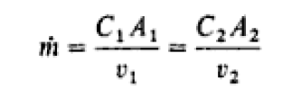
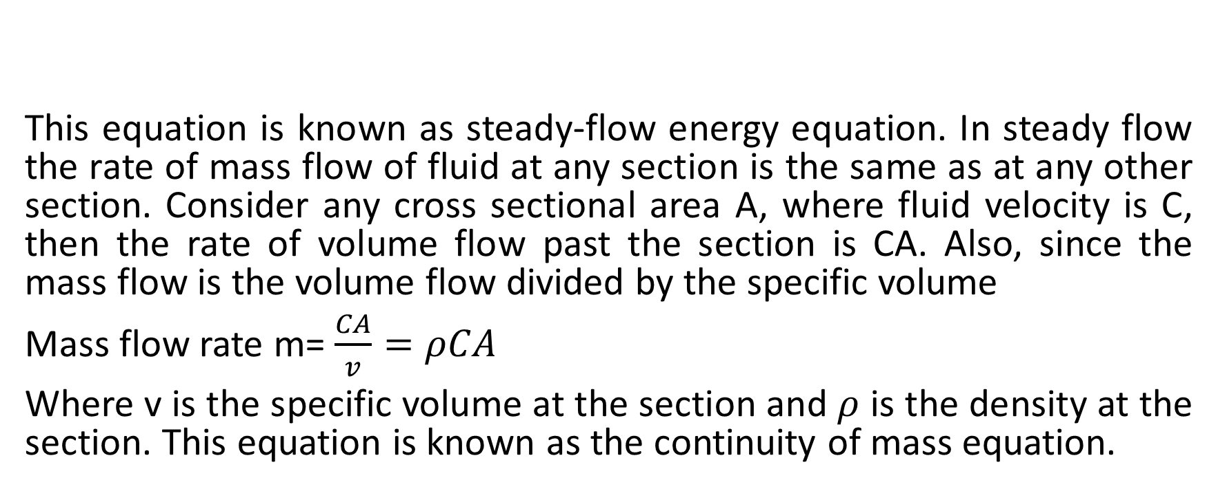
The Study Flow Equation
This equation is known as steady-flow energy equation. In steady flow the rate of mass flow of fluid at any section is the same as at any other section. Consider any cross sectional area A, where fluid velocity is C, then the rate of volume flow past the section is CA. Also, since the mass flow is the volume flow divided by the specific volume
Mass flow rate m= $\frac{CA}{v}=ρCA$
Where v is the specific volume at the section and $ρ$ is the density at the section. This equation is known as the continuity of mass equation.

Slide 11
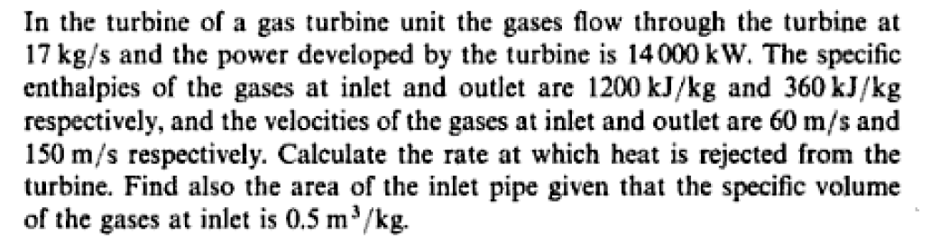
Example

Slide 12
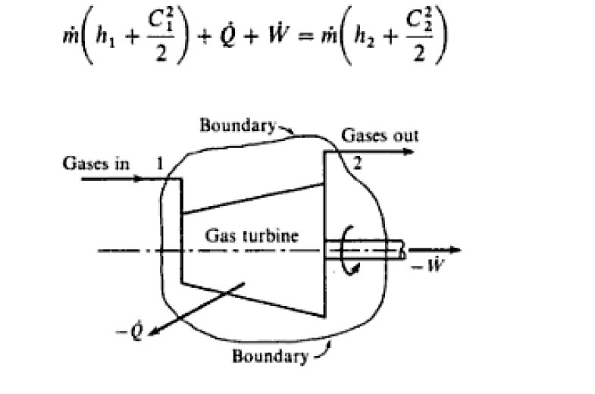
Solution

Slide 13
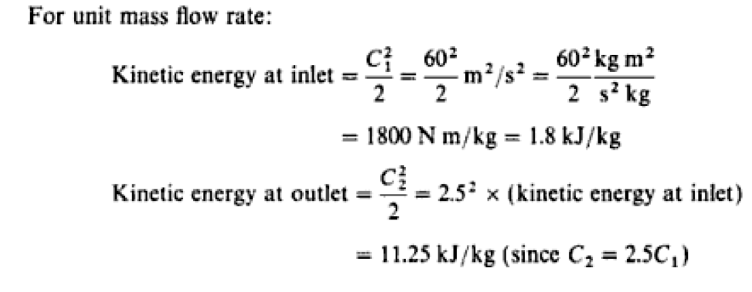

Slide 14
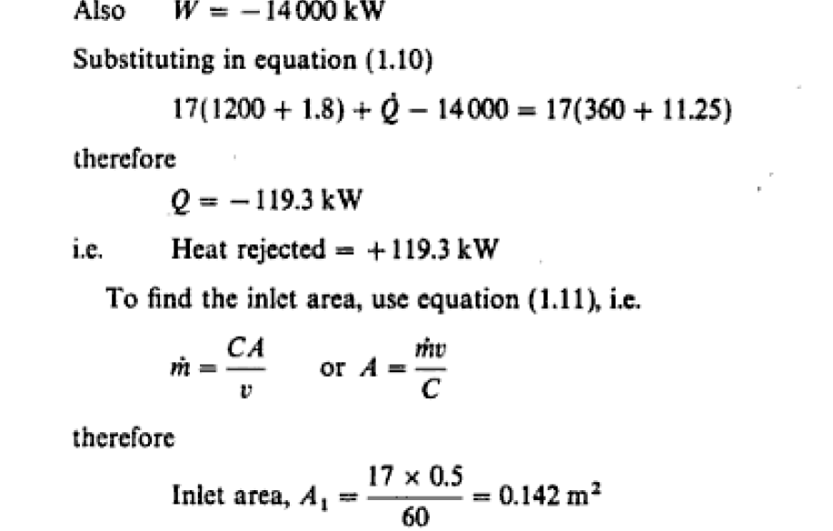

Slide 15
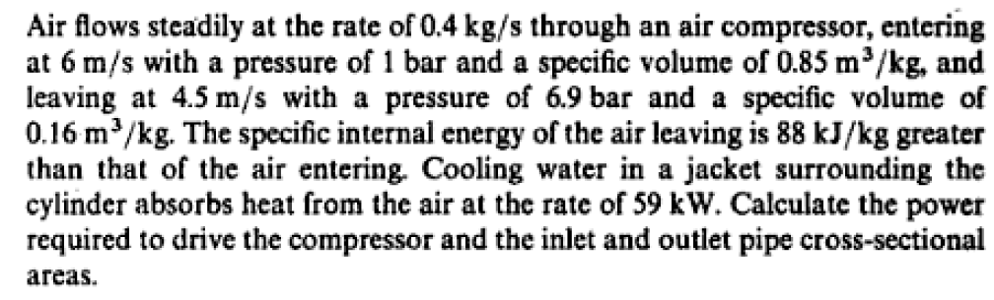
Practice problem

