Slide 1
Applied Thermodynamics
5th Lecture
Asma Mushtaq
Electrical Engineering Department,
GCU, Lahore
asmamushtaq@gcu.edu.pk

Slide 2
The Working Fluid
Matter contained within the boundaries of a system is defined as the working fluid, and it is stated that when two independent properties of the fluid are known then the thermodynamic state of the fluid is defined. In thermodynamic systems the working fluid can be in the liquid, vapour, or gaseous phase. All substances can exist in any one of these phases, but we tend to identify all substances with the phase in which they are in equilibrium at atmospheric pressure and temperature. For instance, substances such as oxygen and nitrogen are thought of as gases; H2O is thought of as liquid or vapour (ie. water or steam); mercury is thought of as a liquid. All these substances can exist in different phases: oxygen and nitrogen can be liquefied; H2O can become a gas at very high temperatures; mercury can be vaporized and will act as a gas if the temperature is raised high enough.

Slide 3
Liquid, Vapour, and Gas
Boiling
When a liquid is heated at any one constant pressure there is one fixed temperature at which bubbles of vapour form in the liquid; this phenomenon is known as boiling. The higher the pressure of the liquid then the higher the temperature at which boiling occurs. It is also found that the volume occupied by 1 kg of a boiling liquid at a higher pressure is slightly larger than the volume occupied by 1 kg of the same liquid when it is boiling at a low pressure.
Reason:
Liquids are generally incompressible, but they expand slightly with temperature.
So, if a liquid boils at higher pressure → it has a higher boiling temperature → density decreases slightly → specific volume increases.

Slide 4
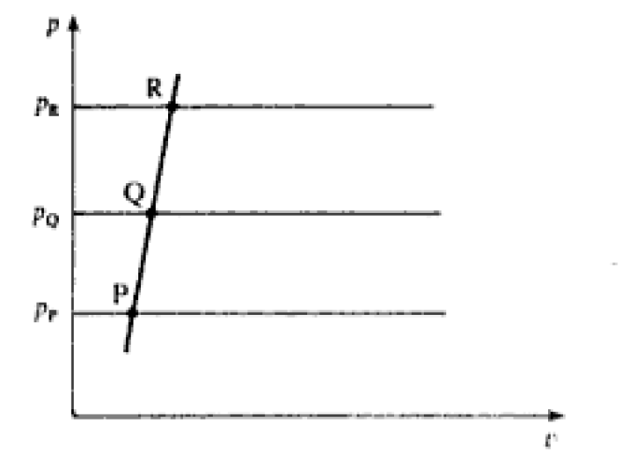
Liquid, Vapour, and Gas
A series of boiling-points plotted on a p-v diagram will appear as a sloping line, as shown in next Fig. The points P, Q, and R represent the boiling-points of a liquid at pressure P_{p}. P_{Q}, and P_{R} respectively.

Slide 5
Vaporization
When a liquid at boiling-point is heated further at constant pressure the additional heat supplied changes the phase of the substance from liquid to vapour; during this change of phase the pressure and temperature remain constant. The heat supplied is called the specific enthalpy of vaporization. It is found that the higher the pressure then the smaller is the amount of heat required. There is a definite value of specific volume of the vapour at any one pressure, at the point at which vaporization is complete giving a series of points shown in the next figure.

Slide 6
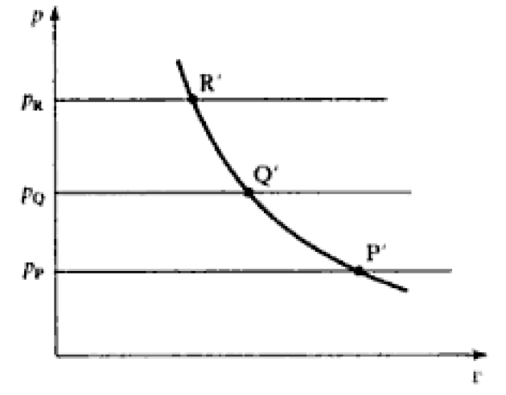
Points of Vaporization Plotted on P-V Diagram

Slide 7
Vaporization
1. Phase Change to Vapor
At the boiling point, the liquid is already undergoing a phase change where some of the liquid molecules gain enough energy to escape into the vapor phase.
If the liquid continues to be heated, more molecules will gain sufficient kinetic energy to transition from the liquid phase to the vapor phase, leading to an increase in the amount of vapor generated.

Slide 8
Vaporization
2. Constant Temperature During Boiling
During the phase change, the temperature of the liquid remains constant despite the addition of heat. This is because the energy supplied is used for the phase transition (latent heat of vaporization) rather than increasing the temperature.
The heat added during this process goes into breaking intermolecular forces in the liquid, allowing the molecules to escape as vapor.
The heat supplied is called specific enthalpy of vaporization.

Slide 9
Boiling and Vaporization Combined Together
When two curves already drawn are extended to higher pressures they form a continuous curve, thus forming a loop. The pressure at which a turning point occurs is called the critical pressure and the turning point itself is called the critical point (point C).

Slide 10
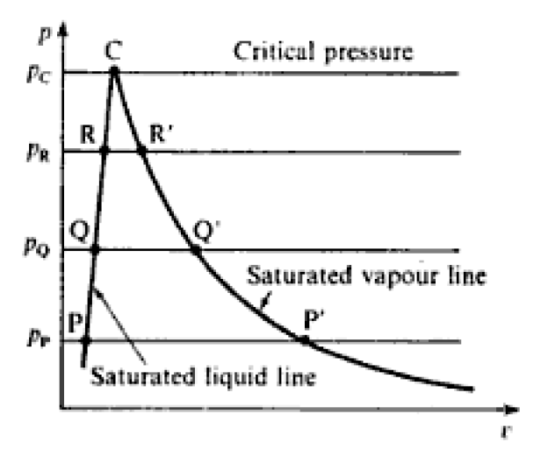
Boiling and Vaporization Combined Together

Slide 11
What is the critical Point?
The critical point is defined as the temperature and pressure at which a substance can coexist as both liquid and vapor. Beyond this point, the distinction between liquid and vapor phases disappears, resulting in a single phase known as the supercritical fluid.
At the critical point, the liquid and vapor phases become indistinguishable, meaning:
Density of liquid = Density of vapor.
Temperature and pressure are at their critical values (e.g., for water, Tc≈374∘C, Pc​≈22.064MPa

Slide 12
Prove that the specific enthalpy of vaporization is zero at the critical point
It can be seen that at the critical point the specific enthalpy of vaporization is zero.
Phase Equilibrium: At the critical point, the liquid and gas phases are indistinguishable. This means that there is no phase transition occurring.
No Energy Required: If there is no phase transition, no additional energy is required to convert the substance from a liquid to a gas or vice versa.
Zero Enthalpy of Vaporization: Since no energy is required for the phase transition, the specific enthalpy of vaporization must be zero.

Slide 13
Wet Vapours
The substance existing at a state point inside the loop consists of a mixture of liquid and dry vapour and is known as a wet vapour.
Wet vapor, also known as saturated vapor, refers to a mixture of liquid and vapor phases of a substance at the saturation point.

Slide 14
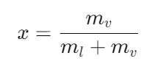
Key Characteristics of Wet Vapor
Here are the key characteristics and concepts related to wet vapor:
Wet vapor is the state of a vapor that contains both liquid droplets and gaseous vapor. It exists at the boiling point of the liquid at a given pressure. The term indicates that the vapor has not completely transitioned to the vapor phase and still has some liquid present.
The state of wet vapor is often described using the dryness fraction (or quality), denoted by x, which is the ratio of the mass of vapor to the total mass of the mixture (liquid + vapor):

Slide 15
Saturation State
A saturation state is defined as a state at which a change of phase may occur without change of pressure or temperature. Hence the boiling-points P, Q, and R are saturation states, and a series of such boiling-points joined up is called the saturated liquid line. Similarly the points P', Q', and R', at which the liquid is completely changed into vapour, are saturation states, and a series of such points joined up is called the saturated vapour line. The word 'saturation' as used here refers to energy saturation.
It means substance has reached the maximum energy content at a given pressure and temperature before a phase change occurs.

Slide 16
Saturation State Example
Consider a pot of water on a stove. As the water is heated, its temperature increases. Eventually, the water reaches its boiling point. At this point, the water is in a saturated state. If we continue to heat the water, the temperature will remain constant until all the water has vaporized. During this phase change, the pressure of the water vapor remains constant.

Slide 17
Saturation State Example
So, a slight addition of heat to a boiling liquid changes some of it into a vapour, and it is no longer a liquid but is now a wet vapour. Similarly when a substance just on the saturated vapour line is cooled slightly, droplets of liquid will begin to form, and the saturated vapour becomes a wet vapour. A saturated vapour is usually called dry saturated to emphasize the fact that no liquid is present in the vapour in this state. Lines of constant temperature, called isothermals, can be plotted on a p-v diagram as shown in next figure.

Slide 18
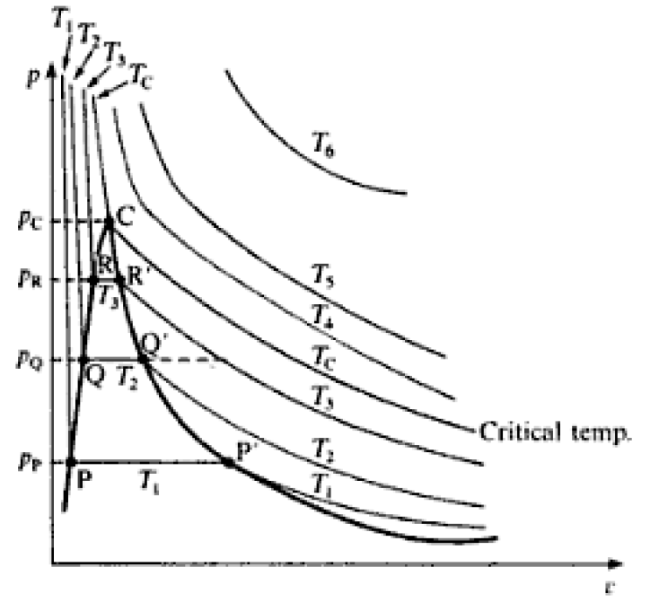

Slide 19
Saturated Temperature
A saturated temperature is the temperature at which a substance, under a given pressure, will change its phase from a liquid to a vapor or vice versa. In other words, it's the temperature at which a substance can coexist in both liquid and vapor phases in equilibrium.
Example
If water is heated in an open container at standard atmospheric pressure, the saturated temperature is 100°C. At this temperature, the water will boil and change from a liquid to a vapor state. If the temperature is lowered below 100°C, the vapor will condense back into a liquid.

Slide 20
Saturated Temperature
The temperature lines become horizontal between saturated liquid line and saturated vapour line (line between P and P’, Q and Q’, R and R’). So there is a corresponding saturation temperature for each saturation pressure.

Slide 21
Superheated Vapour
When a dry saturated vapour is heated at constant pressure its temperature rises and it becomes superheated.
Superheated vapor refers to a vapor that is heated beyond its saturation temperature at a given pressure. This state occurs after the vapour has been completely vaporized and is no longer in equilibrium with its liquid phase.

Slide 22
Degree of Superheat
The difference between the actual temperature of the superheated vapour and the saturation temperature at the pressure of the vapour is called the degree of superheat.
It is stated that two independent properties are sufficient to define the state of a substance. Now between P and P', Q and Q', R and R' the temperature and pressure are not independent since they remain constant for a range of values of v. For example, a substance at P_{Q} and T₂ could be a saturated liquid, a wet vapour, or a dry saturated vapour. The state cannot be defined until one other property (e.g. specific volume) is given. The condition or quality of a wet vapour is most frequently defined by its dryness fraction and when this is known as well as the pressure or temperature then state of the wet vapours is completely defined.

Slide 23
Dryness Fraction
Dryness fraction, x = the mass of dry vapour in 1 kg of the mixture
(Sometimes a wetness fraction is defined as the mass of liquid in 1 kg of the mixture, i.e. wetness fraction = 1 − x.)
Note that for a dry saturated vapour x = 1, and that for a saturated liquid x = 0.
The distinction between a gas and a superheated vapour is not rigid. However, at very high degrees of superheat an isothermal line on the p-v diagram tends to become a hyperbola (i.c. pv= constant). For example the isothermal T on in previous figure is almost a hyperbola. An idealized substance called a perfect gas is assumed to have an equation of state pv/T= constant.

Slide 24
PV/T= Constant
It can be seen that when a line of constant temperature follows a hyperbolic law then the equation pv/T= constant is satisfied. All substances tend to obey the equation pv/T constant at very high degrees of superheat. Substances which are thought of as gases (e.g. oxygen, nitrogen, hydrogen, etc.) are highly superheated at normal atmospheric conditions. For example, the critical temperatures of oxygen, nitrogen, and hydrogen are approximately 119, 147, and 240°C respectively. Substances normally existing as vapours must be raised to high temperatures before they begin to act as a perfect gas. For example, the critical temperatures of ammonia, sulphur dioxide, and water vapour are 130,ate Wind 157, and 374.15°C respectively.

Slide 25
Links
https://www.youtube.com/watch?v=E3rX6SeVcBM&pp=ygU2c2F0dXJhdGVkIHZhcG91cnMgc3VwZXJoZWF0ZWQgdmFwb3VycyBhbmQgd2V0IHZhcG91cnMg

